Slide 1
Asymmetric synthesis
For
Post Graduate Semester-4
By
Dr. Chandrakanta Bandyopadhyay
Department of Chemistry
Ramakrishna Mission Vivekananda Centenary College
Rahara
Kolkata -700118

Slide 3
How to get enantiomerically pure compound?
From Nature: Isolation and derivatisation
Resolution: 50% product is lost
Asymmetric synthesis:
How to judge?
Amount of materials required
Cost of starting materials
Length of synthetic plan
Cost of the process relative to the value of the product

Slide 4
Asymmetric synthesis:
Marckwald’s definition: Conversion of achiral substrate into chiral non-racemic one by the action of chiral reagent.
It means asymmetric syntheses are those syntheses which produce optically active substrate from symmetrically constituted compounds with the intermediate use of optically active materials but with the avoidance of any resolution.

Slide 5
Stereoselective synthesis:
Morrison and Mosher’s definition: An achiral unit having enantiotopic or diastereotopic atoms or faces is converted into chiral unit in such a manner that unequal amounts of stereomers are produced.
Stereoselectivity and stereospecificity:
Stereoselectivity: A single substrate with a prostereogenic element gives preferentially one of the two or more stereomers. It is also called product stereoselectivity.
Diastereoslective synthesis | Enantioslective synthesis

Slide 6
Stereospecificity: Two stereochemically different substrate (diastereomers or enantiomers) react usually under identical conditions at different rates to give stereochemically (or even constitutionally) different products. It is also called substrate stereoselectivity.

Slide 7
Principles of Stereoselective synthesis:
Substrate must have pro-stereogenic elements (centre/axis/plane)
Only stereoheterotopic (enantiotopic/diasterotopic) groups or faces on appropriate modification give rise to stereomers (enantiomers or diastereomers).

Slide 8
The principle of stereoselectivity whether it refers to diastereoselectivity or enantioselectivity in a kinetically controlled reaction is the same. Two stereomers must be formed through two diastereomeric transition state.
Greater the difference between the energies of the transition states higher will be the stereoselection. It is also considered as asymmetric induction.
The stereoelectronic factors, steric factor, other electronic effects (including chelation and H-bonds) are all to be considered in designing high stereoselective reactions.

Slide 9
A few examples of asymmetric synthesis using:
chiral reagents;
(b) chiral catalyst;
(c) chiral solvent;
(d) chiral auxiliary;
(e) chiral substrate.
Chiral reagents:

Slide 11
CBS (Corey, Bakshi and Shibata) Reagent:

Slide 12
R-BINAP (Noyori, Nobel 2001)
L-DOPA (used in Perkinson’s disease)
was synthesised

Slide 13
R,R-DIPAMP (Knowles, Nobel 2001)
L-DOPA (used in Perkinson’s disease)
was synthesised

Slide 14
Generally phosphines are used as ligands in hydrogenation catalyst but not the amines-Why?

Slide 18
α-cyclodextrin = Cyclohexaamylose
β -cyclodextrin = Cycloheptaamylose
γ-cyclodextrin = Cyclooctaamylose

Slide 19
Prelog’s rule
Criteria of chiral auxiliary:
An enantiomerically pure compound
(usually natural product like aminoacid).
2. It should be available as both enantiomers.
3. It should be readily removable by simple operation like hydrolysis.
4. It should not racemise during hydrolysis.
5. It needs to be recycled.
6. Stoichiometric amount is required.
7. Reactions are diastereoselective reactions,
but finally turns to be an enantioselective reaction

Slide 20
Chiral Auxiliary

Slide 21
Chiral Auxiliary

Slide 22
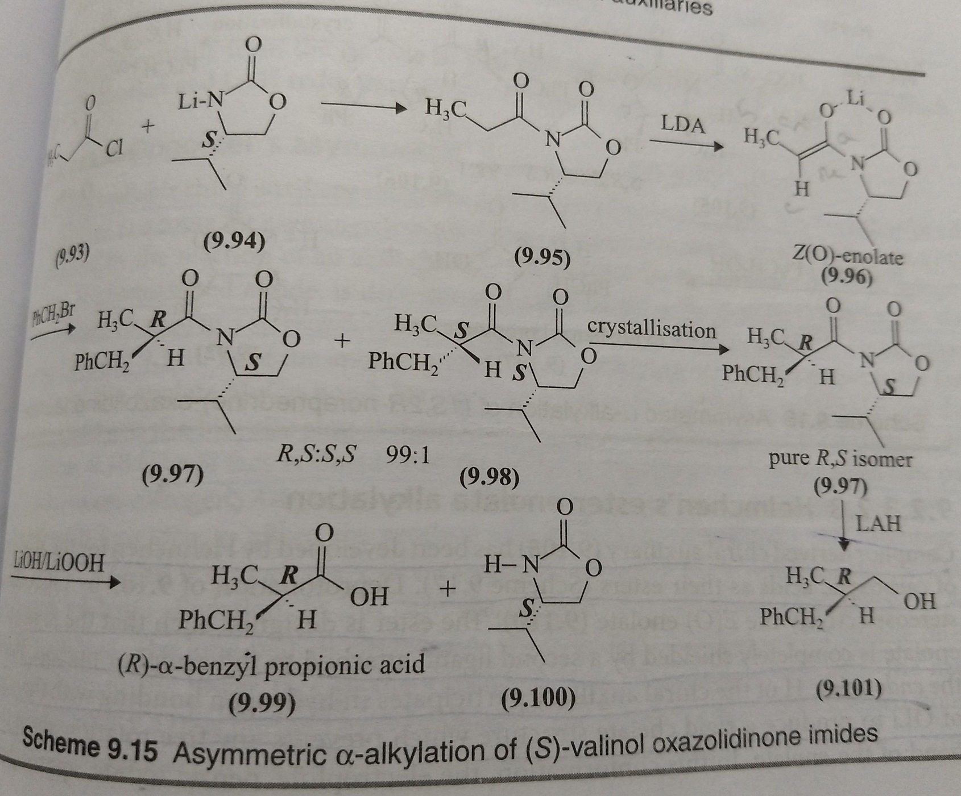
Reactions of chiral enolates:
Evans asymmetric alkylation of oxazolidinone imides:

Slide 23
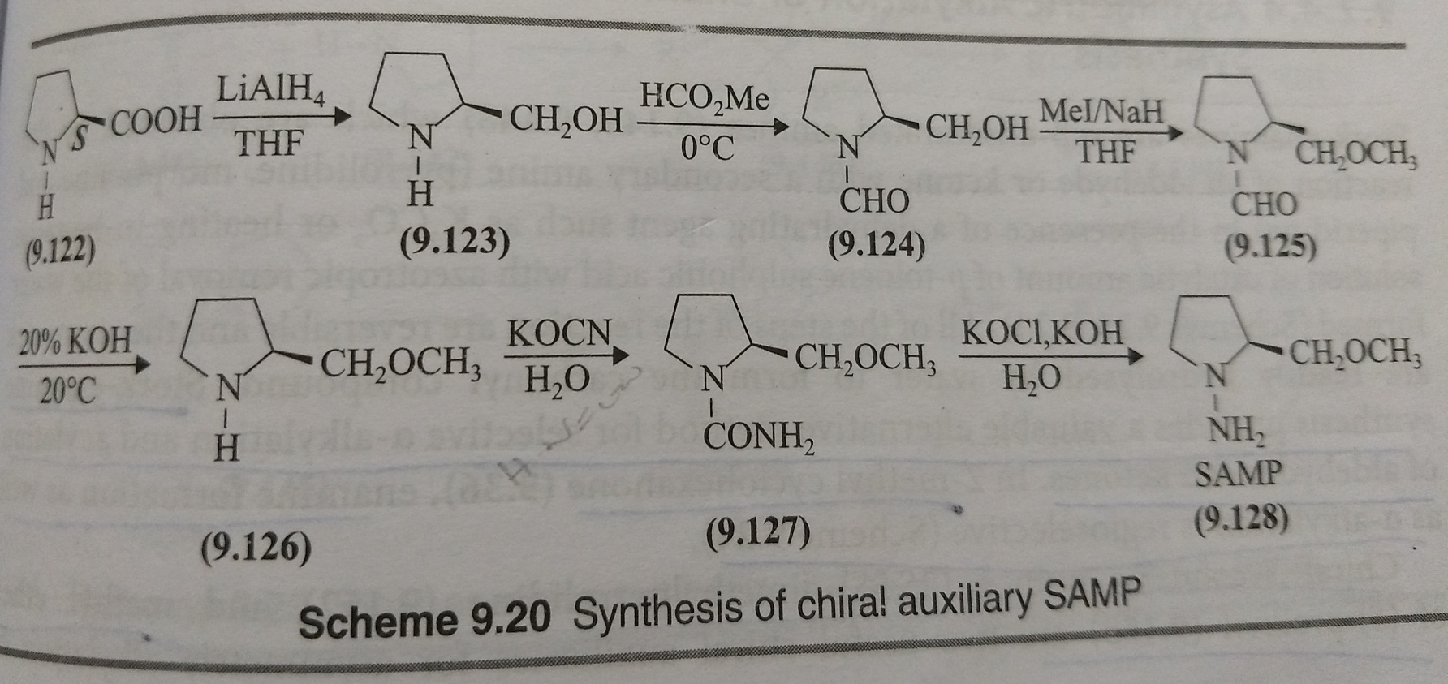
α-Substitution of prochiral ketones:
Enders asymmetric alkylation of ketones and aldehydes via chiral hydrazine:
SAMP: (S)-1-Amino-2-MethoxymethylPyrrolidine

Slide 24
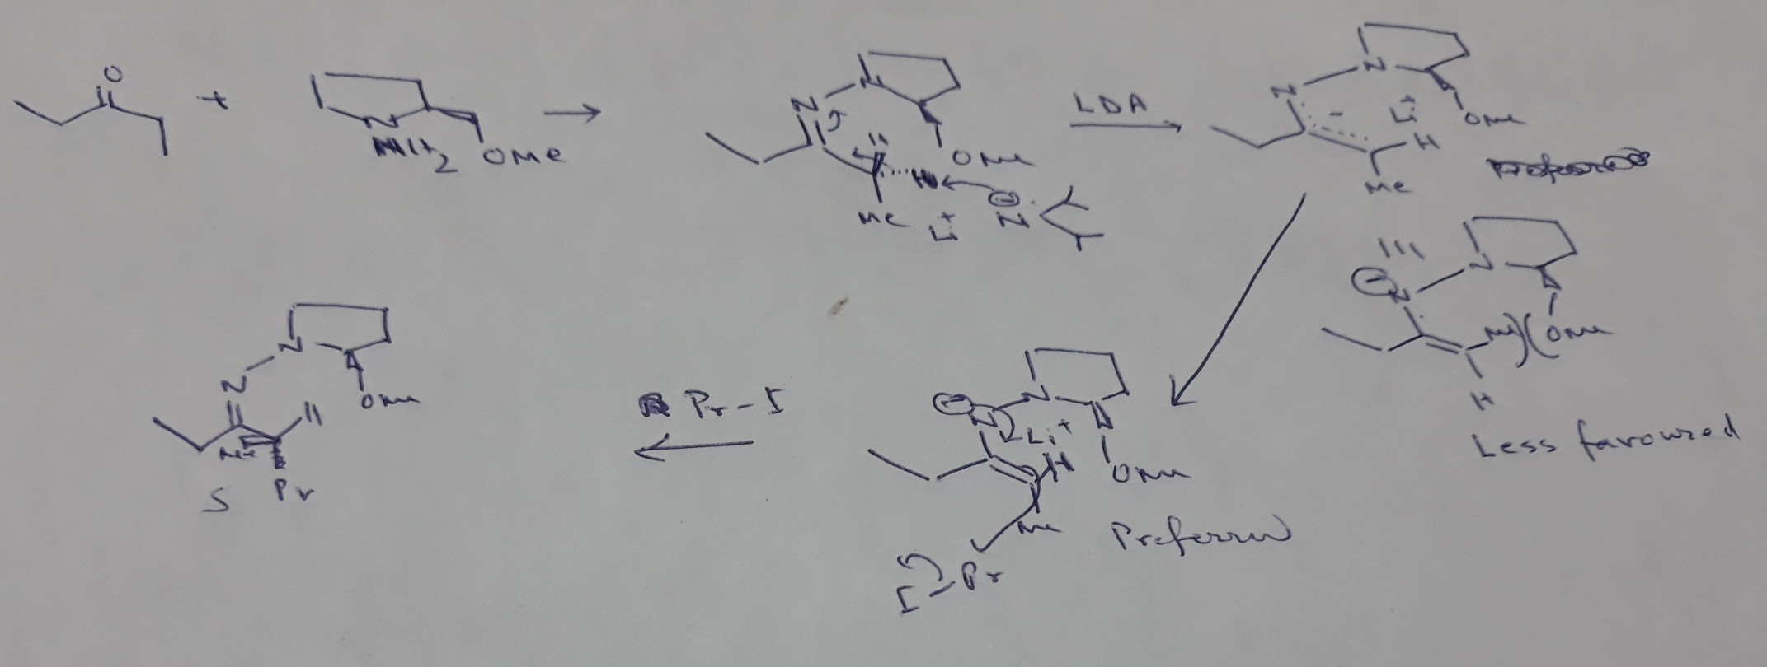

Slide 25
Player ligand and spectator ligand

Slide 26
They showed that further synthesis with asymmetric systems proceeds
in an asymmetric manner.

Slide 27
Rationalisation to predict major diastereomer:

Slide 28
Rationalisation to predict major diastereomer:

Slide 29
Rationalisation to predict major diastereomer:

Slide 30
Rationalisation to predict major diastereomer:
Drawbacks of previous assumptions:
1. Nucleophilic addition to cyclohexanone.
2. Effect of R²

Slide 31
Rationalisation to predict major diastereomer:
Interactions between R²-S and R²-M have been considered

Slide 32
Rationalisation to predict major diastereomer:

Slide 33
Rationalisation to predict major diastereomer:
Ahn and Eisentein’s proposition regarding the substituent to act as ‘L’:
Group ‘L’ occupies perpendicular to carbonyl group.
That group will be ‘L’ where C-L bond has low lying antibonding orbital,
The sterically bulky group will not necessarily always act as ‘L’.
Here Cl acted as ‘L’ in presence of Ph.

Slide 34
Burgi-Dunitz Trajectory

Slide 35
Rationalisation to predict major diastereomer:
Burgi, Lehn and Wipff (1974)
Computational method
Ahn’s analysis (1977)
Hydride nucleophile is set at a distance of 1.5 Aº from C-1 making an angle 90º with H-C=O. Energy calculated by making a rotation around C₁-C₂ bond.

Slide 36
Rationalisation to predict major diastereomer:
Felkin-Ahn model (1977)
Heathcock Refinement (1983)
Nu⁻ approaches the carbonyl carbon not along the normal plane but away
from the bulkier group (R*) and making an angle with the normal plane, which is
called Flippin Lodge angle.
Semiempirical study:

Slide 37
Rationalisation to predict major diastereomer:
Effect of Lewis acid (LA): LA interacts with the less bulkier side LP and pushes
the small group as well as Nu- towards the normal plane. It causes in
increase in selectivity as the chiral centre becomes closure to the Nu^{-.}

Slide 38
Rationalisation to predict major diastereomer:
Yields of diastereomer A with varying substituents: Both polar effect and bulkiness of the group (L) are to be considered.
X | R=Me | R=Et | R=^{i}Pr | R=^{t}Bu | R=Ph
OMe | 58 | 76 | 93 | 93 | 83
Ph | 78 | 86 | 70 | -63 | -

Slide 39
Asymmetric synthesis: stereoselective and stereospecific reactions; diastereoselectivity and enantioselectivity (only definition); enantioselectivity: kinetically controlled MPV reduction; diastereoselectivity: addition of nucleophiles to C=O adjacent to a stereogenic centre: Felkin-Anh and Zimmermann-Traxler models.

Slide 40
Chiral Auxiliary

