Slide 1
Asymmetric Epoxidation
Dr. Chandrakanta Bandyopadhyay
Department of Chemistry,
R. K. Mission Vivekananda Centenary College,
Rahara, Kolkata - 700118,
West Bengal, India
e-mail: kantachandra@rediffmail.com

Slide 2
Diastereoselective Epoxidation:

Slide 3
Sharpless Asymmetric Epoxidation (On allylic alcohol):

Slide 4
Sharpless Asymmetric Epoxidation (On allylic alcohol):

Slide 5
Jacobsen-Katsuki Asymmetric Epoxidation (On Olefins):
(Jacobsen, JACS, 1990, 112, 2801 and Katsuki, TL, 1991, 32, 1055)
It is not restricted to allylic alcohols only but also for simple olefins
Cationic Mn(III)-salen chiral complexes are used.
Structure of Chiral complexes:

Slide 6
Synthesis of Chiral complexes:
Other oxidants: mCPBA (-78 ºC), hydroperoxides, oxone. H₂O₂, amine oxide etc.
Additives: Lewis base (Pyridine, imidazole), 4-phenylpyridine-N-oxide (Increases, Cat TOR&TON)

Slide 7
Mode of Epoxidation:

Slide 8
Shi Asymmetric Epoxidation (Organo-catalysed epoxidation):
(Shi, JACS, 1996, 118, 9806)
General approach:
Oxone: KHSO₅:KHSO₄:K₂SO₄ :: 2:1:1
Structure of Chiral catalyst (Ketone)

Slide 9
Preparation of Chiral ketone:
Shi’s Catalyst
Reactions:

Slide 10
Catalytic Cycle:

Slide 11
Approach of olefin:
Drawback:
Baeyer Villiger Reaction is a side reaction
Poor selectivity with cis- and terminal olefines.

Slide 12
Modification of catalysts:
Modified catalyst for
cis-disubstituted olefins and styrenes
Baeyer-Villiger Oxidation is retarded
Reacts with e-deficient olefins

Slide 13
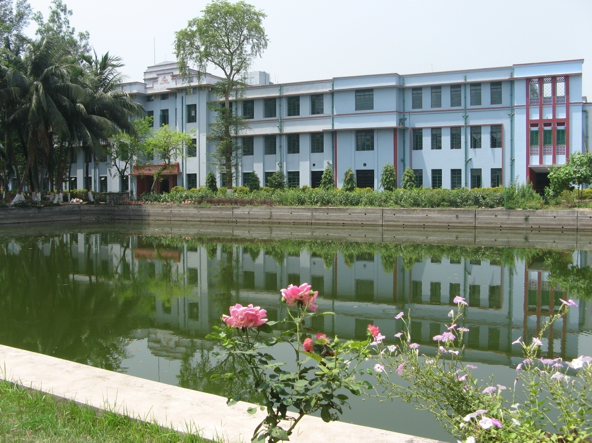
Thank you

