Slide 1
Asymmetric Dihydroxylation
Dr. Chandrakanta Bandyopadhyay
Department of Chemistry,
R. K. Mission Vivekananda Centenary College,
Rahara, Kolkata - 700118,
West Bengal, India
e-mail: kantachandra@rediffmail.com

Slide 2
Dihydroxylation:
Diastereselective Dihydroxylation:

Slide 3
Use of Et₃N, DABCO, NMO etc N-bases increase the rate of
reaction of Osmylation.
Use of Chiral bases could induce enantioselectivity on the
enantiotopic faces of olefins.
Use of Cinchona alkaloids (Dihydroquinine and Dihydroquinidine)
as ligands with OsO₄ shows higher selectivity.
Schematic presentation:

Slide 4
Chiral amine-induced Asymmetric Dihydroxylation:

Slide 5
Sharpless Asymmetric Dihydroxylation:

Slide 6
Direction of Dihydroxylation

Slide 7
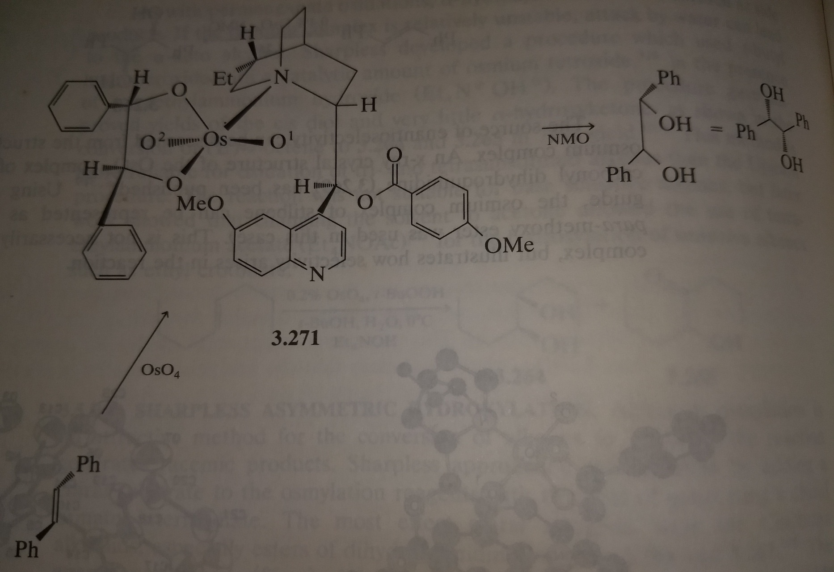
S
S
R
S
Stibene-DHQ-OsO₄ -Complex

Slide 8
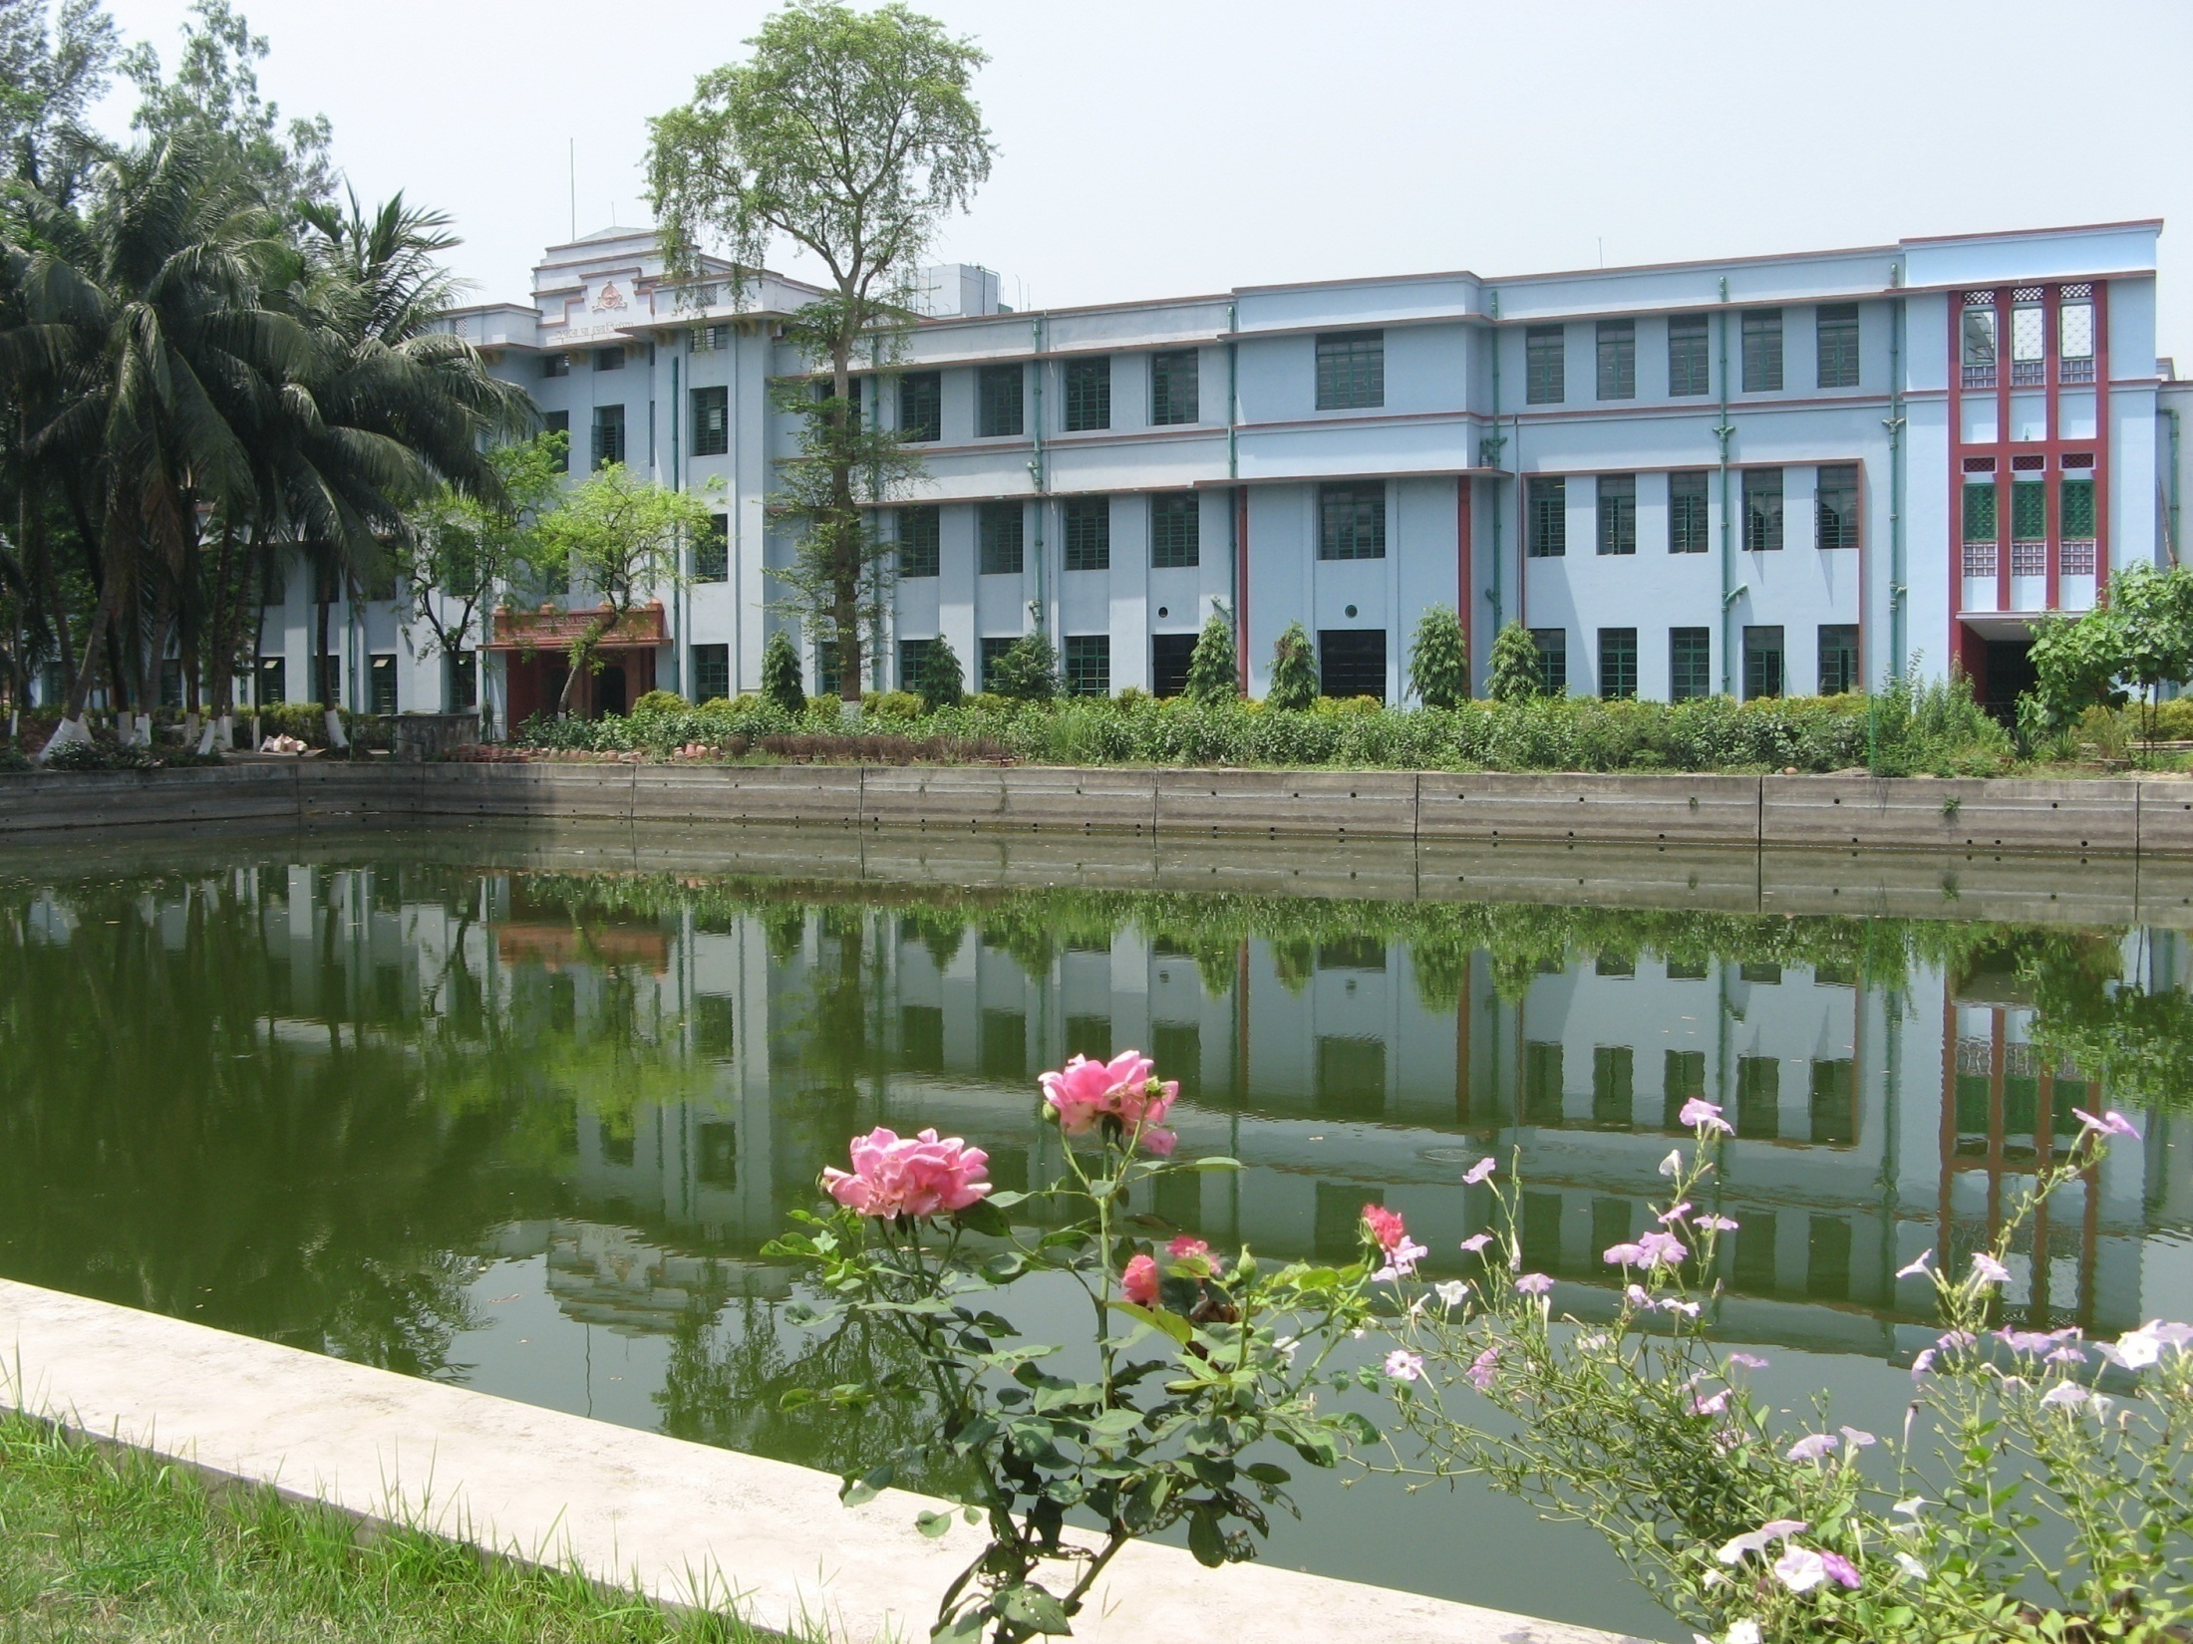
Thank you

