Slide 1
Mass Spectrometry
Dr. Chandrakanta Bandyopadhyay
Department of Chemistry,
R. K. Mission Vivekananda Centenary College,
Rahara, Kolkata - 700118,
West Bengal, India
e-mail: kantachandra@rediffmail.com

Slide 2
Spectroscopy and Spectrometry
UV-spectroscopy,
IR-spectroscopy,
NMR spectroscopy etc.
Mass spectrometry
The term ‘Scopy’ expresses ‘notion of examination’ or observation
SPECTROSCOPY is equivalent to a theoretical approach;
Study of the interaction between radiation and matter
‘Metry’ expresses ‘the notion of measurement’.
SPECTROMETRY, would be equivalent to a practical approach based on spectroscopy;
It refers to the execution of measures related to a spectrum

Slide 3
What is obtained from mass spectrometric study?
Molecular mass of a compound is commonly determined by mass spectrometry;
Molecular weight may be determined accurately by High Resolution Mass Spectrometry (HRMS) and from that measurement molecular formula of the compound can be assessed.
Identity of two compounds can be judged as no two different compounds give the same mass fragmentation.
It helps determine the structure of a compound by showing the presence of certain structural units.
Sometimes it is employed to distinguish between two isomeric compounds by following the fragmentation pattern.

Slide 4
Principles of mass spectrometry:
It requires vapour equivalent to vapour pressures less than 10⁻⁹ mm of Hg at room temperature; for non-volatile solids different methods are applied under high vacuum conditions (10⁻⁵ to 10⁻⁷ mm of Hg).
The stream of vapour of organic compound is bombarded with high energy (~ 70 eV) electrons obtained from heated tungsten or rhenium filaments under high vacuum (10⁻⁶ mm of Hg).
The ionisation potential of an organic molecule is in the order of 8-15 eV. As the bombarding electrons are with energy of 70 eV. This extra energy will undergo cleavage of the molecular ion to smaller fragments.
AB + e → AB*(e) →AB⁺ (Parent ion or Molecular ion) + 2e
AB⁺ → A⁺ + B or A + B⁺ (A⁺ and B⁺ are fragmented ions)
A molecule having non-bonded electrons can release one electron after bombardment forming a radical ion (1).
R₃N: + e → R₃N]^{.+} (1) + 2e
Only the resultant molecular ions or fragmented charged particles are accelerated by applying an acceleration potential and are analysed by applying appropriate electric field and magnetic fields.
A detector detects the ions as mass/charge (m/e or m/z) ratio and also the abundance of the ions.

Slide 5
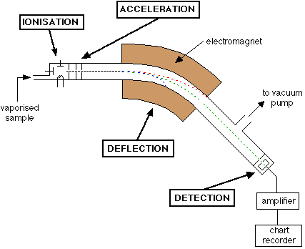
Schematic presentation of the instrument

Slide 6
How does system calculate m/e value?
When a charged particle of mass ‘m’ and charge ‘e’ is accelerated by a potential ‘V’, the energy ½mv² = eV (v = velocity of the charged particle).
The force on the particle with charge ‘e’ and velocity ‘v’ in magnetic field ‘H’ is ‘Hev’. When it passes through semi-circular path of radius ‘r’, it produces an acceleration of v²/r. Now applying Newton’s second law P = mf (Force = mass × acceleration);
Hev = mv²/r; or H²e²v² = m²v⁴/r²; or H²e² = m²v²/r²; [putting ½mv² = eV; or mv² = 2eV]
H²e² = 2meV/r²; or H²e = 2mV/r²; or m/e = H²r²/2V.
So, m/e can be evaluated from magnetic field (H), acceleration potential (V) and the radius of the semi-circular path.

Slide 7
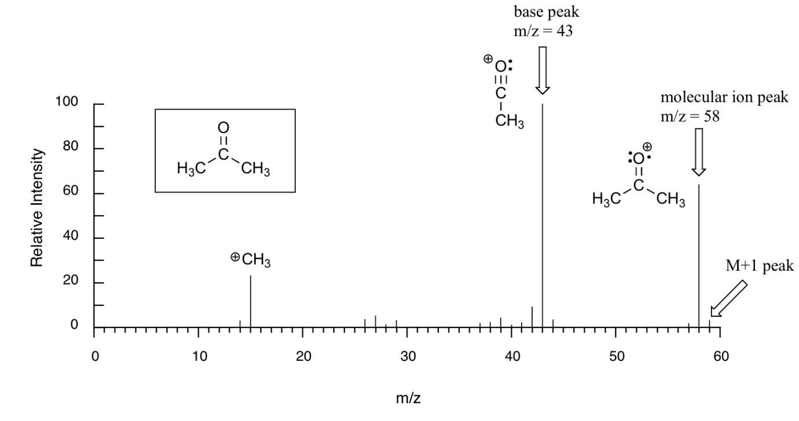
Mass spectral presentation:
Mass spectra are presented considering m/e (or m/z)-value along X-axis (abscissa) vs. abundance of ions along Y-axis (ordinate).
Some features of mass spectrometry:
Commonly mono positive ions are developed in the fragmentation process. If doubly charged ion is formed, peak will appear accordingly at m/2e position.
The highest m/e is commonly considered as parent ion or molecular ion (M⁺). It may not be always true. Highly susceptible molecular ions may not appear in the spectrum.

Slide 8
3. Peak corresponding to the most populated or most abundant ion is called base peak. Its abundance is considered as 100 and abundance of other ion-fragments are calculated on the basis of this base peak (as 100%). In most cases, base peak and molecular ion peak are different, but sometimes molecular ion may be the most abundant base peak.
4. Mass spectra are found to contain very small peaks after the large peak. These small peaks are due to the presence of heavier isotopes. As the population of heavier isotopes are usually very small that is why the peaks are also very small.
5. Peaks (M+2, M+4 etc) become very important in the presence of halogens like Cl or Br which contains considerable amount of heavier isotopes.
6. In some cases peaks are obtained at the non-integral m/e values and these peaks are much broadened than normal peaks and with low abundance. Such peaks are called metastable peak (m*).

Slide 9
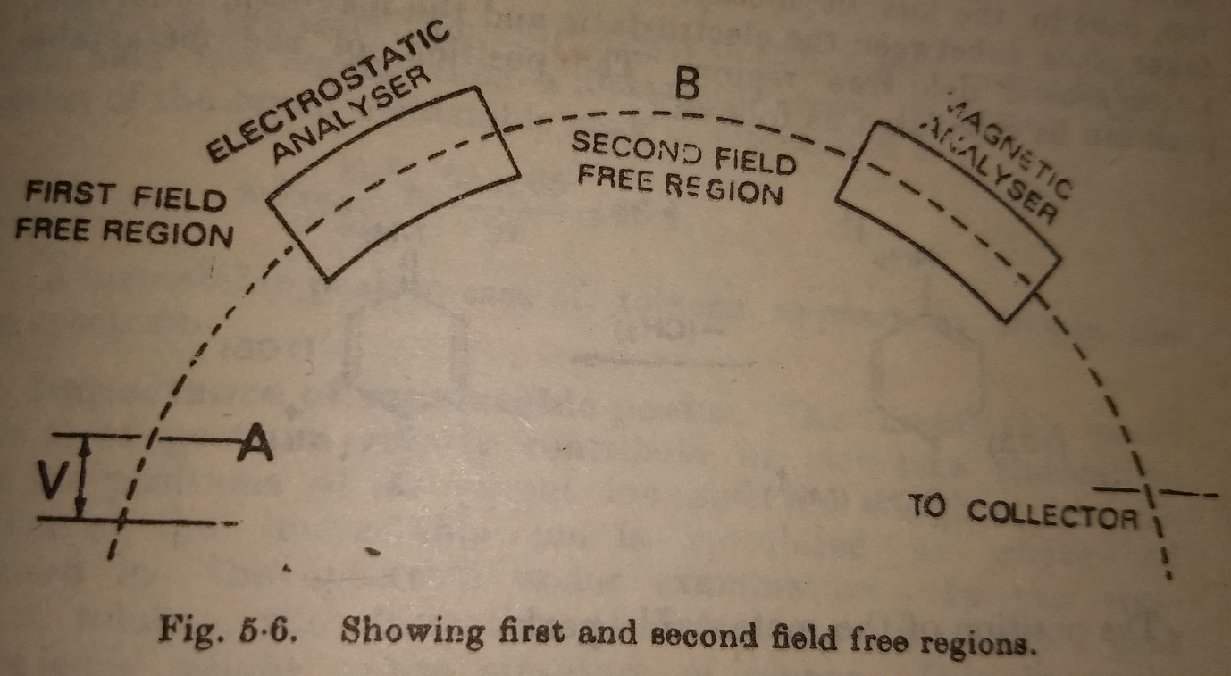
Metastable peak
Metastable peak develops due to untimely fragmentation of the molecular ion. It is commonly observed that molecular ion formation and its fragmentation occur in the ionisation chamber. These ions are accelerated by applying acceleration potential and they enter into the analyser. But between these two chambers there are two field free regions. If the molecular ion formed in the ionisation chamber undergoes fragmentation in the field free region ie after coming out from the zone where acceleration potential was applied, but before the arrival to the collector, these fragmented ions will develop a metastable peak.

Slide 10
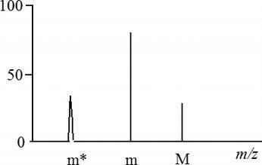
The molecular ion (M⁺) will have a kinetic energy eV and when it undergoes fragmentation outside the ionisation chamber, this kinetic energy will be distributed among the two fragments according to their masses.
The fragmented ion (or daughter ion) will gain energy = (m/M)×eV
m⁺ ion with energy eV is reported by the detector as mass ‘m’.
So, m⁺ ion with energy (m/M)×eV will be reported by the detector as mass [m/(eV)]×[(m/M)×eV] = m²/M; This metastable peak (m*) = m²/M.
This value becomes non-integral and of low abundance.
P-Anisidine shows peaks at 123, 108 and 94.8. 123 is corresponding to M⁺ ion; 108 corresponding to M⁺ - Me (123-15 = 108) and peak corresponding to non-integral m/e value is 94.8 is a metastable peak m²/M = (108×108)/123 = 94.8.

Slide 11
General fragmentation mode:
Homolytic cleavage: Mode-1:
Alcohol, ether aliphatic amine etc undergo such type of cleavage
Homolytic cleavage: Mode-2:
Ketone, ester, amide etc undergo such type of cleavage
Heterolytic cleavage: C-Heteroatom (X) bond cleavage is not a very common phenomenon as in many cases C-X bond is stronger than C-C bond. As for example C-Cl bond cleavage is relatively less common than C-Br or C-I bond cleavage. The formation of carbocation depends on its stability.

Slide 12
Benzylic cleavage:
Retro-Diel’s Alder reaction:
Hydrogen transfer rearrangement and H-involving elimination: Elimination of small neutral molecule involving H at a suitable position is very common and generally passes through a six-membered transition state.
Distinguish ortho- isomer from meta and para isomers of methyl toluate
Differentiation between cis- and trans- isomers of methyl crotonate

Slide 13
McLafferty Rearrangement: In this rearrangement a γ-H is abstracted by the
unsaturated moiety of the type C=X, where X = O, CR_{2.}
Ester, acid, ketone, aldehyde, olefins undergo such cleavage.
Effect of Isotopes on mass spectrometry
Halogen | ³⁵Cl-100; ³⁷Cl-32.5; | ⁷⁹Br-100, ⁸¹Br-98
Oxygen | ¹⁶O-100; ¹⁷O-0.04; ¹⁸O-0.20
Sulphur | ³²S-100; ³³S-0.78; ³⁴S- 4.40
Carbon | ¹²C-100; ¹³C- 1.08
Nitrogen | ¹⁴N-100; ¹⁵N-0.38
Hydrogen | ¹H-100; ²H- 0.016

Slide 14
The isotopic distribution helps to identify a molecule from molecules having same integral mass eg CH₃CH=CH₂ (C₃H₆; m/e 42) and CH₂N₂ (m/e 42). Intensity of M+1 peak will help to identify.
Relative intensity for M+1 peak in C₃H₆: 3×1.08 + 6×0.016 = 3.34%
Relative intensity for M+1 peak in CH₂N₂: 1×1.08 + 2×0.016 + 2×0.38 = 1.87%
Similarly calculate relative intensities of M+1 and M+2 peaks for CO, N₂ and C₂H₄ all having same integral mass (m/e 28).
 | CO (%) | N₂(%) | C₂H₄ (%)
M+1 | 1×1.08 + 1×.04 = 1.12 | 2×0.38 = 0.76% | 2×1.08 + 4×0.016 = 2.224%
M+2 | (1.08×0.04)/100 +0.20= 0.20 | (.38×.38)/100=.001 | (1.08)²/100+ ⁴C₂×(0.016)²/100 +2x1.08×4×.016/100=.01

Slide 15
M+2, M+4 and M+6 peaks are more important having Cl and/or Br atoms in organic compounds.
 | M (100%) | M+2(% of abundance) | M+4(% of abundance) | M+6(% of abundance) | M+8
CH₄ | 16 | - | - | - | -
CH₃Cl | 50 | 52(32.5) | - | - | -
CH₂Cl₂ | 84 | 86 (2×32.5=65) | 88 (32.5×32.5/100=10.56) | - | -
CHCl₃ | 118 | 120 (3×32.5=97.5) | 122 (10.56×³c₂=31.9) | 124 (32.5×10.56/100=3.43) | -
CCl₄ | 152 | 154 (4×32.5=130) | 156 [10.56×6(⁴C₂)=63.36] | 158 [3.43×4(⁴C₃)= 13.72] | 160 (32.5)⁴/ (100)³=.03
CH₂Br₂ | 172 | 174 (2×98=196) | 176 (98×98/100=96) | - | -
CH₂BrCl | 128 | 130 (98+32.5=130.5) | 132 (98×32.5/100=31.85) | - | -
CHBr₂Cl | 206 | 208 (98+98+32.5=228.5) | 210 (96+2×31.85=159.7) | 212 (98×98×32.5/10000=31.21) | -

Slide 16
Examples of a few mass spectral fragmentation:
PhCH₃ (m/e: 91, 65, 46.4)
1-Heptene (m/e = 98, 56)
4-Heptanone (m/e = 114, 86, 58)
Limonene (m/e: 136, 68)

Slide 17
Ph(CH₂)₂CH₃ and Ph(CH₂)₂CMe₃
How can you distinguish among 1º-, 2º- and 3º- butanols by mass spectrometry?

Slide 18
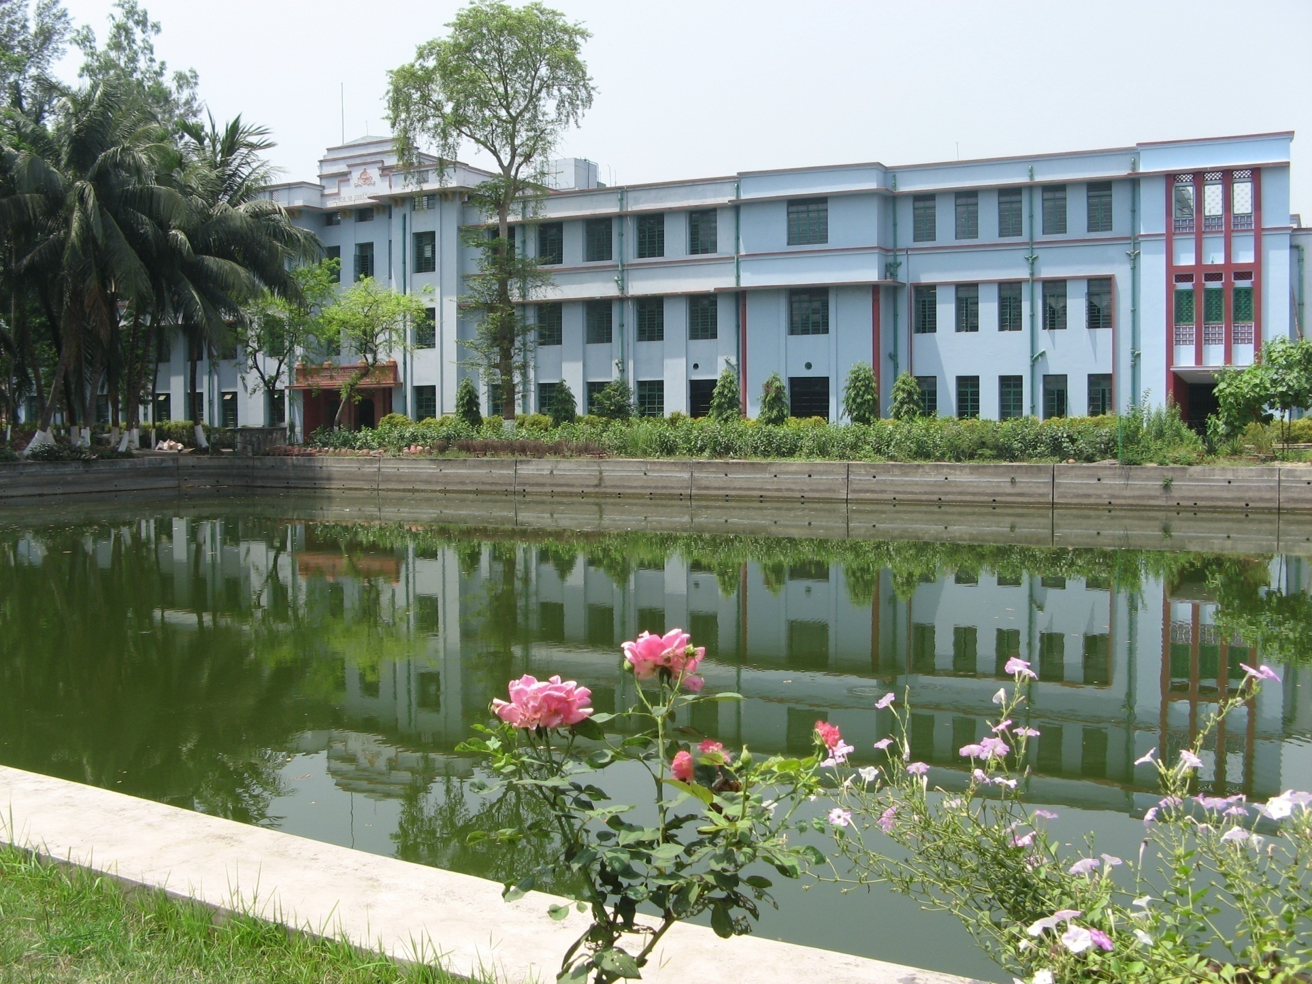
Thank you

