Slide 1
Stereochemistry 1
For
Post Graduate
Semester-1
By
Dr. Chandrakanta Bandyopadhyay
Department of Chemistry
Ramakrishna Mission Vivekananda Centenary College
Rahara
Kolkata -700118

Slide 3
Concept of symmetry of a molecule:
symmetry operation
(ii) symmetry elements.
Symmetry operation: It is a movement of an object or a molecule in such a way that after the movement has been carried out, every point or atom of the object or molecule is in coincidence with an equivalent point or atom of the object or molecule in its original position. In other way symmetry operation may be discussed as an operation that carries an object or molecule into a position indistinguishable from its original arrangement.

Slide 4
Symmetry elements: It is a geometrical entity such as a point or a line or a plane with respect to which one or more symmetry operations can be carried out.
Plane of symmetry (two-dimensional symmetry element);
Centre of symmetry (zero-dimensional symmetry element);
Simple axis of symmetry (one-dimensional symmetry element)
Alternating axis of symmetry.

Slide 5
‘Symmetry point group’
The term ‘symmetry’ is related to different symmetry elements present in a molecule; ‘group’ is a set of symmetry operations those can be performed in a molecule. The term ‘point’ in ‘symmetry point group’ comes from the fact that all the symmetry elements (geometrical entities) intersect at a point and this point is not shifted by any of the symmetry operations. This point is the centre of gravity of the molecule.
Any molecule having more than one c_{n}-axes where n>2, belongs to high-symmetry point group.
Other molecules are of low-symmetry molecules.

Slide 6
The symmetry operations are the elements of a group. This set of symmetry operations which form a group are governed by the following rules:
The combination of any two operations or the square of each element must be another element/operation in the group.
The associative law of multiplication must hold good. [(A×B)×C = A×(B×C)].
One of the operations of the group must be the identity operation (E), which when commutes with any other operation leaves the latter operation unchanged. [eg C₃×E=C₃].
Every operation has a reciprocal operation, which is also an element of the group. When an operation commutes with its reciprocal operation it becomes identity operation (E).
[ A×A_{inv} = E = A_{inv}×A; eg C₄¹×C₄³=E; C₄² is its own inverse.]

Slide 7
Schoenflies notations:
Sr No. | Presence of symmetry elements | Schoenflies notation
1 | Only c_{n} | C_{n}
2 | Only σ (plane of symmetry) | C_{s}
3. | Only i (centre of symmetry) | C_{i}
4. | c_{n} + σ_{h} | C_{nh}
5. | c_{n} + n number of σ_{v} | C_{nv}
6. | c_{n} + n number of perpendicular c₂ (┴ n-c₂) | D_{n}
7. | c_{n} + ┴ n-c₂ + σ_{h} | D_{nh}
8. | c_{n} + ┴ n-c₂ + σ_{d} | D_{nd}

Slide 8
Order of a group: The number of symmetry operations present in a group is called order of a group.
Symmetry number: It is the number of indistinguishable arrangements that may arise by rotation around different simple axes.

Slide 9
Chiral Point Groups |  |  |  | Achiral Point Groups
Schoenflies Notation | Order | Symmetry No |  | Schoenflies Notation | Order | Symmetry No
C₁ | 1 | 1 |  | C_{s} | 2 | 1
C_{n} | n | n |  | S_{2n} | 2n | n
D_{n} | 2n | 2n |  | C_{nv} | 2n | N
T | 12 | 12 |  | C_{∞v} | ∞ | 1 ?
O | 24 | 24 |  | D_{nd} | 4n | 2n
I | 60 | 60 |  | D_{nh} | 4n | 2n
 |  |  |  | D_{∞h} | ∞ | 2 ?
 |  |  |  | T_{d} | 24 | 12
 |  |  |  | T_{h} | 25(T_{d}+i) | 12
 |  |  |  | O_{h} | 48 | 24
 |  |  |  | I_{h} | 120 | 60
 |  |  |  | K_{h} | ∞ | ∞

Slide 10
How to determine the symmetry point group of low-symmetry molecules?
(i) Search for highest order axis (c_{n}), which is considered as the principal axis.
(ii) If more than one highest order axes (c₂) are present, that axis will be considered as principal axis, which passes through maximum number of atoms of the molecule.
(iii) After determining the principal axis, hold the molecule in such a way that the principal axis appears vertically to the viewer.
(iv) Search for c₂-axes perpendicular to the principal axis. If highest order axis be c_{n}, and one c₂ axis perpendicular to the c_{n} axis was viewed, the molecule must contain n-number of c₂-axes perpendicular to the c_{n}-axis.

Slide 11
(v) Search for σ-plane:
(a) Any σ-plane perpendicular to the principal axis will appear horizontally as the principal axis was adjusted vertically. This σ-plane is considered as σ_{h}-plane (‘h’ stands for horizontal). A molecule cannot have more than one σ_{h}-plane.
(b) σ-Planes containing the principal axis appear vertically. These planes are called σ_{v}-planes (‘v’ stands for vertical). When a molecule having c_{n} as principal axis is found to have at least one σ_{v}-plane, it must contain ‘n’ number of σ_{v}-planes.
(c) If the molecule contains c₂-axes perpendicular to the principal axis, the above-discussed σ_{v}-planes are to be checked whether they bisect the angle subtended by c₂-axes. If they bisect the angle the σ_{v}-planes will be considered as σ_{d}-planes (‘d’ stands for dihedral/diagonal). The priority of σ-planes in considering point group is σ_{h}> σ_{d} >σ_{v}.

Slide 13
Chiral point groups:
Symmetry number = Order of the group
C_{n} point group:
Symmetry number = Order of the group = n
C₁ point group: All molecules belong to this point group are chiral. These molecules do not contain c_{n} (n>1) or any s_{n} symmetry.
Examples CHBrClI, CH₃CH=C=C(Cl)(Br).
Symmetry number = Order of the group = 1 (E)
C₂ point group: Chiral compounds having c₂-axis only.
Example: ClCH=C=CHCl.
Symmetry number = Order of the group = 2 (E, C₂)

Slide 14
C₃ point group: Chiral compounds having c₃-axis only.
Example: Tri-o-thymotide, Trans, trans, trans-3,7,11-trimethylcyclododeca
-1,5,9-triene
Symmetry number = Order of the group = 3 (E, C₃¹, C₃²)

Slide 15
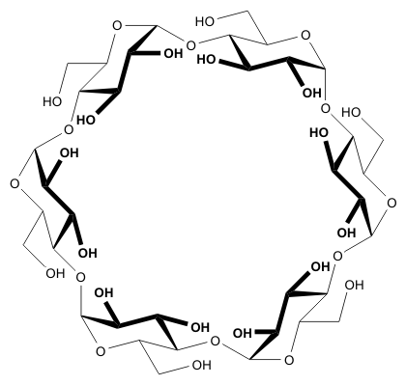
C₆ point group: Chiral compounds having c₆-axis only.
Example: α-cyclodextrin (cyclohexaamylose)
Symmetry number = Order of the group = 6 (E, C₆¹, C₆², C₆³, C₆⁴, C₆⁵ )

Slide 16
D_{n} point group:
Symmetry number = Order of the group = 2n
D₂ point group: Molecules having three c₂-axes mutually
Perpendicular to each other belong to this point group.
Here one c₂ axis, passing through maximum number of atoms
of the molecule, acts as principal axis and other two c₂-axes are
perpendicular to this principal axis.
Example: Twist boat form of cyclohexane, twistane.
Symmetry number = order of the group = 4 (E, C₂, C₂' and C₂'').

Slide 17
D₃ point group: Molecules having one c₃-axis, which acts as principal axis) and three c₂-axes perpendicular to each other belong to this point group.
Example: Trans-transoid-trans-transoid-trans-perhydrotriphenylene.
Symmetry number = order of the group = 6 [E, C₃¹, C₃², 3 perpendicular C₂-axes (C₂', C₂'' and C₂''')].

Slide 18
Achiral point groups: All molecules belong to achiral point group are achiral in nature.
Order of the group = 2 × Symmetry number
C_{s} point group: Achiral compounds having only plane of symmetry as symmetry element belong to this point group.
Example: Furfural, chloroethene, 1-bromo-3-chlorobenzene
Symmetry number = 1; Order of the group = 2 (E, σ)

Slide 19
S_{n} point group: (n is even) ≡ S_{2n'} (n' is an integer):
S₂ point group: (n' = 1): It is equivalent to centre if symmetry (i).
Example:
Symmetry number = 1; Order of the group = 2 (E, i)
[Note: If n = 4m+2 (m = 0, 1 ,2, ….any integer), molecules belong to such point groups those possess centre of symmetry (i); but for n = 4m, molecules belong to such point groups which do not possess centre of symmetry.]

Slide 20
S₄ point group: (n' = 2):
Example:
Symmetry number = 2; Order of the group = 4 (E, S₄¹, S₄²(C₂), S₄³).
C_{nv} point group: Molecules having c_{n}–axis and n number of σ_{v} planes.
Symmetry number = n; Order of the group = 2n

Slide 21
C_{2v} point group: Presence of c₂ and 2 σ_{v} planes.
Example:
Symmetry number = 2; Order of the group = 4 (E, c₂, 2 σ_{v})
C_{3v} point group: Presence of c₃ and 3 σ_{v} planes.
Example:
Symmetry number = 3; Order of the group = 6 (E, c₃¹, c₃², 3 σ_{v})

Slide 22
C_{4v} point group: Presence of c₄ and 4 σ_{v} planes.
Example:
Symmetry number = 4; Order of the group = 8 [E, c₄¹, c₄² (c₂), c₄³, 4 σ_{v}]
C_{5v} point group: Presence of c₅ and 5 σ_{v} planes.
Example:
Symmetry number = 5; Order of the group = 10 (E, c₅¹, c₅², c₅³, c₅⁴, 5 σ_{v})

Slide 23
C_{αv} point group: Presence of c_{α} and α σ_{v} planes. It has the symmetry of a cone, it is also called conical symmetry.
Example: HCl, HC≡N, HC≡C-Cl, ⁻C≡O⁺
Symmetry number = 1 or α; Order of the group = α
C_{nh} point group: Presence of c_{n} and σ_{h}.
Symmetry number = n; Order of the group = 2n
C_{2h} point group: Presence of c₂ and σ_{h}.
Example:
Symmetry number = 2; Order of the group = 4 [E, c₂, σ_{h}, s₂ (i)]

Slide 24
C_{3h} point group: Presence of c₃ and σ_{h}.
Example:
Symmetry number = 3; Order of the group = 6 (E, c₃¹, c₃², σ_{h}, s₃¹, s₃⁵).
C_{6h} point group: Presence of c₆ and σ_{h}.
Example:
Symmetry number = 6; Order of the group = 12 (E, c₆¹, c₆²(c₃¹), c₆³(c₂) , c₆⁴ (c₃²), c₆⁵, σ_{h}, s₃¹, s₃³, s₆¹, s₆³, s₆⁵.

Slide 25
C_{αv} point group: Presence of c_{α} and α σ_{v} planes. It has the symmetry of a cone, it is also called conical symmetry.
Example: HCl, HC≡N, HC≡C-Cl, ⁻C≡O⁺
Symmetry number = 1 or α; Order of the group = α
C_{nh} point group: Presence of c_{n} and σ_{h}.
Symmetry number = n; Order of the group = 2n
C_{2h} point group: Presence of c₂ and σ_{h}.
Example:
Symmetry number = 2; Order of the group = 4 [E, c₂, σ_{h}, s₂ (i)]

Slide 26
C_{3h} point group: Presence of c₃ and σ_{h}.
Example:
Symmetry number = 3; Order of the group = 6 (E, c₃¹, c₃², σ_{h}, s₃¹, s₃²).
C_{6h} point group: Presence of c₆ and σ_{h}.
Symmetry number = 6;
Order of the group = 12 (E, c₆¹, c₆²(c₃¹), c₆³(c₂) , c₆⁴ (c₃²), c₆⁵,
σ_{h}, s₃¹, s₃², s₆¹, s₆³, s₆⁵.

Slide 27
D_{nd} point group: Presence of c_{n}, n c₂-axes perpendicular to c_{n}-axis and n number of σ_{d} planes.
Symmetry number = 2n; Order of the group = 4n
D_{2d} point group:Presence of c₂, 2 c₂-axes perpendicular to principal
(c₂)-axis and 2 σ_{d} planes.
Example:
Symmetry number = 4;
Order of the group = 8 (E, c₂¹, c_{2'}¹, c_{2''}¹, 2 σ_{d}, s₄¹, s₄³).

Slide 28
D_{3d} point group: Presence of c₃, 3 c₂-axes perpendicular to c₃-axis and
3 σ_{d} planes.
Example: Staggered ethane, chair form of cyclohexane
Symmetry number = 6;
Order of the group =12 (E, c₃¹, c₃², c_{2'}¹, c_{2''}¹, c_{2'''}¹, 3 σ_{d}, s₆¹, s₆³, s₆⁵).
D_{5d} point group: Presence of c₅, 5 c₂-axes perpendicular to c₅-axis
and 5 σ_{d} planes.
Example: Staggered conformation of ferrocene.
Symmetry number = 10;
Order of the group =20 (E, c₅¹⁻⁴, 5 c_{2,} 5 σ_{d}, s₁₀^{1,3,7,9}, s₁₀⁵ _{≡ i}).

Slide 29
D_{6d} point group: Presence of c₆, 6 c₂-axes perpendicular to
c₆-axis and 6 σ_{d} planes.
Example: Staggered conformation of dibenzenechromium.
Symmetry number = 12;
Order of the group =24 (E, c₆¹⁻⁵, 6 c_{2,} 6 σ_{d}, s₁₂^{1,3,5,7,9,11}).
D_{8d} point group: Presence of c₈, 8 c₂-axes perpendicular to c₈-axis and 8 σ_{d} planes.
Example: Staggered conformation of uranocene.
Symmetry number = 16;
Order of the group =32 (E, c₈¹⁻⁷, 8 c_{2,} 8 σ_{d}, s₁₆^{1,3,5,7,9,11,13,15}).

Slide 30
D_{nh} point group: Presence of c_{n}, n c₂-axes perpendicular to c_{n}-axis and one σ_{h} plane.
Symmetry number = 2n; Order of the group = 4n
D_{2h} point group: Presence of c₂, 2 c₂-axes perpendicular to the principal (c₂)-axis and one σ_{h} plane.
Example:
Symmetry number = 4;
Order of the group = 8 (E, c₂¹, c_{2'}¹, c_{2''}¹, σ_{h}, 2 σ_{v}, i)

Slide 31
D_{3h} point group: Presence of c₃, 3 c₂-axes perpendicular to the c₃-axis and one σ_{h} plane.
Example:
Symmetry number = 6;
Order of the group = 12 (E, c₃¹, c₃², c₂¹, c_{2'}¹, c_{2''}¹, σ_{h}, 3 σ_{v}, s₃¹, s₃⁵).
D_{4h} point group: Presence of c₄, 4 c₂-axes perpendicular to the c₄-axis and one σ_{h} plane.
Example: Planar cyclobutane
Symmetry number = 8; Order of the group = 16 (E, c₄¹⁻³, 4-c₂ axes perpendicular to c₄, σ_{h}, 4 σ_{v}, s₄¹, I, s₄³).

Slide 32
D_{5h} point group: Presence of c₅, 5 c₂-axes perpendicular to the c₅-axis and one σ_{h} plane.
Example: Eclipsed ferrocene, Cyclopentadienyl anion.
Symmetry number = 10; Order of the group = 20 (E, c₅¹⁻⁴, 5-c₂ axes perpendicular to c₅, σ_{h}, 5 σ_{v}, s₅¹, s₅³, s₅⁷, s₅⁹).
D_{6h} point group: Presence of c₆, 6 c₂-axes perpendicular to the c₆-axis and one σ_{h} plane.
Example: Benzene, coronene.
Symmetry number = 12; Order of the group = 24

Slide 33
D_{7h} point group: Presence of c₇, 7 c₂-axes perpendicular to the c₇-axis and one σ_{h} plane.
Example: Cycloheptatrienyl cation
Symmetry number = 14; Order of the group = 28
D_{8h} point group: Presence of c₈, 8 c₂-axes perpendicular to the c₈-axis and one σ_{h} plane.
Example: Cyclooctatetraenyl dianion, uranocene
Symmetry number = 16; Order of the group = 32
D_{9h} point group: Presence of c₉, 9 c₂-axes perpendicular to the c₉-axis and one σ_{h} plane.
Example: Cyclononatetraenyl anion
Symmetry number = 18; Order of the group = 36

Slide 34
D_{αh} point group: Presence of c_{α}, α c₂-axes perpendicular to the
c_{α}-axis and one σ_{h} plane. It resembles the symmetry of a cylinder.
It is called cylindrical symmetry.
Example: Cyclononatetraenyl anion,
Symmetry number = 2; Order of the group = α

Slide 36
High symmetry molecules (Platonic symmetry):
Molecules bearing more than one c_{n} (where n>2) are high symmetry molecules.
T_{d} point group: Molecules belong to this symmetry point group contain 4c₃-axes, 3 c₂-axes and 6 σ planes.
Example: methane, adamantane
Symmetry number = 12;
Order of the group = 24 [E, 4 × (c₃¹, c₃²), 3 × c₂, 6 σ, 3 × (s₄¹, s₄³)].

Slide 37
T point group: Desymmetrisation of T_{d} in such a way that 6 σ-planes mentioned before are vanished by distortion of the tetrahedral geometry without disturbing the different c_{n}-axes. Such symmetry is termed as ‘T’. It becomes a chiral point group.
The average symmetry is T_{d}, but proper desymmetrisation takes it to T.
Symmetry number = Order of the group = 12 [E, 4 × (c₃¹, c₃²), 3 × c₂]
T_{h} point group: It is another modification of T_{d} point group. σ_{d} planes are changed to σv planes. In such cases a centre of symmetry (i) will appear.
No organic molecule is known but [Co(NO₂)₆]³⁻belong to this category.

Slide 38
O_{h} point group: It is a cubic point group. Molecules belong to this symmetry point group contain 3c₄-axes, 4c₃-axes, 6 c₂-axes and 9 σ planes. c₄-Axes pass through opposite sides, hence six sides give 3 c₄-axes. c₃-Axes pass through opposite corners, hence eight corners give 4 c₃-axes. c₂-Axes pass through opposite edges, hence 12 edges give 6c₂-axes. The σ-planes are of two categories; 3 σ planes bisect the opposite faces and edges, whereas 6 σ planes pass diagonally. Cube and octahedron belong to octahedral point group.
Example: Cubane, SF₆.
Symmetry number = 24;
Order of the group = 48 [E, 3 ×(c₄¹, c₄², c₄³,) 4 × (c₃¹, c₃²), 6 × c₂ (=24), 9 σ, i, 3 × (s₄¹, s₄³), 4 × (s₃¹, s₃²)].

Slide 39
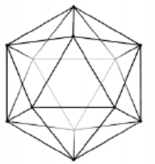
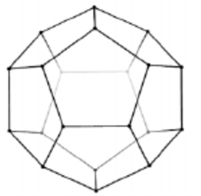
O point group: It is a hypothetical point group. Molecules of O_{h} point group are desymmetrised by removing σ planes without disturbing the different c_{n}-axes to get O point group. It is also a chiral point group.
I_{h} point group: This system contains 6c₅, 10c₃, 15c₂ and 15σ. Icosahedron contains 20 faces which are like equilateral triangle as shown aside:
Dodecahedron also belongs to this point group which contains twelve faces which are like regular pentagon as shown aside:
Example: C₁₂H₁₂, B₁₂H₁₂⁻².

Slide 40
I point group: When σ-planes are removed from molecules of I_{h} point group. The new point group is I and is chiral point group.
K_{h} point group: ‘K’ stands for Kugel (a German word which means sphere). It is related to spherical symmetry. It is the highest symmetry point group.
Reciprocal solids: When the faces and vertices of a solid are interchanged, the resultant solid is called its reciprocal solid. As for example a cube has six faces and eight vertices, whereas the octahedron has eight faces and six vertices; so cube and octahedron are reciprocal solids. Again icosahedron has 20 faces, 12 vertices and dodecahedron has 12 faces and 20 vertices; so they are reciprocal solids. Tetrahedron has four faces and four vertices so tetrahedron is its own reciprocal.

Slide 41
Desymmetrisation: A series of desymmatrisation is considered below. The symmetry point group is gradually changing from high symmetry to low symmetry point groups.
Caaaa (T_{d})→Caaab (C_{3v})→Caabb(C_{2v})→Caabc(C_{s})→Cabcd(C₁) (chiral).
A few hypothetical molecules are considered to explain desymmetrisation. Caabb-type molecule is linked appropriately to get a spiro-type compound which becomes chiral.

Slide 42
Caaab-type molecule is linked appropriately to get chiral molecule with point group C₃.
Caaaa can be desymmetrised to a chiral molecule by linking two groups with different linkers as shown below:

Slide 43
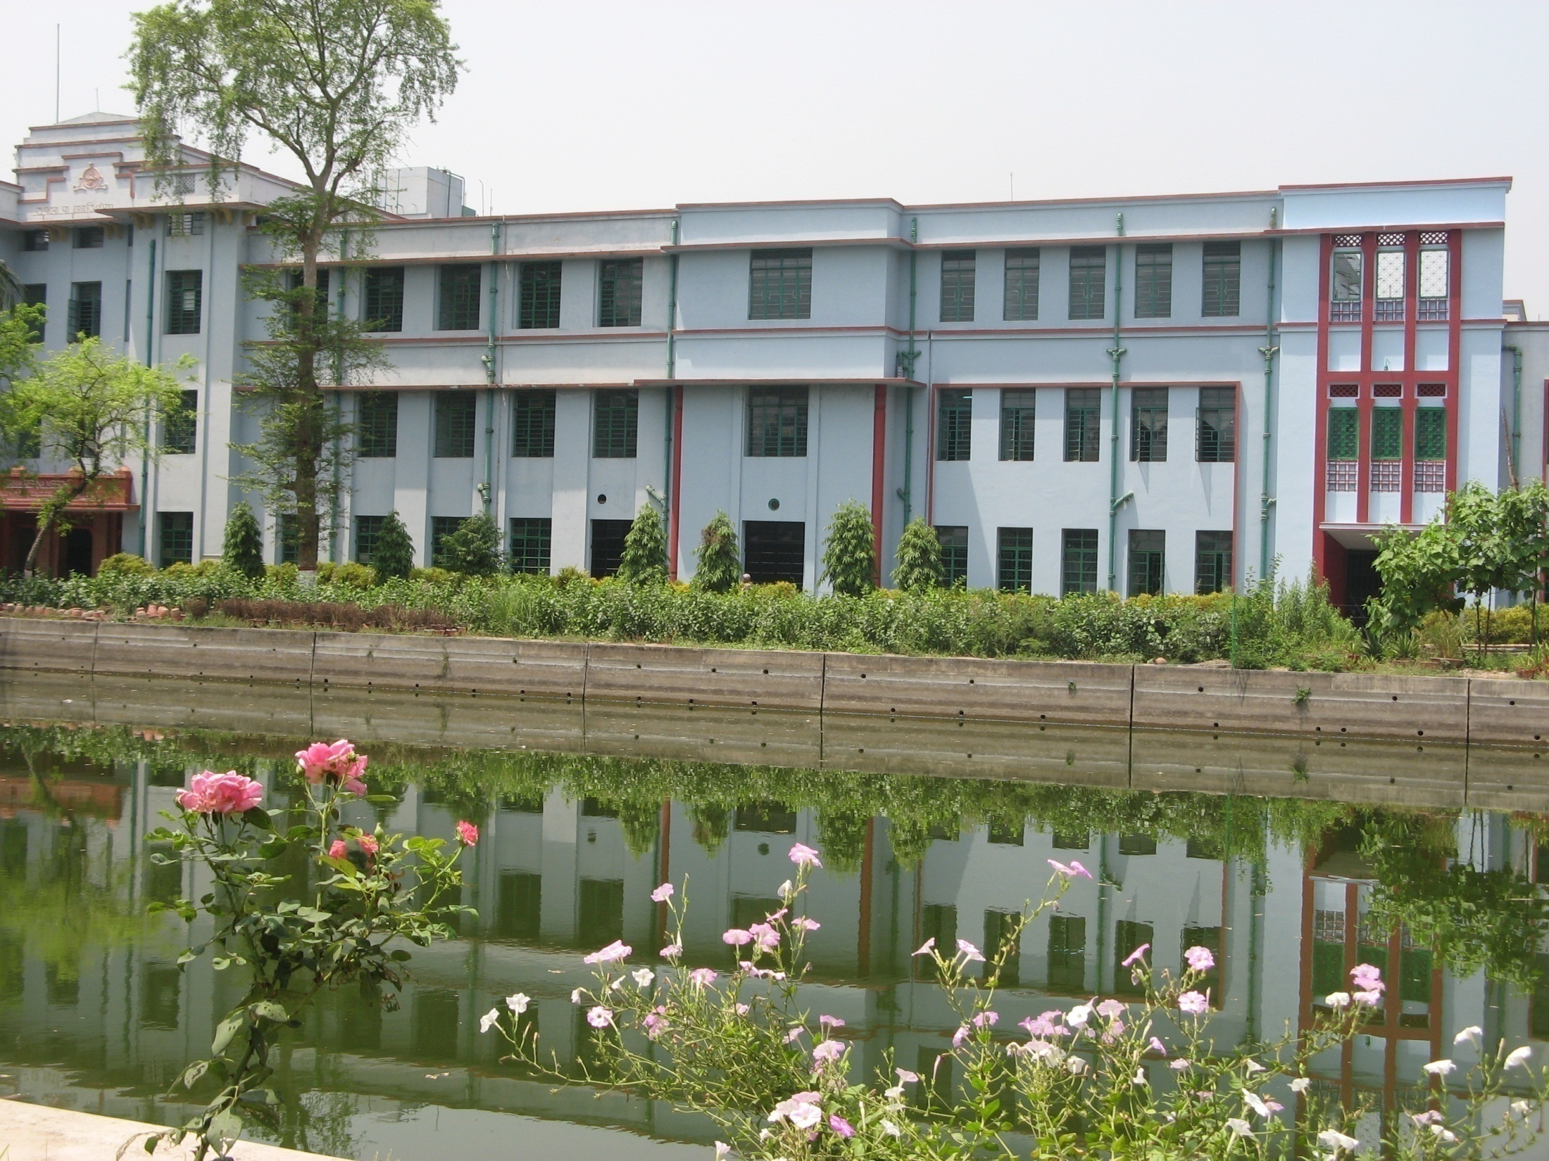
Thank you

