Slide 1
Next Generation Sequencing
Dr. Ajoy mallik

Slide 2
Next Generation Sequencing
Next Generation Sequencing (NGS) is a powerful platform that has enabled the sequencing of thousands to millions of DNA molecules simultaneously.
This powerful tool is revolutionizing fields such as personalized medicine, genetic diseases, and clinical diagnostics by offering a high throughput option with the capability to sequence multiple individuals at the same time.
The so-called “next-generation” sequencing (NGS) technologies allows us, in a short time, low cost and in parallel, to sequence millions to billions of DNA nucleotides, minimizing the need for the fragment-cloning methods and overcoming the limitations of the original Sanger sequencing methods used to sequence the first human genome.
Using different sequencing technologies, a wide variety of different NGS platforms have been made available.
Massive-parallel and Next-generation DNA sequencing are used to refer collectively the available high throughput DNA sequencing technologies.
However, the difference in the sequencing platforms lies in how the templates are generated and how they are detected to expose their sequences.

Slide 3
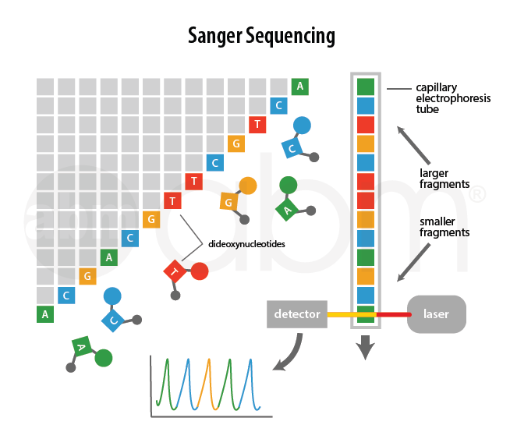
Sanger Sequencing
Sanger Sequencing utilizes a high fidelity DNA-dependent polymerase to generate a complimentary copy to a single stranded DNA template.
In each reaction a single primer, complementary to the template, initiates a DNA synthesis reaction from its 3’ end.
Deoxynucleotides or nucleotides, which are the monomers of DNA, are added one after the other in a template-dependent manner forming phospho-diester bonds between the 3’ hydroxyl of the growing end of the primer and the 5’ tri-phosphate group of the incoming nucleotide.
Each reaction also contains a mixture of four di-deoxynucleotides, one for each DNA base (i.e. A, G, T, and C).
These di-deoxynucleotides resemble the DNA monomers enough to allow incorporation into the growing strand, however, they differ from natural deoxynucleotides in two ways:
1) they lack a 3’ hydroxyl group which is required for further DNA extension resulting in chain termination once incorporated in the DNA molecule, and
2) each di-deoxynucleotide has a unique fluorescent dye attached to it allowing for automatic detection of the DNA sequence.

Slide 4
Sanger Sequencing
Many copies of different-length DNA fragments are generated in each reaction, terminated at all of the nucleotide positions of the template molecule by one of the di-deoxynucleotides.
The reaction mixtures are loaded on the sequencing machine, either manually onto slab gels or automatically with capillaries, and are electrophoresed to separate the DNA molecules by size.
The DNA sequence is read through the fluorescent emission of the di-deoxynucleotide as it flows through the gel.
Modern day Sanger Sequencing instruments use capillary based automated electrophoresis, which typically analyzes 8–96 sequencing reactions simultaneously.

Slide 5
Similarities between different NGS Technologies
Next Generation Sequencing systems have been introduced in the past decade that allow for massively parallel sequencing reactions.
These systems are capable of analyzing millions or even billions of sequencing reactions at the same time.
Although different machines have been developed with various differing technical details, they all share some common features
1. Sample Preparation:
All Next Generation Sequencing platforms require a library obtained either by amplification or ligation with custom adapter sequences.
These adapter sequences allow for library hybridization to the sequencing chips and provide a universal priming site for sequencing primers.

Slide 6
Similarities between different NGS Technologies
2. Sequencing machines:
Each library fragment is amplified on a solid surface (either beads or a flat silicon derived surface) with covalently attached DNA linkers that hybridize the library adapters.
This amplification creates clusters of DNA, each originating from a single library fragment; each cluster will act as an individual sequencing reaction.
The sequence of each cluster is optically read (either through the generation of light or fluorescent signal) from repeated cycles of nucleotide incorporation.
Each machine has its own unique cycling condition; for example, the Illumina system uses repeated cycles of incorporation of reversibly fluorescent and terminated nucleotides followed by signal acquisition and removal of the fluorescent and terminator groups.

Slide 7
Similarities between different NGS Technologies
3. Data output:
Each machine provides the raw data at the end of the sequencing run.
This raw data is a collection of DNA sequences that were generated at each cluster.
This data could be further analysed to provide more meaningful results.

Slide 8
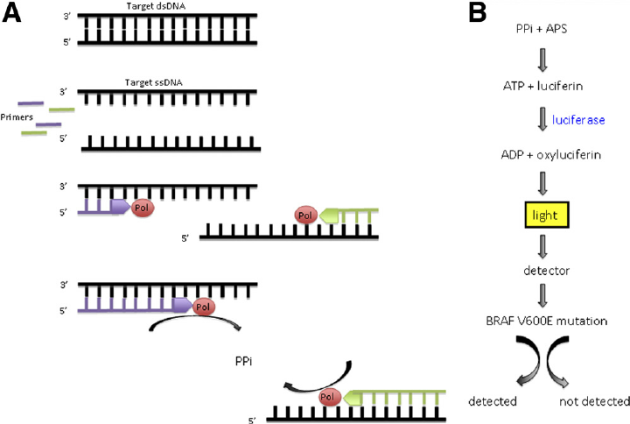
Differences between different NGS Technologies
The differences between the different Next Generation Sequencing platforms lie mainly in the technical details of the sequencing reaction.
Pyrosequencing
In pyrosequencing, the sequencing reaction is monitored through the release of the pyrophosphate during nucleotide incorporation.
combining the solid phase sequencing method using streptavidin coated magnetic beads with recombinant DNA polymerase lacking 3´to 5´exonuclease activity (proof-reading) and luminescence detection using the firefly luciferase enzyme.
A mixture of three enzymes (DNA polymerase, ATP sulfurylase and firefly luciferase) and a nucleotide (dNTP) are added to single stranded DNA to be sequenced and the incorporation of nucleotide is followed by measuring the light emitted.
A single nucleotide is added to the sequencing chip which will lead to its incorporation in a template dependent manner.
This incorporation will result in the release of pyrophosphate which is used in a series of chemical reactions resulting in the generation of light.
Light emission is detected by a camera which records the appropriate sequence of the cluster.
The nucleotide mixture is removed before the next nucleotide mixture is added. This process is repeated with each of the four nucleotides until the DNA sequence of the single stranded template is determined.
Any unincorporated bases are degraded by apyrase before the addition of the next nucleotide.
This cycle continues until the sequencing reaction is complete
Disadvantages: High reagent cost, and high error rate over strings of 6 or more single base nucleotides.
An additional enzyme apyrase is introduced to remove nucleotides that are not incorporated by the DNA polymerase. This enabled the enzyme mixture including the DNA polymerase, the luciferase and the apyrase to be added at the start and kept throughout the procedure, thus providing a simple set-up suitable for automation. An automated instrument based on this principle was introduced to the market the following year by the company Pyrosequencing.

Slide 9
Differences between different NGS Technologies
 | GS Junior | GS Junior Plus | GS FLX+ System
 |  |  | GS FLX Titanium XL+ | GS FLX Titanium XLR70
Read Length | 400bp | 700bp | 700bp (up to 1,000bp) | 450bp (up to 600bp)
Throughput | 35Mb | 70Mb | 700Mb | 450Mb
Reads per Run | 100,000 Shotgun, 70,000 amplicon | 100,000 shotgun, 70,000 amplicon | 1,000,000 shotgun | 1,000,000 shotgun, 700,000 amplicon
Accurarcy | 99% at 400bp | 99% at 700bp | 99.997% | 99.995%
Run Time | 10 hr | 18 hr | 23 hr | 10 hr

Slide 10
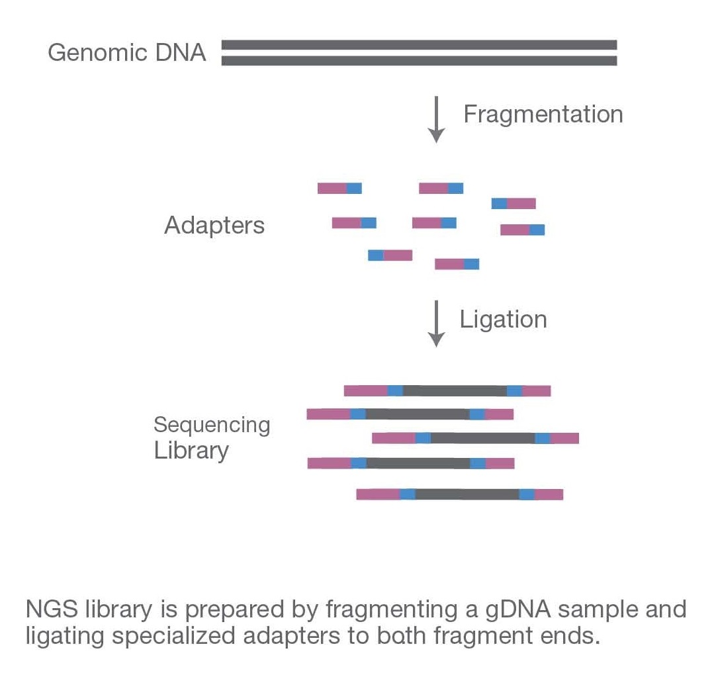
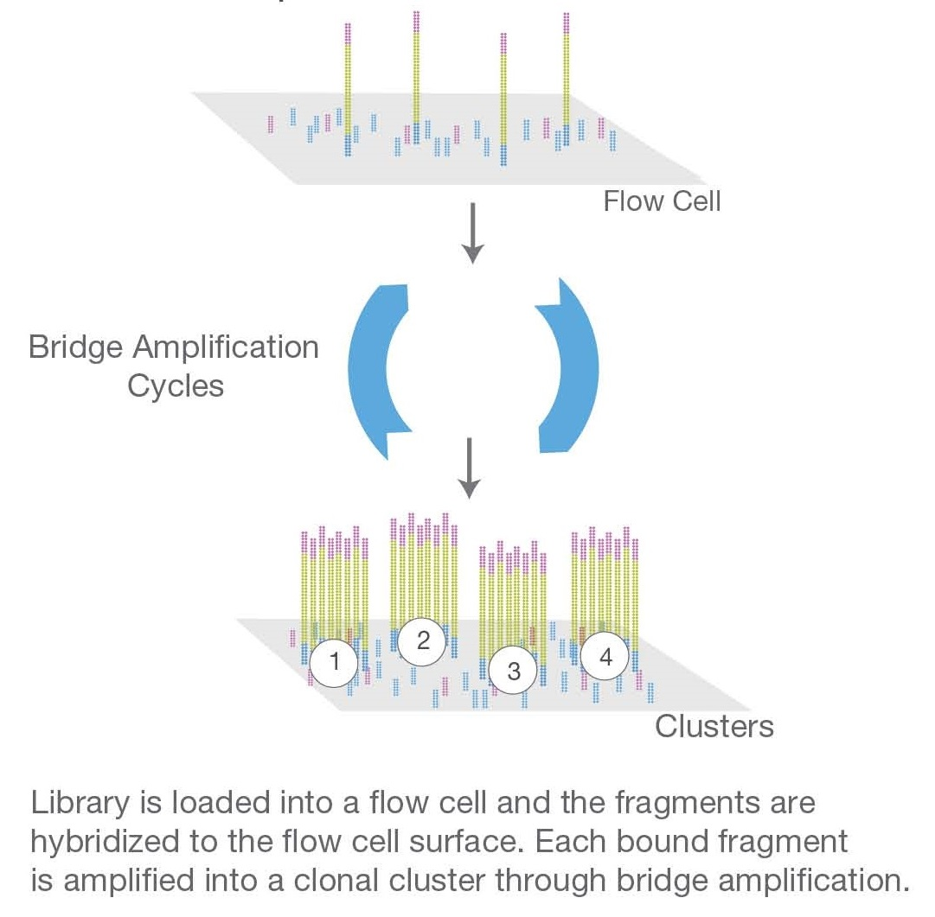
Illumina
Sequencing by Synthesis
Sequencing by synthesis utilizes the step-by-step incorporation of reversibly fluorescent and terminated nucleotides for DNA sequencing and is used by the Illumina NGS platforms.
The nucleotides used in this method have been modified in two ways:
1) each nucleotide is reversibly attached to a single fluorescent molecule with unique emission wavelengths, and
2) each nucleotide is also reversibly terminated ensuring that only a single nucleotide will be incorporated per cycle.
All four nucleotides are added to the sequencing chip and after nucleotide incorporation the remaining DNA bases are washed away.
The fluorescent signal is read at each cluster and recorded; both the fluorescent molecule and the terminator group are then cleaved and washed away. This process is repeated until the sequencing reaction is complete.
This system is able to overcome the disadvantages of the pyrosequencing system by only incorporating a single nucleotide at a time

Slide 11
The workflow of Illumina NGS
Step 1. Library preparation
Through ultrasonic fragmentation, the genomic DNA becomes DNA fragment with 200-500bp in length.
The 5’ and 3’ adapter are added to the two ends of these small segments, “tagmentation” combines the fragmentation and ligation reactions into single step that greatly increases the efficiency of the library preparation process.
Adapter-ligated fragments are then PCR amplified and gel purified. The sequencing library is constructed.
Step 2. Cluster generation
Flow cell is a channel for adsorbing mobile DNA fragments, and it’s also a core sequencing reactor vessel — all the sequencing happens here.
The DNA fragments in the sequencing library will randomly attach to the lanes on the surface of the flow cell when they pass through it. Each flow cell has 8 Lanes, each lane has a number of adapters attached to the surface, which can match the adapters added at the ends of the DNA fragment in the building process, which is why flow cell can adsorb the DNA after the building, and can support the amplification of the bridge PCR on the surface of the DNA. In theory, there is no mutual influence between these lanes.
Bridge PCR was performed using the adapters on flow cell surface as template, after continuous amplification and mutation cycles, each DNA fragment will eventually be clustered in bundles at their respective locations, each containing many copies of a single DNA template.
The purpose of this process is to amplify the signal intensity of the base to meet the signal requirements for sequencing. When cluster generation is complete, those templates are ready for sequencing.

Slide 12
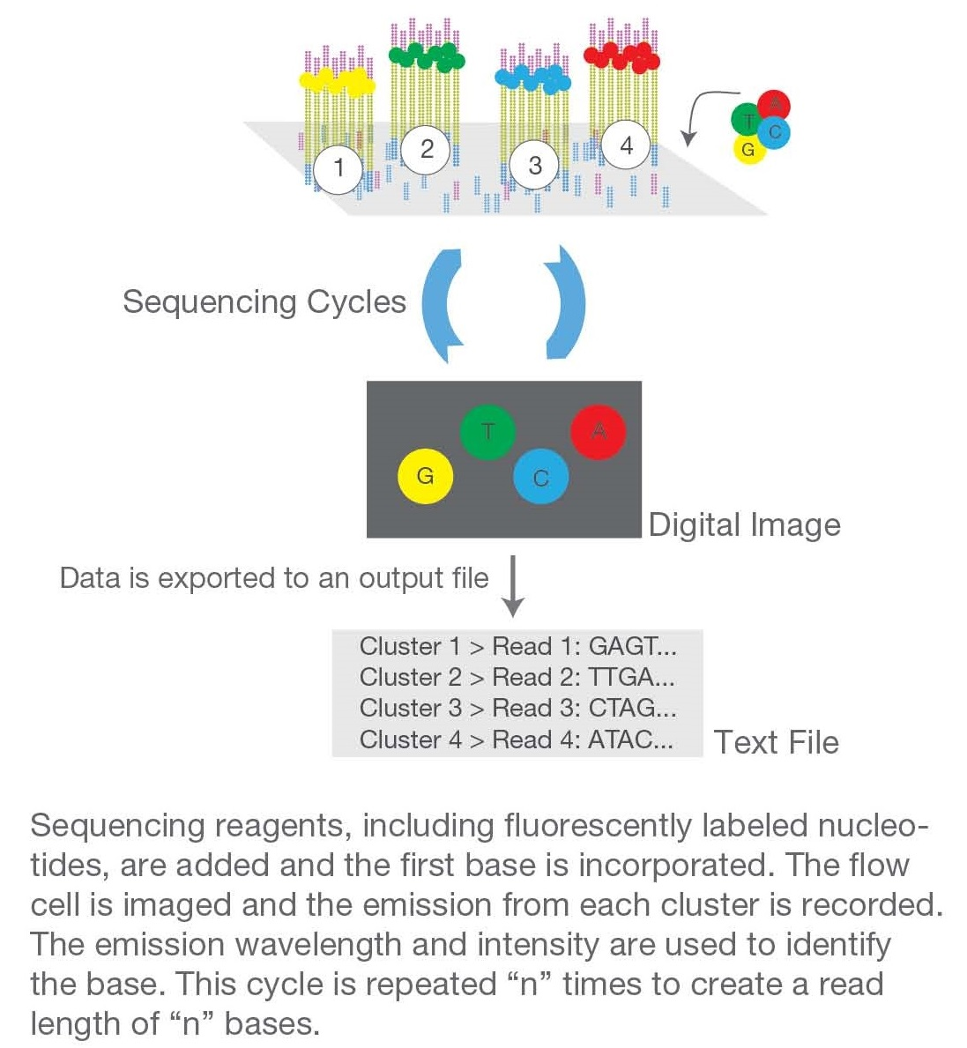
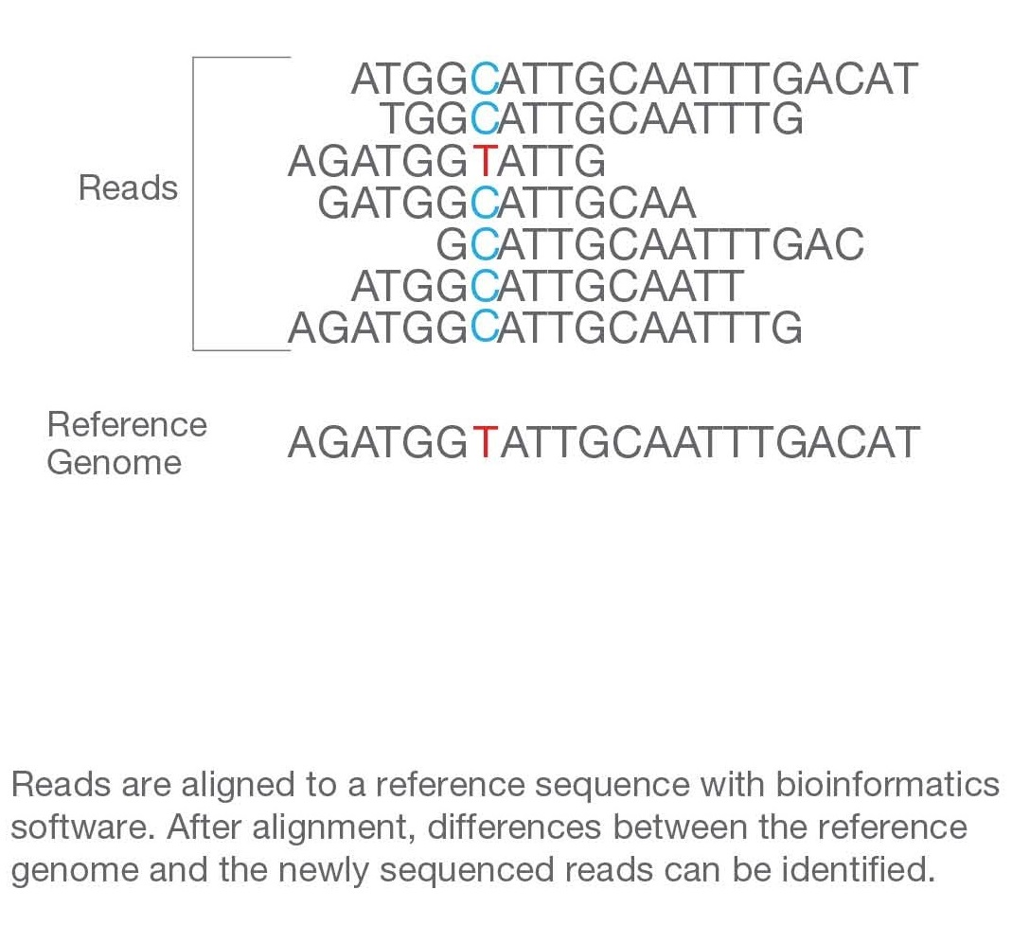
Illumina
Step 3. Sequencing
The sequencing method is based on sequencing-by-synthesis (SBS).
DNA polymerase, connector primers and 4 dNTP with base-specific fluorescent markers were added to the reaction system.
The 3′-OH of these dNTP are protected by chemical methods, which ensures that only one base will be added at a time during the sequencing process.
All unused free dNTP and DNA polymerase are eluted after the synthesis reaction finished.
Then, buffer solution needed for fluorescence excitation are added, the fluorescence signal is excited by laser, and fluorescence signal is recorded by optical equipment.
Finally, the optical signal is converted into sequencing base by computer analysis.
When the fluorescence signal is recorded, a chemical reagent is added to quench the fluorescence signal and remove the dNTP 3′-OH protective group, so that the next round of sequencing reaction can be performed.
Step 4. Alignment & Data analysis
The newly identified sequence reads are aligned to a reference genome, then many variations of bioinformatics analysis are possible such as SNP/InDel/SV/CNV calling, annotation and statistics, pathway enrichment analysis, population genetics analysis and more.

Slide 13
Differences between different NGS Technologies
 | MiSeq | NextSeq 500 |  | HiSeq 2500 |  | HiSeq 3000 | HiSeq 4000
Run Mode | N/A | Mid-Output | High-Output | Rapid Run | High-Output | N/A | N/A
Flow Cells Per Run | 1 | 1 | 1 | 1 or 2 | 1 or 2 | 1 | 1 or 2
Output Range | 0.3-15 Gb | 20-39 Gb | 30-120 Gb | 10-300 Gb | 50-1000 Gb | 125-750 Gb | 125-1500 Gb
Run Time | 5-55 hrs | 15-26 hrs | 12-30 hrs | 7-60 hrs | <1-6 days | <1-3.5 days | <1-3.5 days
Reads per Flow Cell | 25million | 130 million | 400 million | 300 million | 2 billion | 2.5 billion | 2.5 billion
Maximum Read Length | 2 x 300bp | 2 x 150bp | 2 x 150bp | 2 x 250bp | 2 x 125bp | 2 x 150bp | 2 x 150bp

Slide 14
Differences between different NGS Technologies
Sequencing by Ligation (ABI SOLiD)
Sequencing by ligation is different from the other two methods since it does not utilize a DNA polymerase to incorporate nucleotides.
Instead, it relies on short oligonucleotide probes that are ligated to one another.
These oligonucleotides consist of 8 bases (from 3’-5’): two probe specific bases (there are a total of 16 8-mer probes which all differ at these two base positions) and six degenerate bases; one of four fluorescent dyes are attached at the 5’ end of the probe.
The sequencing reaction commences by binding of the primer to the adapter sequence and then hybridization of the appropriate probe.
This hybridization of the probe is guided by the two probe specific bases and upon annealing, is ligated to the primer sequence through a DNA ligase.
Unbound oligonucleotides are washed away, the signal is detected and recorded, the fluorescent signal is cleaved (the last 3 bases), and then the next cycle commences.
After approximately 7 cycles of ligation the DNA strand is denatured and another sequencing primer, offset by one base from the previous primer, is used to repeat these steps - in total 5 sequencing primers are used (Table 3).

Slide 15
Differences between different NGS Technologies
Genetic Analyzer V2.0
 | 5500W System | 5500xl W System
Instrument Throughput
1 x 50 | 80 Gb | 160 Gb
1 x 75 | 120 Gb | 240 Gb
2 x 50 MP | 160 Gb | 320 Gb
50 x 50 PE | 160 Gb | 320 Gb
Accuracy | 99.99% | 99.99%
Run Time | 7 days | 7 days

Slide 16
Differences between different NGS Technologies
Ion Semiconductor Sequencing
Ion semiconductor sequencing utilizes the release of hydrogen ions during the sequencing reaction to detect the sequence of a cluster.
Each cluster is located directly above a semiconductor transistor which is capable of detecting changes in the pH of the solution.
During nucleotide incorporation, a single H+ is released into the solution and it is detected by the semiconductor.
The sequencing reaction itself proceeds similarly to pyrosequencing but at a fraction of the cost.

Slide 17
Differences between different NGS Technologies
 | Ion Proton System
Output | up to 10 Gb
Reads | 60-80 million Reads
Read Length | up to 200bp
Run time | 2-4 hrs

Slide 18
Useful Terms
Next Generation Sequencing is a young field, with the first machines marketed in 2005.
However, in less than a decade NGS has become a cornerstone of molecular biology and genetics.
As such, being familiar with its technical terms will help in better understanding the available literature and becoming a member of its ever expanding community.
Next Generation Sequencing:
Next Generation Sequencing, or NGS, is a sequencing method where millions of sequencing reactions are carried out in parallel, increasing the sequencing throughput.
Reads:
The output of an NGS sequencing reaction. A read is a single uninterrupted series of nucleotides representing the sequence of the template.
Read Length: The length of each sequencing read. This variable is always represented as an average read length since individual reads have varying lengths.
Coverage:
The number of times a particular nucleotide is sequenced. Due to the error -prone sequencing reactions, random errors could occur. Therefore, 30x coverage is typically required to ensure each nucleotide sequence is accurate.

Slide 19
Useful Terms
Deep Sequencing:
Sequencing where the coverage is greater than 30x. This is used in cases where dealing with rare polymorphisms which only a subset of the sample expresses the mutation. This method increases range, complexity, sensitivity, and accuracy of the result.
Paired-End Sequencing:
Sequencing from both ends of a fragment while keeping track of the paired data. With this method the sequencing reaction will commence from one end of the fragment. Once completed, the fragment is denatured and a sequencing primer is hybridized to the reverse side adapter. The fragment is then sequenced again. Using this method will allow either further confirmation of the accuracy of the sequence or it could be used to increase the overall read length.
Mate-Paired reads:
A sample preparation step where large DNA fragments (~10kb) are circularized with an adapter sequence followed by degradation of the circular DNA. This method links DNA fragments that are separated from each other by a certain distance and it is used in applications such as de novo assembly, structural variant detection, and identification of complex genomic rearrangements.

Slide 20
Useful Terms
Adapter:
Unique sequences used to cap the ends of a fragmented DNA. The adapter’s functions are as follows: 1) allow hybridization to solid surface; 2) provide priming location for both amplification and sequencing primers; and 3) provide barcoding for multiplexing different samples in the same run.
Library:
A collection of DNA fragments with adapters ligated to each end. Library preparation is required before a sequencing run. Our next knowledge base will delve into the different sample and library preparation methods available.
Alignment:
Mapping a sequence read to a known reference genome
Reference sequence/genome:
A fully sequenced and mapped genome used for the mapping of sequence reads.
De Novo Assembly:
Assembly of the sequence reads to generate a reference sequence.
Specificity:
The percentage of sequences that map to the intended targets out of total bases per run.
Uniformity:
The variability in sequence coverage across target regions. When performing whole genome sequencing or exome sequencing, it is expected that the result will be highly uniform (as there should be a 1:1 ratio in the starting material). However, RNA sequencing will not be uniform since differences in expression alter its starting material.
Homopolymer:
A stretch of single nucleotide bases, such as AAAA or GGGGGG.

Slide 21
Second generation sequencing
Basic characteristics of the second generation sequencing involve the shotgun sequencing of the fragmented genomic DNA or cDNA ligated to the linkers or adapters for construction of template libraries.
A solid surface or beads are used for the library amplification and the incorporated nucleotide is monitored by the luminescence generation or changes in electrical current.
A major defining feature of the second generation sequencing is the parallelization of millions of nucleotide short reads in a much shorter time.
Second generation sequencing includes: Roche 454, Illumina, SOLiD and Ion Torrent.

Slide 22
Roche 454 pyrosequencing
Roche 454 pyrosequencing by synthesis was the first successful second generation sequencing system developed in 2005.
This technology made use of sequencing chemistry, wherein the visible light produced by ATP sulfurylase, luciferase, DNA polymerase enzymatic system and is measured in proportion to the amount of released pyrophosphate in the newly synthesized DNA chain.
This ensures that the reaction can be detected at a given light intensity and can analyze a large number of samples in parallel, vastly improving the output as compared to the original Sanger method.
Roche in 2008 released the upgraded 454 GS FLX Titanium system with an average read length to 700 bp, 99.997% accuracy and 0.7 Gb of data per run output within 24 hrs.
The major drawbacks of Roche 454 in most cases was the high error rates in homopolymer repeats and the high reagent cost.
This technology has been discontinued for several years now.

Slide 23
How does 454 DNA sequencing work?
The process begins with a sample of double-stranded DNA.
The DNA is broken up into fragments of around 400 to 600 base pairs using restriction enzymes that ‘cut’ the DNA at specific points.
Short sequences of DNA called adaptors, are attached to the DNA fragments.
Tiny resin beads are added to the mix.
DNA sequences on the beads are complementary to sequences on the adaptors, allowing the DNA fragments to bind directly to the beads, ideally one fragment to each bead.
When the DNA fragments attach to the DNA on the beads the bonds joining the double-strand together, break and the strands separate, becoming single-stranded DNA.
The fragments of DNA are then copied numerous times on each bead by a reaction known as the polymerase chain reaction (PCR). This creates millions of identical copies of the DNA sequence.
The beads are then filtered to remove any that have either failed to attach to any DNA or contain more than one type of DNA fragment.
Then, the remaining beads are put into wells on a sequencing plate (one bead per well) along with enzyme beads that contain the DNA polymerase and primer needed for the sequencing reaction
The polymerase enzyme and primer attach to the DNA fragments on the beads.
Nucleotide bases are added to the wells in waves of one type of base at a time: a wave of As, followed by a wave of Cs, followed by Gs, followed by Ts.
When each base is incorporated into the DNA, light is given out and this is recorded by a camera.
The intensity of the light corresponds to the number of nucleotides of the same type that have been incorporated. For example, if there are three consecutive As in the fragment, the amount of light generated would be three times that of a single A in the fragment.
By plotting this pattern of light intensity on a graph, the sequence of the original piece of DNA can be decoded.

Slide 24
Roche 454 pyrosequencing
Illumina (Solexa) HiSeq and MiSeq Illumina sequencer also adopted the sequencing by synthesis technology using removable fluorescently labeled chain-terminating nucleotides that are capable of producing a larger output at a lower reagent cost.
A process called bridge amplification or cluster generation occurs allowing generation of copies of a clonally enriched template DNA to be made into miniaturized colonies called as polonies.
The sequencing data output per run is approximately higher (600 Gb) with shorter read lengths (~100 bp) and cheaper cost cheaper cost.
Illumina provides at least eight industrial level sequencing machines (NextSeq 500, HiSeq series 2500, 3000 and 4000 and HiSeq X series five and ten) having mid to high output (120 - 1500 Gb).
Also, MiSeq is a small compact laboratory sequencer using the same sequencing and polony technology with faster turnover rates and an output of 0.3 to 15 Gb.
Further, Illumina’s new method of TruSeq technology involving synthetic long reads resolves the complex, repetitive transposable elements and improves de novo assembly.

Slide 25
Roche 454 pyrosequencing
Illumina (Solexa) HiSeq and MiSeq Illumina sequencer also adopted the sequencing by synthesis technology using removable fluorescently labeled chain-terminating nucleotides that are capable of producing a larger output at a lower reagent cost.
A process called bridge amplification or cluster generation occurs allowing generation of copies of a clonally enriched template DNA to be made into miniaturized colonies called as polonies.
The sequencing data output per run is approximately higher (600 Gb) with shorter read lengths (~100 bp) and cheaper cost cheaper cost.
Illumina provides at least eight industrial level sequencing machines (NextSeq 500, HiSeq series 2500, 3000 and 4000 and HiSeq X series five and ten) having mid to high output (120 - 1500 Gb).
Also, MiSeq is a small compact laboratory sequencer using the same sequencing and polony technology with faster turnover rates and an output of 0.3 to 15 Gb.
Further, Illumina’s new method of TruSeq technology involving synthetic

Slide 26
Third generation sequencing
Third generation single molecule sequencing actually allows for sequencing without PCR amplification of the DNA enabling shorter preparation times, while decreasing the chances of error.
This allows for billions of unique fragments to be independently sequenced at the same time.
Third Generation Sequencing includes Helicos True Single Molecule Sequencing, Single Molecule Real time Sequencing (SMRT) and Oxford Nanopore.

