Slide 1
Loop-Mediated Isothermal Amplification (LAMP)

Slide 2
Introduction to LAMP
ABBREVIATION: Loop-mediated Isothermal AMPlification.
Diseases are the primary constrains for the development of any living forms i.e., both plants and animals including humans.
Diagnosis is a critical step for effective treatment and control of infectious diseases.
PCR (Polymerase Chain Reaction) has revolutionized the earlier detection of infection, tumor, etc.,
However, LAMP has several pros over PCR.
LAMP is used in the rapid diagnosis of viral, bacterial and parasitic diseases.
It helps in the identification of genus and species-specific parasites.
First reported by Notomi et al in 2000 of EIKEN Chemical Co. Ltd., Japan.
It is a very sensitive, easy and time-efficient method. The LAMP reaction proceeds at a constant temperature using a strand displacement reaction.

Slide 3
Introduction to LAMP and Comparison to PCR
Amplification takes place at a single temperature
Uses a polymerase with high strand displacement activity
Amplification is rapid
Can be used for RNA templates by addition of reverse transcriptase (RT) or by using an enzyme with both RT and DNA pol activities

Slide 4
LAMP vs PCR
LAMP | PCR
Isothermal Reaction. | Cyclic Reaction.
Isothermal Temperature (60-65⁰C). | Variable Temperature. Denaturation (95⁰C); Annealing (50-60⁰C); Polymerization (72⁰C)
Doesn’t require expensive thermocycler. | Require thermocycler.
The detection limit is greater. | The detection limit is lower.
Amplification specificity is higher as it uses 4/6 oligonucleotides. | Amplification specificity is lower than that of LAMP.
It could be done using crude DNA samples. | Need pure DNA samples for amplification.
Loop primers accelerate the reaction rate. | No loop primer.
Visualization of DNA could be done through eyes, gel electrophoresis, and turbidimeter. | Visualization of DNA is done through gel electrophoresis.

Slide 5
Principle
Amplification of DNA via cyclic and non-cyclic amplification steps using 4 or 6 primers, while the reaction proceeds at a constant temperature using a strand displacement reaction.
Types of Primers used in LAMP:
LAMP is characterized by the use of 4 different primers specifically designed to recognize 6 distinct regions of the target gene. The four primers used are as follows:
Forward Inner Primer (FIP)
Forward Outer Primer (FOP): The FOP (also called F3 Primer)
Backward Inner Primer (BIP)
Backward Outer Primer (BOP)

Slide 6
Principle
When the target gene (DNA template) and the reagents are incubated at a constant temperature between 60- 65⁰C, the following reaction steps proceed. Stages in Loop-mediated Isothermal Amplification
Step 1: One of the LAMP primers can anneal to the complementary sequence of double-stranded target DNA, then initiates DNA synthesis using the DNA polymerase with strand displacement activity, displacing and releasing a single-stranded DNA.
With the LAMP method, unlike with PCR, there is no need for heat denaturation of the double-stranded DNA into a single strand.

Slide 7
Principle

Slide 8
Principle

Slide 9
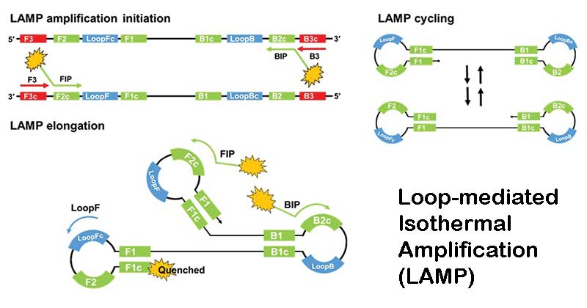

Slide 10
Principle

Slide 11
Principle

Slide 12
Principle

Slide 13
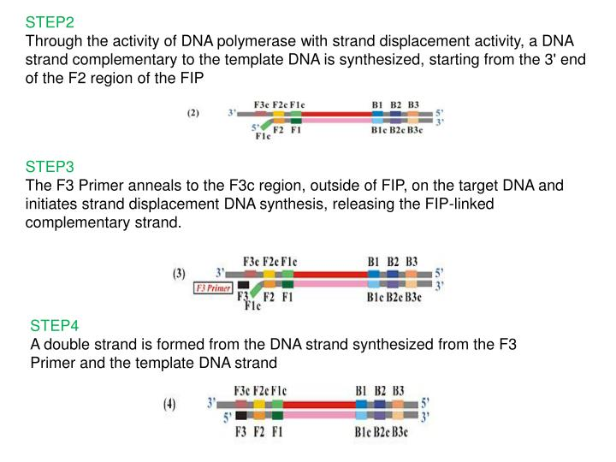
Principle

Slide 14
Principle

Slide 15
Principle

Slide 16
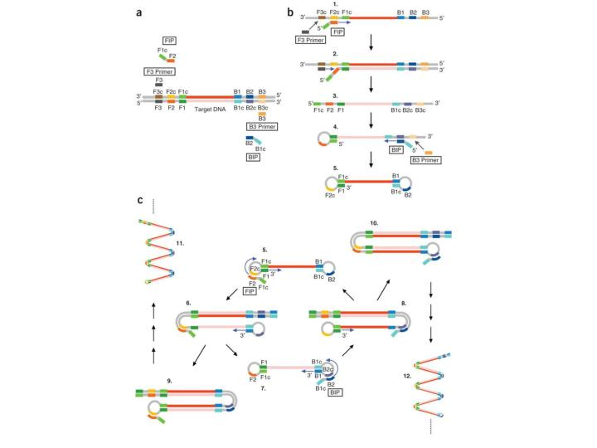

Slide 18
Principle

Slide 19
Principle

Slide 21
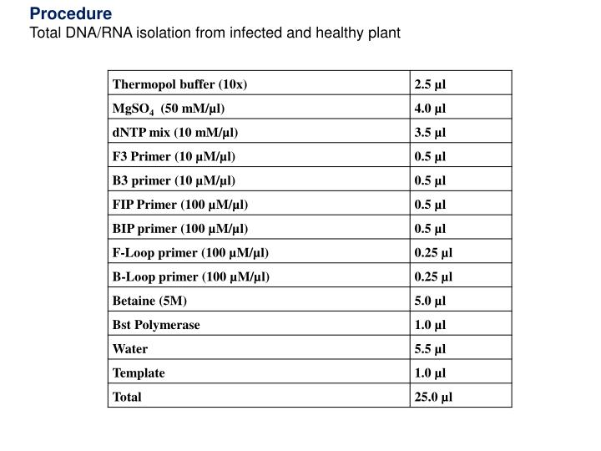

Slide 24
Advantage of LAMP: ASSURED
LAMP is an ideal amplification technology for Point of Care/Point of Need assays
• Test platform using LAMP could fulfil WHO’s recommended ASSURED characteristics:
1. Affordable
2. Sensitive
3. Specific
4. User friendly
5. Robust and rapid
6. Equipment free
7. Deliverable to end user

Slide 25
Which applications are you interested in performing using LAMP assays?

