Slide 1
RESPIRATION IN VERTEBRATES
A Comparative approach

Slide 2
INTRODUCTION
Effective metabolism and survivality of cells within the body of an animal requires constant supply of oxygen and eliminate carbon dioxide as gaseous by-product from the body.
Two systems involved in the transport of O₂₋CO₂ are circulatory and respiratory systems by process of passive diffusion.

Slide 3
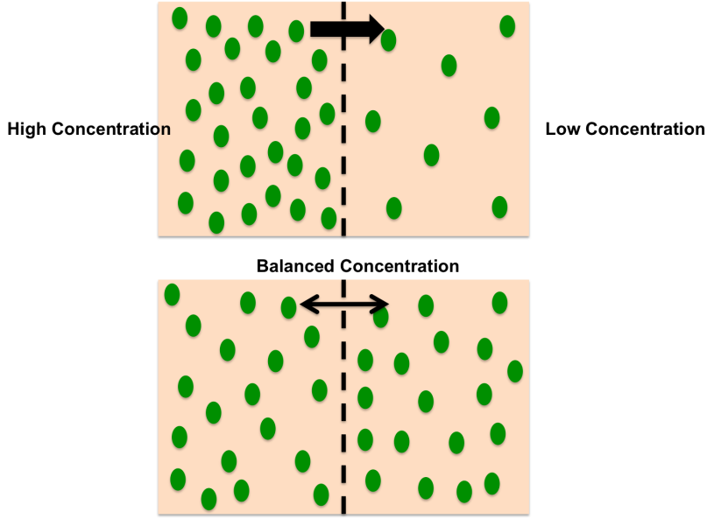
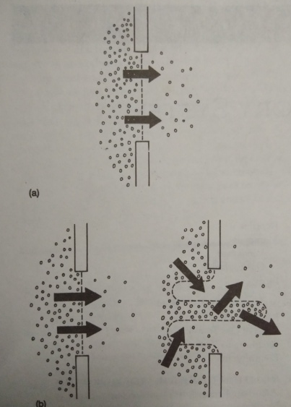
Characteristics of diffusion
Passive diffusion involves random movement of molecules from an area of high to an area of low partial pressure until equilibrium is reached.
The rate of movement of diffusing molecules depends on surface area.
Time taken for a molecule to reach deep into the tissues depends upon the distance they travel.
Rate of diffusion depends upon the difference in partial pressure across the exchange surface.

Slide 4
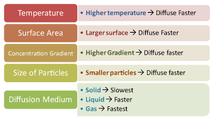
Rate of diffusion varies

Slide 6
Fick’s Law

Slide 7
Basic characteristics of a respiratory organ
The surface area of gaseous exchange is enormous.
Surface area is ultrathin so that gaseous exchange takes no time.
Richly vascularisation of the respiratory surface for effective exchange.
Respiratory surface should be moist for adsorption of gases followed by absorption.

Slide 8
Some terminologies
External respiration- gas exchange between environment and blood
Internal respiration- gas exchange between blood and deep body tissues.
Ventilation/ breathing- active process of moving the respiratory medium (air or water) across the exchange surface.
Perfusion- pumping of blood through an organ via capillaries.
Surfactant- secretory products lining the respiratory surfaces (lung, gills) that reduces surface tension at the water- air interface and stabilises the respiratory compartments by maintaining structural integrity for exchange.

Slide 9
Difficulties in diffusion and exchange
Air pressure varies slightly with weather conditions and temperature rise.
Varies with increase in altitude and air pressure drops significantly as air is less dense and breathing becomes laboured.
The gas contributes only the partial pressure of oxygen.
Water being more denser than air, animal experiences more pressure changes than animal descending through air.
The solubility of a gas in air differs from that in water.
The amount of gas dissolved in water depends on chemistry of the gas, temperature of medium and presence of other dissolved substances .

Slide 10
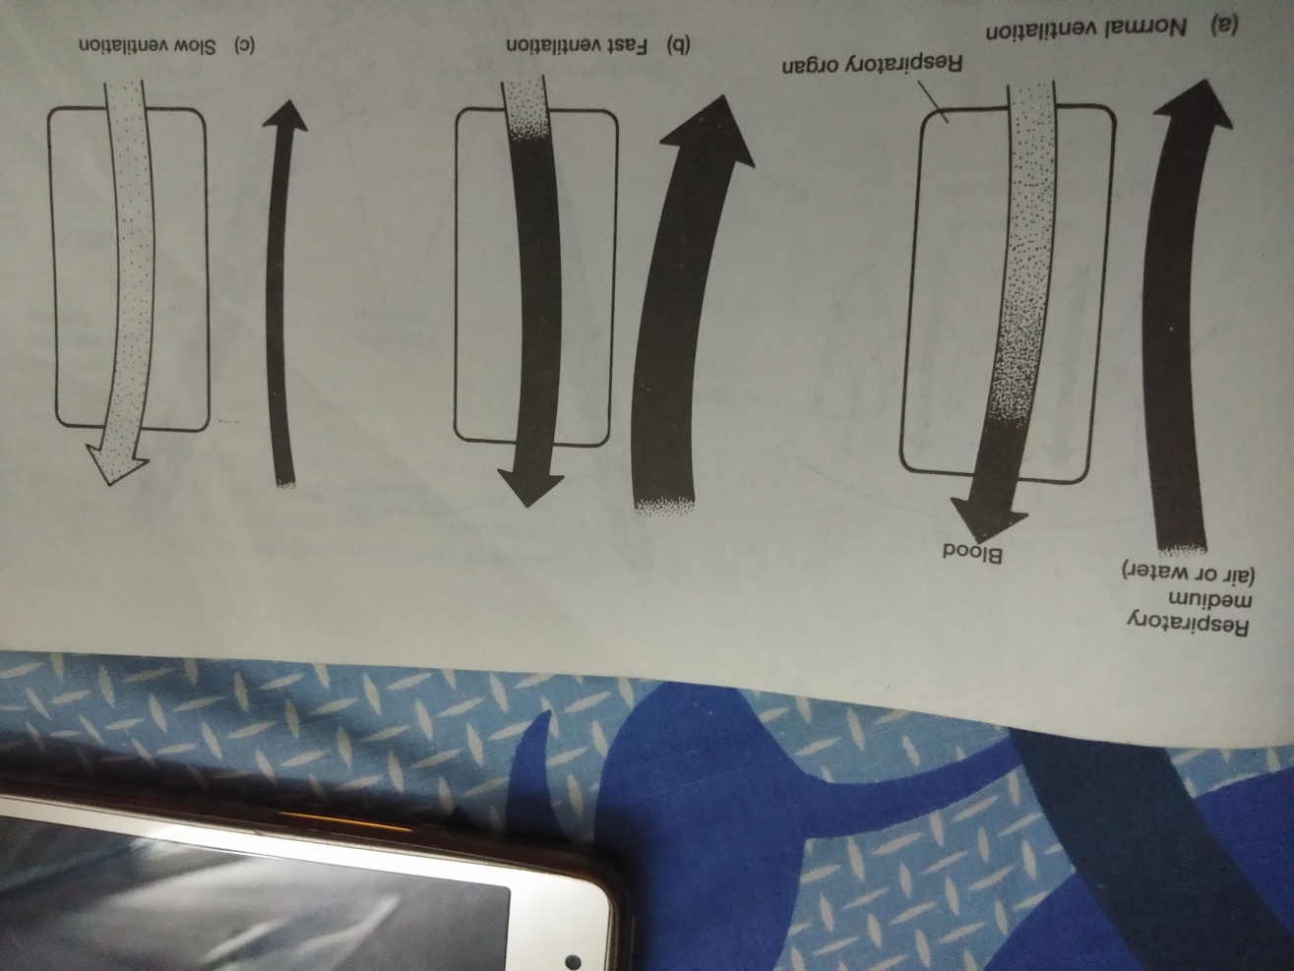
Ventilation: perfusion matching
The air or water breathing organ balances blood flow (perfusion) with movement of respiratory medium (ventilation).
If ventilation and perfusion is properly matched, blood leaving the respiratory organ is fully O2 saturated.
If ventilation too fast, blood lingers longer in the respiratory organ and becomes early O2 saturated but takes up no more O2.
If ventilation is too slow, blood is partially oxygenated and departs from respiratory organ.
Hence breathing too fast and too slow is inefficient.

Slide 11
Pattern s of gas exchange mechanism
The pattern of gas transfer for ventilation across the medium and blood are basically of three types in vertebrate body-
Counter current- flow of water across secondary lamellae in one direction is opposite to the flow of capillary blood in fishes.
Uniform pool- mammalian lung illustrates gas exchange in an uniform pool where mixing of gases with in the alveolar space encounters uniform partial pressure with the circulating blood in the capillaries.
Secondary and tertiary septal compartments (faveoli) forming parabronchial lung in birds have less surface area and less elastic in respect to alveolar lung shows cross current mechanism of gas exchange.
Exchange of respiratory gas occurs at an angle of 90 degree to that of the flow of blood through capillaries.

Slide 12
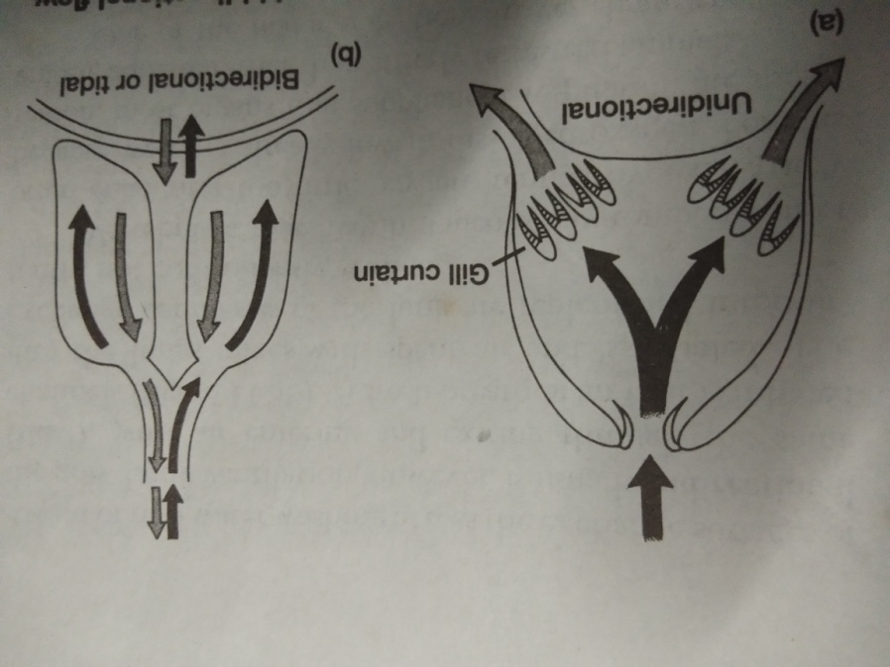
Unidirectional and bidirectional flow
Unidirectional flow- movement of water through mouth into buccal cavity and irrigating row of gill curtain followed by water exit (gill slits or opercular opening) in one direction only. Eg. Fishes and many aquatic amphibians
Bidirectional or tidal flow- lung ventilation with air entering and exiting through the same route. Eg. Air breathing vertebrates
Vertebrates live in water often encounter lack of oxygen (Hypoxia) due to low dissolved O₂ , hence supplementary respiratory borgans evolved among aquatic vertebrates than terrestrial animals.

Slide 13
Gills as respiratory organ
Gills as primary respiratory organ in aquatic vertebrates like all fishes, larva of salamander (amphibia), larva of lung fishes.
Mechanism depends upon the location of gills externally or internally.
Internal gills associated with pharyngeal slits and pouches often covered with inter-branchial septum (lateral skin folds). Eg. Chondrichthyan fishes
External gills developed in the branchial region as filamentous capillary beds protruding in the surrounding water outside the body. Eg. Larva of vertebrates like lung fishes, actinopterygians and amphibians.

Slide 14
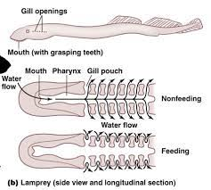
Ventilation in Agnathans
Feeding- ventilation current of water is produced by pumps composed of muscular Velar folds/ velum and by compression and expansion of branchial apparatus.
Velum rolls up and down as branchial pouches contract to drive water current across gills and out of gill pores.

Slide 15
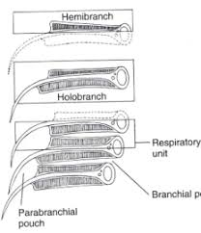
Gill ventilation in Chondrichthyes
Operculum absent hence gills are open to the environment.
Ram ventilation-Fast swimming irrigates the gills continuously with rich oxygenated water and nearly replace dual pump during such times. Eg. Shark.
The first gill slit is reduced in to small oval opening called spiracle with reduced hemibranch (spiracular pseudobranch). Spiracle may sometimes play a role in chemical sampling of water.
Compression and expansion of branchial apparatus irrigates lamprey gills tidally.
Scrolling of a velum moves water across the gills of hagfishes.

Slide 16
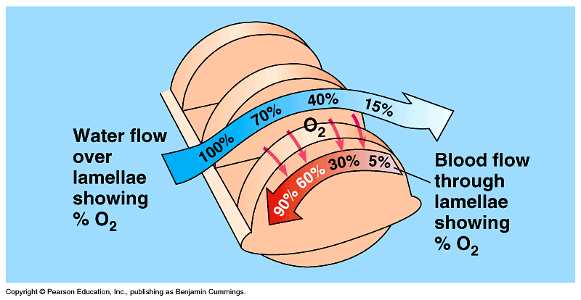
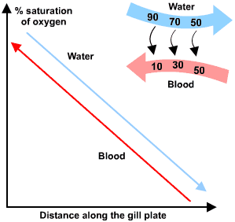
Gill ventilation in Osteichthyes
The operculum in teleost is a bony/ cartilagenous cover over branchial arches and gills.
Each gill is V-shaped composed of gill filaments (primary lamellae) and subdivided into secondary lamellae supported on branchial arch.
Adductor muscles in between the filaments controls flow of water across gill lamellae.
Each secondary gill lamellae is perfused with afferent and efferent arterioles carrying blood opposite to the direction of water flow; hence counter current exchange.

Slide 17
Gill ventilation in teleosts

Slide 18
Dual pump mechanism of gas exchange
Buccal pump and opercular pump in tandem works synchronously to drive water in a continuous, unidirectional flow across the gill curtain between them.
Mechanism involving gill ventilation is viewed as two stroke pump.
Suction phase (1st stroke)- starts with compression of buccal and opercular cavities and closed oral and opercular valves
Expansion of buccal cavity creates lowering intraoral pressure and oral valves open promoting outside water to enter buccal cavity.
Expansion of posterior opercular cavity lowers the internal pressure with valve closed and thus water irrigates the gill curtain and flow from buccal cavity to opercular cavity
Force phase (2nd stroke)- oral valve closes and opercular valve opens with contraction of muscles in the buccal and opercular cavities.
Water flows from buccal cavity to opercular cavity as opercular cavity pressure is lower than that of buccal cavity an water exits through the opercular valves.
Timing of suction phase and force phases together with the pressure differences between them, regulates in the continuous, unidirectional flow of water for ventilation.

Slide 19
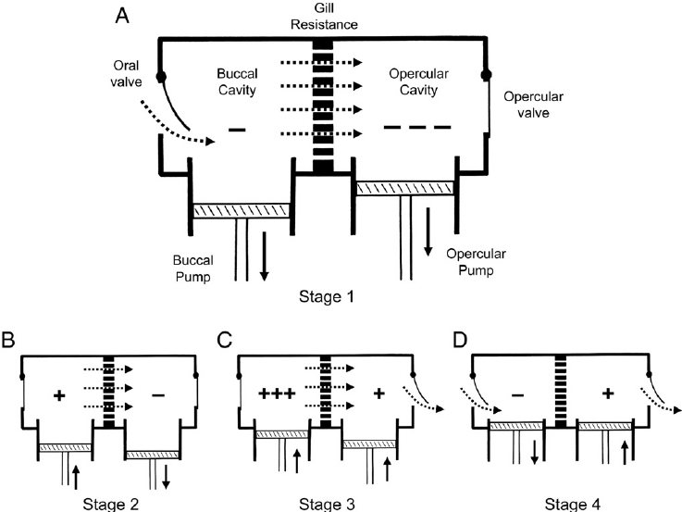
Dual pump mechanism of ventilation

Slide 20
Gill ventilation in sturgeon
During normal breathing, water moves into the mouth, across the gill curtains and exit under the operculum.
During detritus feeding, mouth does not serve the portal od water; hence water enters along the dorsal opercular channel to sweep across the gill curtain and then normally exit through opercular opening.

Slide 21
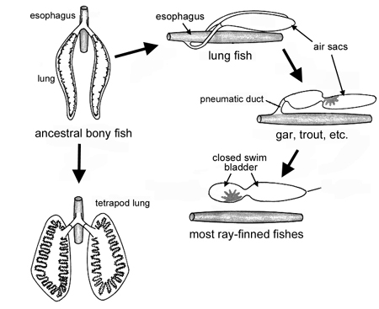
Ventilation by other respiratory organs in aquatic vertebrates
Gas bladder- a single elongated pneumatic sac dorsally located to the digestive tract in aquatic vertebrates (actinopterygian fishes) serves as gas secretory organ from blood.
Red gland or rete mirabile present in the anterior compartment of the fish swim/ gas bladder fills the bladder with oxygen and provides more buoyancy to the fishes.
Beside lungs and gills, skin can supplement breathing during cutaneous respiration in land and aquatic vertebrates. Eg. Frogs- 30% ventilation, bats 12% CO₂ exchange and 2-3% O₂ intake through skin, sea snakes- 30% O₂ intake, larva of Monopterus albus performs cutaneous respiration.

Slide 22
Cutaneous respiration in different vertebrates

Slide 23
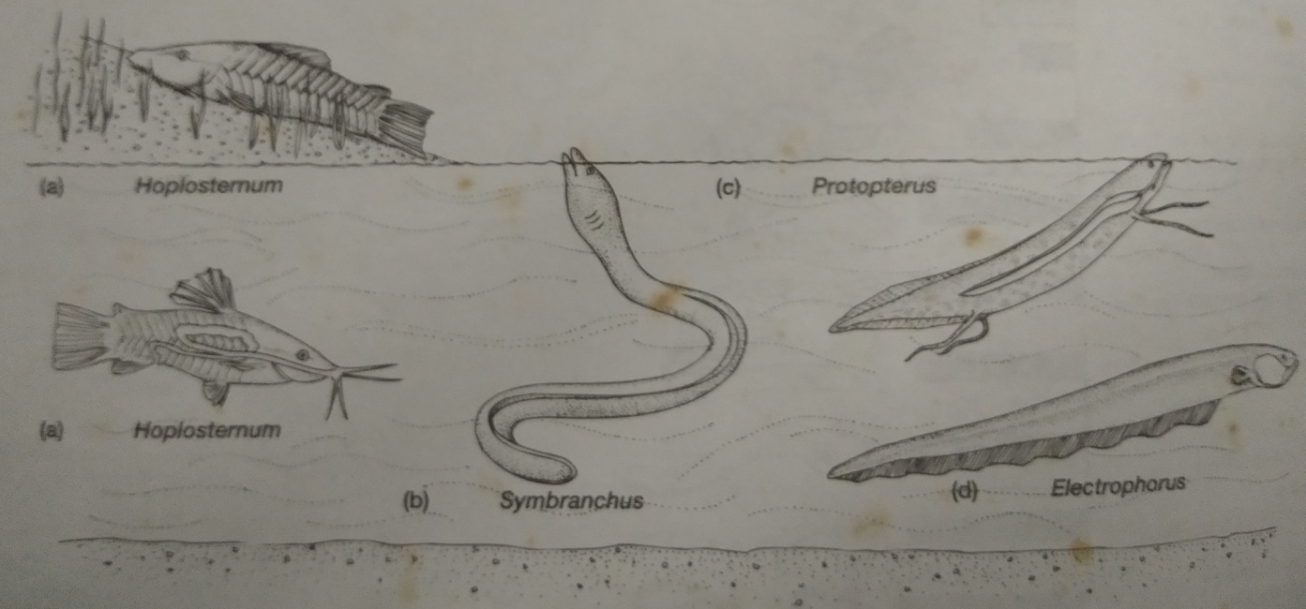
Accessory air breathing organs
Hoplosternum, a tropical cat fish in fresh water of S.America gulps air into the digestive tract which diffuses into blood stream.
Electric eel electrophorus gulps and hold air in its mouth to expose capillary network with oxygen.
Anamniotic embryos respiration occurs through body skin.
Embryos of birds and reptiles have extraembryonic membrane called chorioallantois lying beneath the shell acts as respiratory organ.
Symbranchus holds a gulped air bubble against its reinforced gills to take up extra oxygen.
Protopterus, a lung fish has well developed lungs for breathing air.

Slide 24
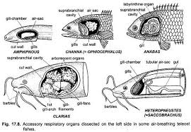
Accessory respiratory organs in jeol fishes

Slide 25
ARO in fishes

Slide 26
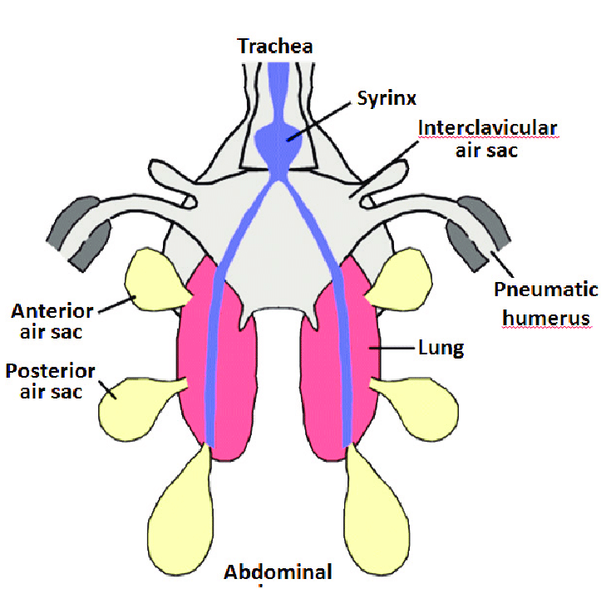
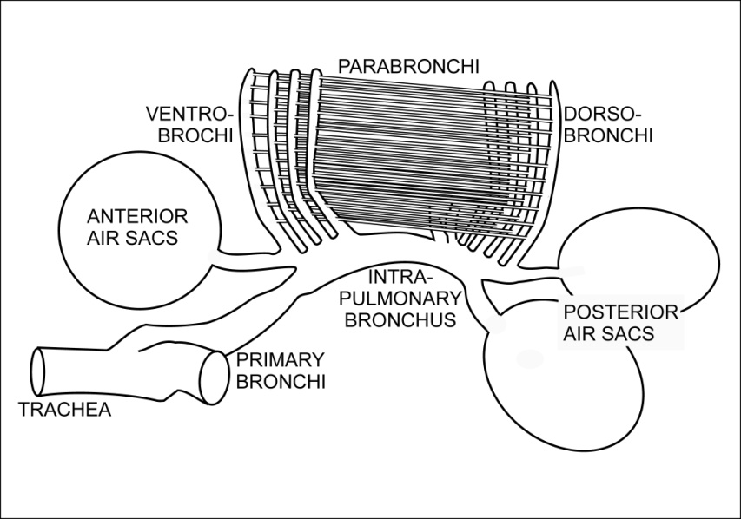
Gas exchange in birds
Respiratory exchange surface along the interior walls of the lung is long conducting passage with repeated branching called parabronchi.
Small air capillaries open off the walls of each parabronchi and gas exchange occurs in the air capillaries.
Nine avascular air sacs connected to the lung acts as bellows and accessory respiratory structures that extends into the cores of most large bones (pneumatic).
Lung sections shows the trachea branches into primary bronchi (mesobronchi) that extends into posterior secondary bronchi and finally terminates into parabronchi.

Slide 27
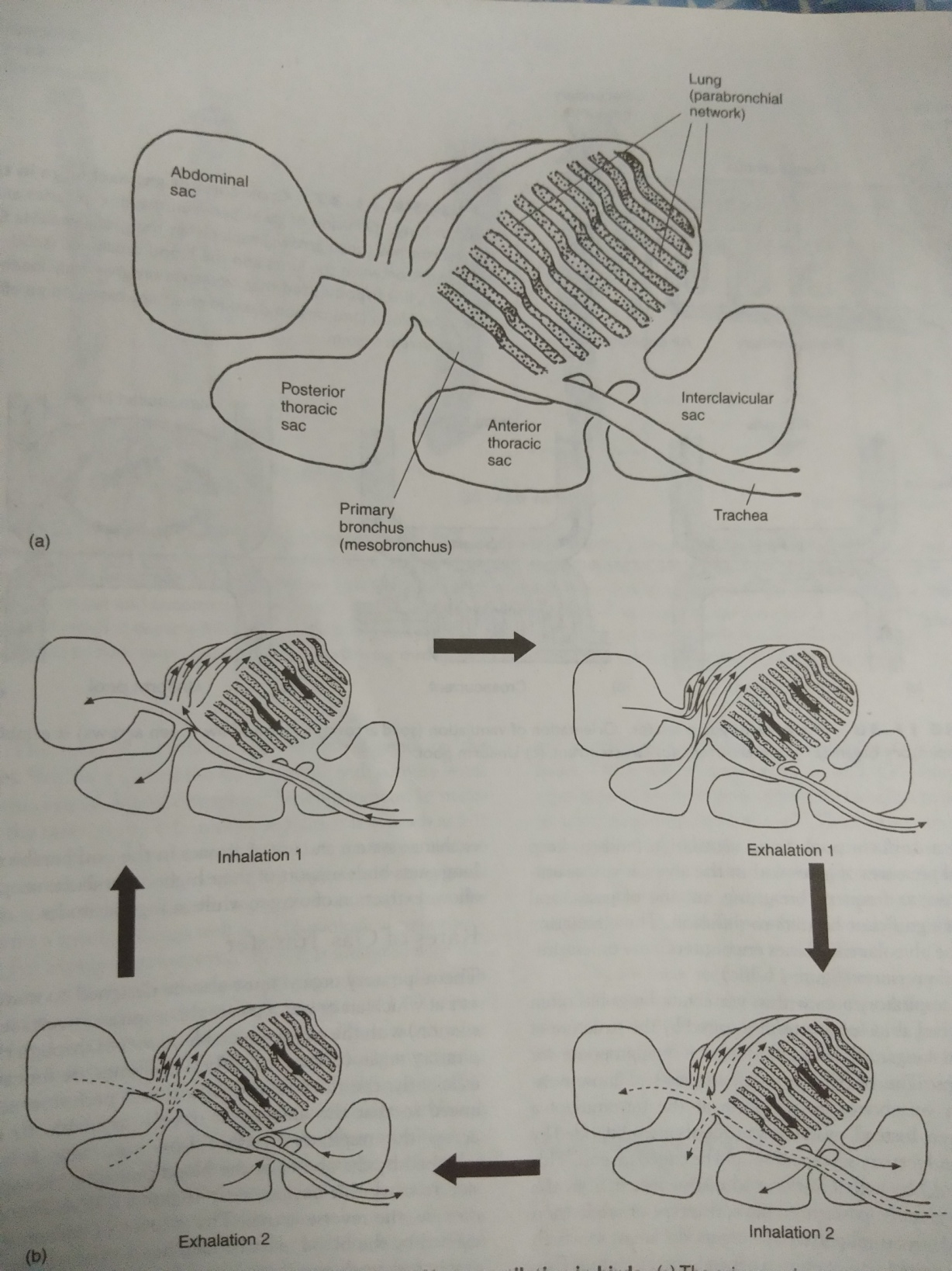
Lung ventilation in birds

Slide 28
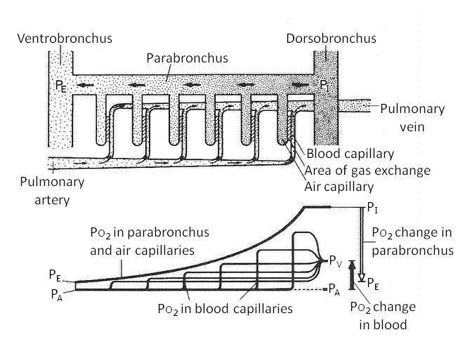
Lung ventilation mechanism in birds
Avian respiratory system includes anterior (interclavicular and ant.thoracic) and posterior (post.thoracic and abdominal) air sacs that connect to the parabronchi network of the respiratory tissue.
Movement of air in, through and out requires two cycles of inhalation/ exhalation.
Diffusion of gases between the air capillaries and the parabronchi replenishes the gas available for exchange between lungs and the blood capillaries.
Oxygen is progressively loaded into the blood (and carbon dioxide is deloaded) based on an efficient crosscurrent mechanism.

Slide 29
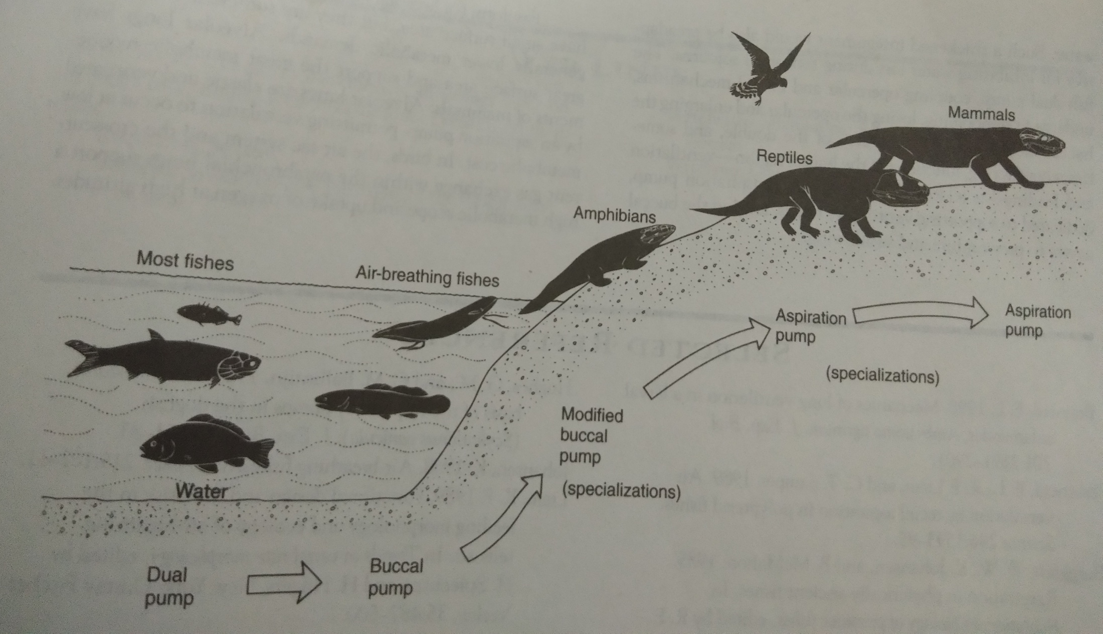
Evolution of ventilatory mechanism

