Slide 1
URINOGENITAL SYSTEM
COMPARATIVE ANATOMY ALONG PHYLOGENY

Slide 2
INTRODUCTION
Excretion and osmoregulation are two homeostatic processes performed by the kidneys and urinary ducts, which form the urinary system.
The genital system includes the gonads which generate gametes and the genital ducts that serve as passages for the gametes.
Embryonic origin and anatomical design of the urinary system and genital system are closely integrated.
Both the systems develops from the same segmental blocks of trunk mesoderm or adjacent tissues and share many of the ducts.
The gonads (testis and ovary) lie adjacent to the kidneys. These organs specially the testis tends to take over part of the tubules of the urinary structures as a conducting system for their products.

Slide 3
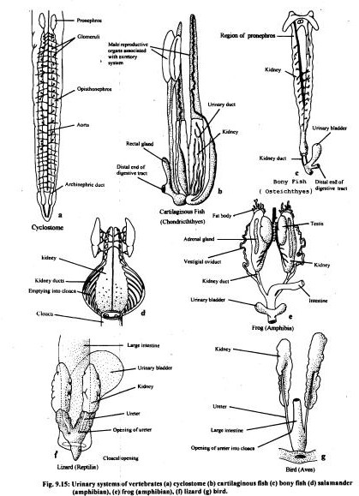
Variations in Urinary system along Phylogeny

Slide 4
GENITAL SYSTEM
The reproductive system and is made up of the gonads, gonoducts and genital openings.
Originates from mesodermal embryonic genital ridges (a thickening of the coelomic mesothelium), located medial to mesonephroi.
Primordial germ cells (progenitor of sperms and eggs) migrate into genital ridges and moves internal to peritoneum.
The ovaries and testes come to be attached to the dorsal body wall in cartilagillous and bony fishes and mesentery like bands of tissue, the mesorchium in the male and mesovarium in the amphibians while amniotes include the females.
The reproductive ducts, associated glands and intromittent organs are accessory organs that brings the germ cells of the primary sex organs for releasing outside.

Slide 5
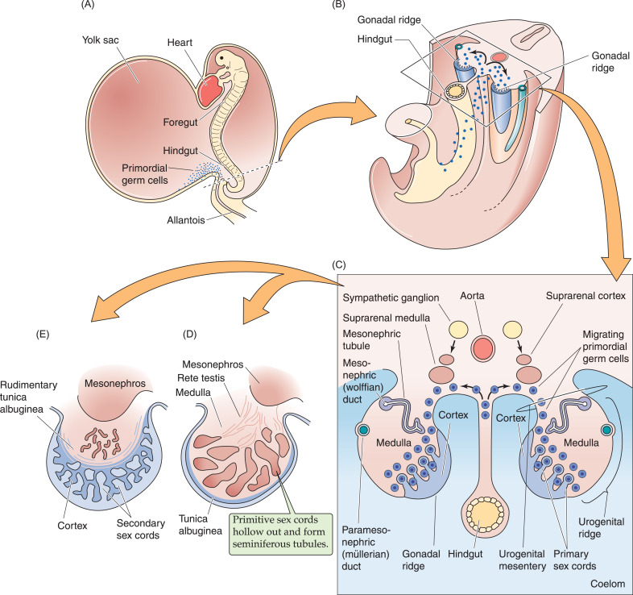

Slide 6
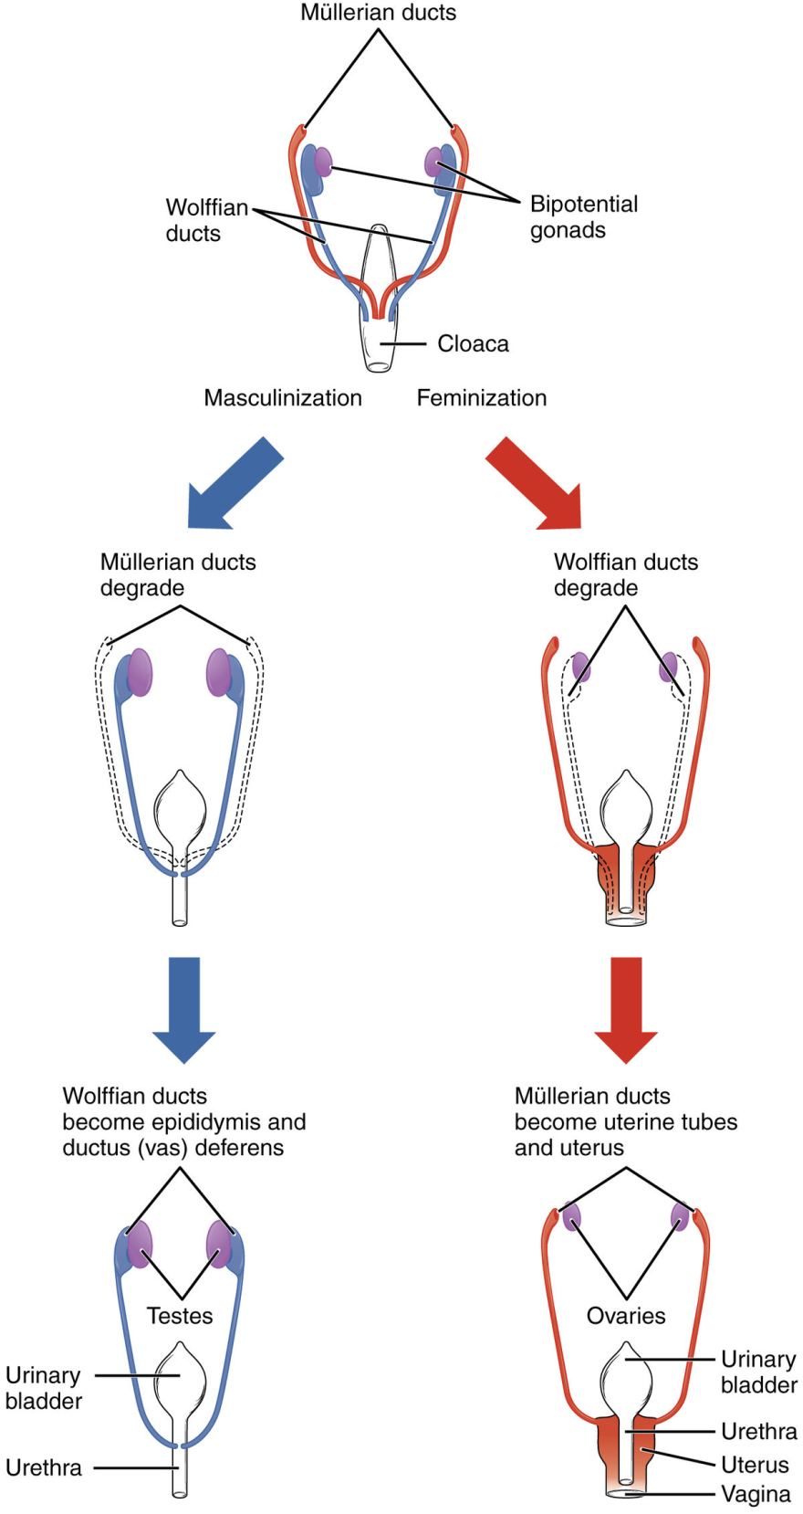

Slide 7
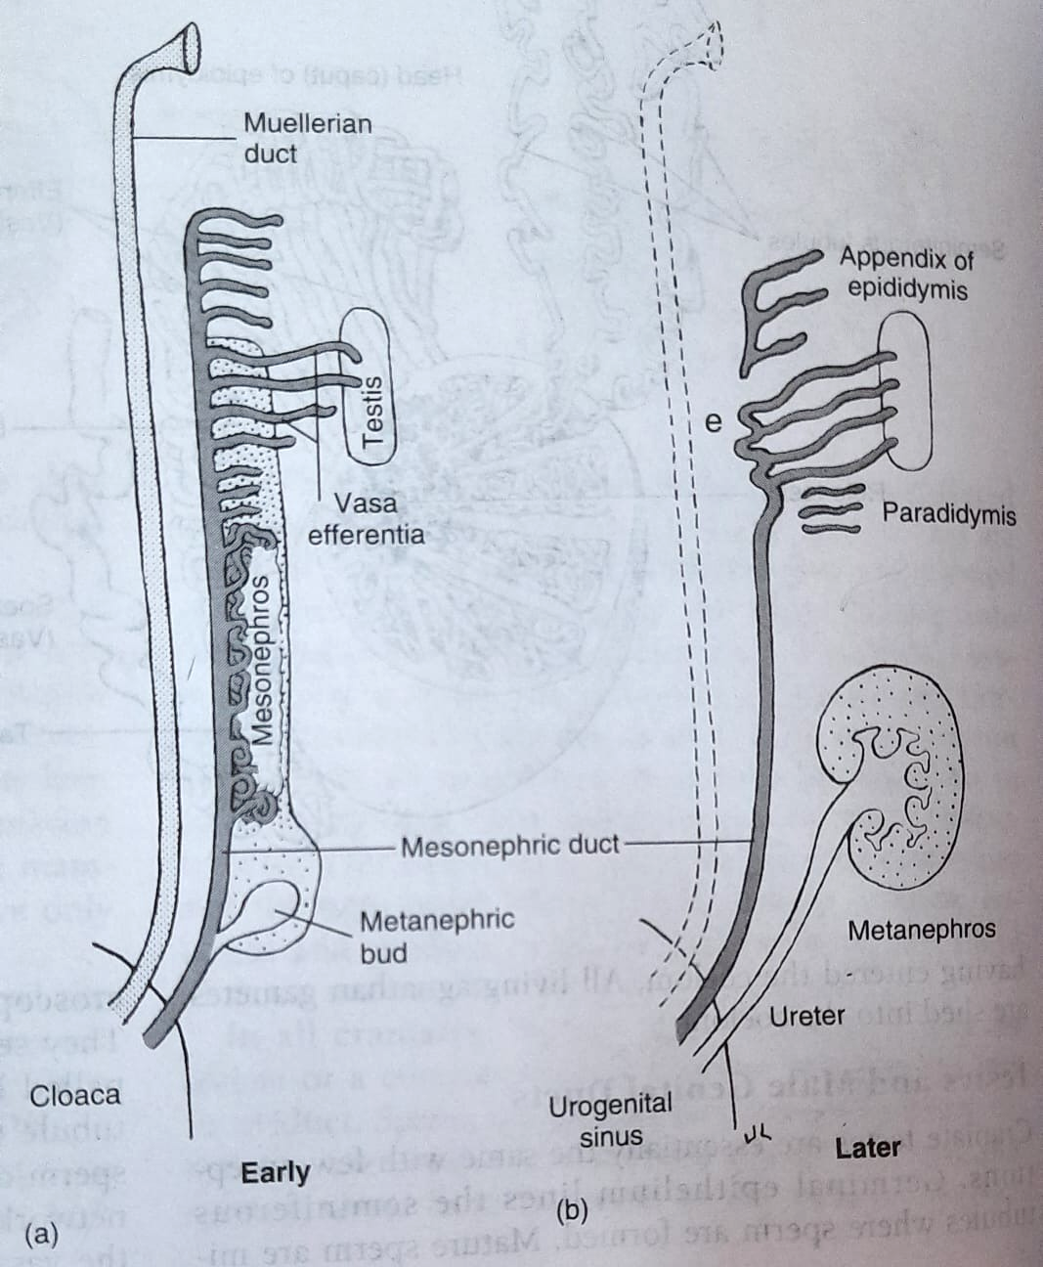
Developmental changes in Urinogenital System

Slide 8
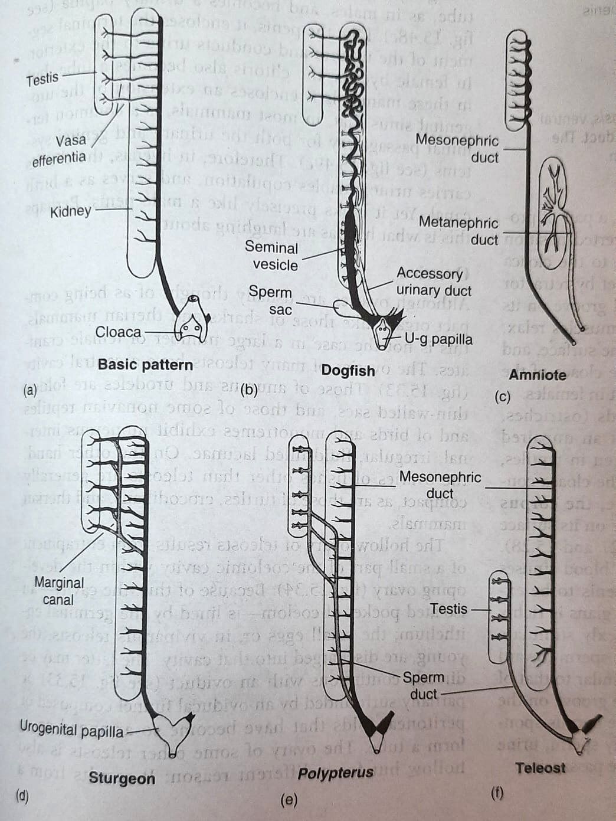
Mesonephric Duct as carrier of sperm and urine

Slide 9
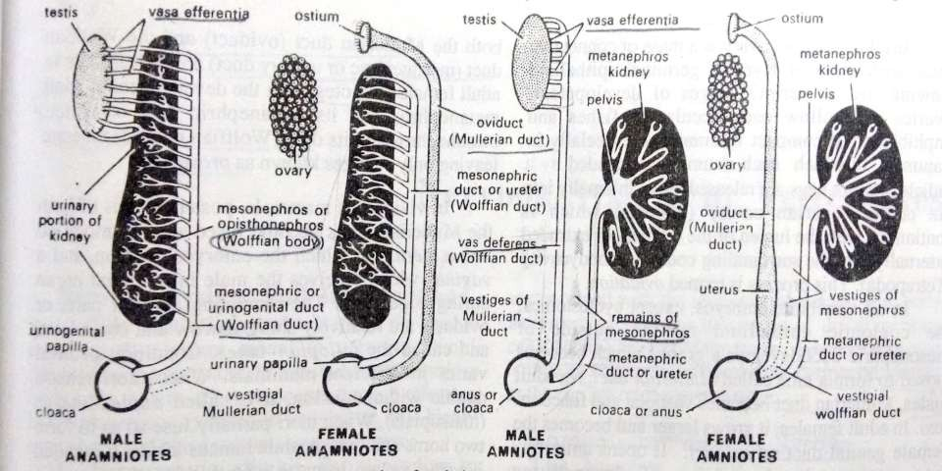
Evolution of Urinogenital ducts

Slide 10
Evolution of urinogenital ducts along phylogeny (cyclostomes)
No genital ducts present. Sperm are shed into the coelom and exit via abdominal pore.
In females also no presence of genital ducts.
The archinephric ducts drain the kidneys exclusively.

Slide 11
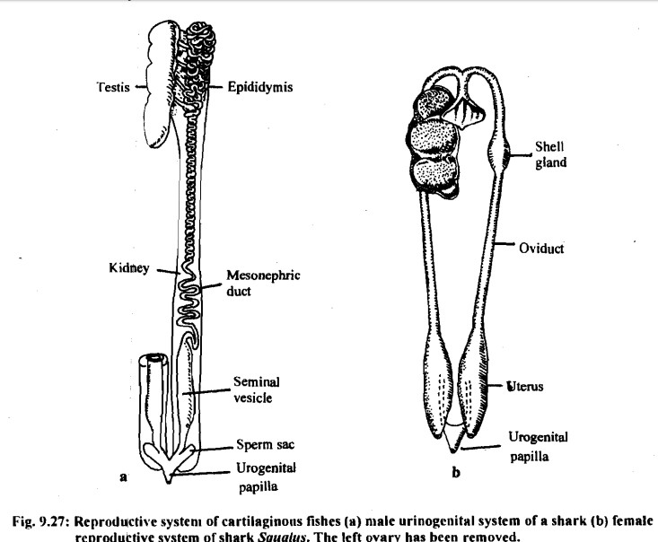
Evolution of urinogenital ducts along phylogeny (anamniotes)
Opisthonephros (or mesonephros) type of kidney has the anterior genital portion in males, some uriniferous tubules lose excretory function, form slender Vasa efferentia, and become continuous with seminiferous tubules of the adjacent testis. They serve to convey sperm of testis to the mesonephric duct of kidney.
Thus, in male anamniotes, mesonephric or wolffian duct forms a urinogenital duct, serving both as a vas deferens for sperm as well as a ureter for urine.
However, in many elasmobranchs (e.g. dogfish), accessory urinary ducts drain urine from kidney to cloaca so that the mesonephric duct serves entirely or mainly as a vas deferens.

Slide 12
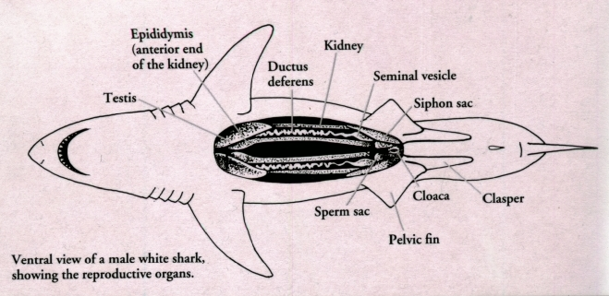
Evolution of urinogenital ducts along phylogeny (anamniotes)
The coelomic epithelium on the outside of mesonephric duct develops a groove which becomes closed to form a tube called Mullerian duct.
In adult females, the Mullerian duct grows larger and becomes the female genital duct or oviduct.
It opens anteriorly into coelom, in the region of degenerating pronephros, by a coelomic funnel or ostium, and terminates posteriorly into cloaca.

Slide 13
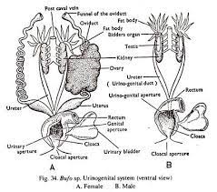
Evolution of urinogenital ducts along phylogeny (anamniotes)
In the embryos of Anura, each testis is made of two portions - the anterior portion disappear and the posterior portion becomes the adult functional testis.
In adult male toad, the anterior portion also persists as the Bidder's organ, containing large cells similar to immature ova.
Mullerian ducts function as oviducts as long and convoluted tubes.
Posteriorly each oviduct dialates to form uterus/ovisac that open independently into cloaca.

Slide 14
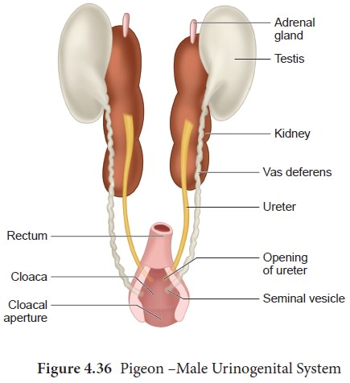
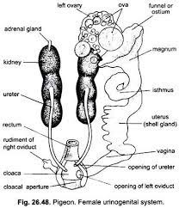
Evolution of urinogenital ducts along phylogeny (amniotes)
A metanephros develops as the adult functional kidney with its own urinary duct or ureter to transport urine.
Thus, mesonephric or Wolffian duct becomes solely a genital duct or vas deferens.
The remnants of embryonic mesonephros and a coiled portion of mesonephric duct become the epididymis of the adult kidney.
From each testis sperms pass first through epididymis, then through vas deferens to reach urethra.
Both the oviducts (Mullerian ducts) appear in the embryo but only the left grows and becomes functional in the adult. A vestige of the right persists attached to the cloaca. The left oviduct is a long, muscular, convoluted tubule.
The anterior end widens to form the oviducal funnel/infundibulum that serves to receive the ova released from the ovary.

Slide 15
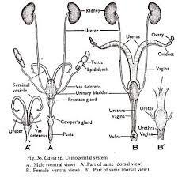
Evolution of urinogenital ducts along phylogeny (mammal)
Mammals have paired oviducts (Mullerian ducts). Each oviduct consists of anterior narrow Fallopian tube and a posterior wide uterus. The former opens into coelom by an Ostium bordered by fringed margins called fimbria/ fallopian funnel/ infundibulum.
The uteri terminate in vagina through cervix. However in monotremes, only the left oviduct is functional.

Slide 16
Fate of urinogenital ducts
Duct | Future modifications
Archinephric duct → Pronephric duct → Mesonephric duct (Wolffian duct) | Vas deferens in male genital system
Mullerian duct | Oviduct in female genital system
Metanephric duct | Ureter (urinary duct)

