Slide 1
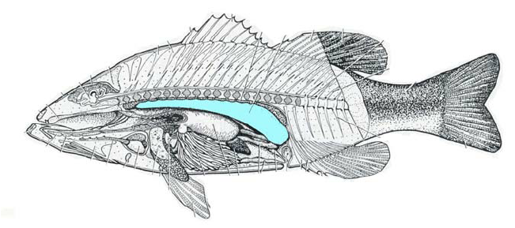
SWIM BLADDER- AN EVOLUTIONARY APPROACH

Slide 3
Problem of a fish in aquatic habitat:
Water density is nearly equal to 1, but density of fish muscle is more than 1.5 hence a fish sinks within water medium.
Resistance of movement is high due to more viscosity of water medium.
Solubility of dissolved gases in water varies with various factors like temperature, salinity, presence of aquatic plants etc.
Probable solutions:
Density of whole body is decreased or made equal to aquatic medium by developing coelom, air bladders, secreting oils within muscle layers, presence of fat- rich organs and livers etc. This lowering density provides buoyancy by upthrust to the fish within water.
Development of powerful myotome muscles and spines and associated fins with finrays ( modified flippers, fert)for rapid movement within water.
Development of extensive respiratory structures and accessory organs to assist in respiratory demand of gases.

Slide 4
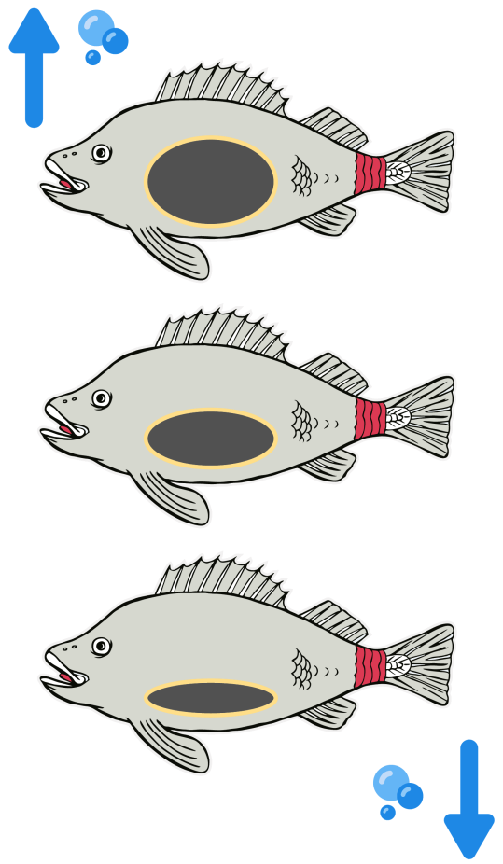
Biomechanics of Swimbladder
In the water, two forces act on a fish. The downward pull of gravity (due to weight) and the upward force of buoyancy (due to pressure of fluid). Buoyancy is the upward force exerted by the water on an object which is opposed by the weight of that object. The difference in the weight and force of buoyancy determines whether an object will float, sink, stay submerged in water.
Since fish has a density greater than that of water, it experiences a greater force of gravity that pulls it downward towards the ocean floor. In order to swim, the fish needs to reduce its density by increasing its volume while keeping the mass nearly the same. Fish achieve this by using swim bladder.
When a fish fills the swim bladder with oxygen, its volume increases without causing a significant rise in its mass. This reduces the density of the fish. The fish experiences a greater force of buoyancy that makes the fish move up in water. When a fish expels oxygen from the swim bladder, its volume decreases which makes the fish to sink. Fish can remain at a specific depth when the force of buoyancy is same as the force of gravity.

Slide 6
INTRODUCTION
Evolution of Vertebrates promoted various organs to develop or regress leading to misleading concepts. Swim bladder is one of such organ which claims to be the forerunner of tetrapod lung.
Most of the actinopterygian fishes possess a bladder (elongated sac) dorsal to the digestive tract.
Origin: Air sacs arises as an outgrowth from the oesophagus but showing great diversity in mode of development, structure and function in various fishes.
Only adult osteichthyans that do not have pneumatic sac or their ancestors probably have lost them are few marine teleost, bottom dweller flounders, Latimeria ( air sacs replaced by fat-filled organ for buoyancy) and one clade of tailed amphibian salamanders (Plethodontidae).

Slide 7
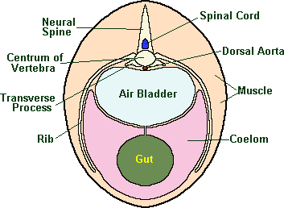
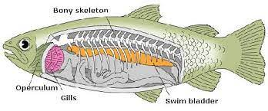
Swim Bladder
Swim bladder also known as air bladder or gas bladder is a
characteristic structure in most of the osteichthyes
It situated between the alimentary canal and kidneys and sac like in appearance, hence retroperitoneal.
It contain air and develop as a small outgrowth from wall of the
gut

Slide 8
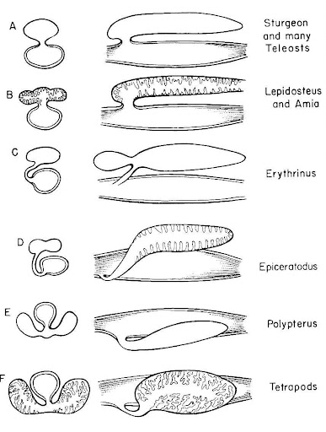
Structural Modification
In primitive bony fish, Polypterus it is in the form of bilobed sac having smooth wall. The right lobe is larger than the left and the two are joined at the proximal ends before opening into the pharynx by an aperture (glottis) provided with muscular sphincter.
In Lepidosteus (Holostei) the bladder is single elongated sac which open into gut by glottis. The wall of sac is not smooth but shows alveoli arranged in two rows.
In Dipnoi, Neoceratodus, Protopterus and Lepidosiren the bladder resembles the lung of an amphibian. The wall of bladder is highly vascular and shows numerous alveoli that are further divided into the smaller sacculi. Their bladder is modified for aerial respiration.

Slide 9
Structural Modification in teleost
Gas bladder is present in most teleost but it is absent in several order of fishes such as Pleuronectiformes, Echeneiformes, Giganturiformes, Saccopharyngiformes, Pegasifformes and Symbranchiformes
Teleost species in which bladder is present , it may be oval, tubular fusiform, heart shaped, horse-shoe shaped or dumb bell shaped
In Cyprinidae (Labeo, Cirrhinus, Catla) the air bladder is divided into two inter connecting chambers
In several sound producing fishes, the air bladder has finger like caecal outgrouth. In Gadus a pair of such caeca extend into the head region of the fish. In Otolithus, pair of short tubular caeca develop from the antero-lateral wall of the bladder and each further divides into two. One of which grows forwards and the other backwards. In Corvina lobata, several tubular appendages develop from lateral walls of the air bladder

Slide 10
Evolution of lung and swim bladder

Slide 11
Phylogenetic tree for evolution of lung and swim bladder

Slide 12
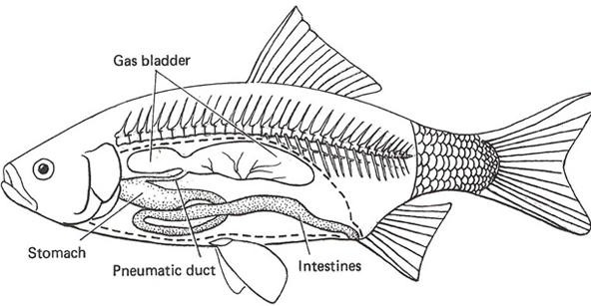
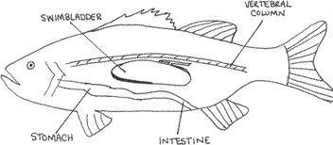
Physostomous and Physoclist bladder in Teleost
In physostomi telesost bladder open into gut by the mean of long pneumatic duct (open type swim bladder) eg: fishes belong to order Cypriniformes, Clupeiformes, Anguilliformes and Esociformes
In physoclisti teleost the pneumatic duct is absent (closed type swim bladder) eg: fishes belongs to order Gasterosteiformes, Mugilifomes, Notacathiformes and Acanthopterygii. Gas reabsorption structure called oval is present in physoclists only
Physostomous Bladder
Physoclist Bladder

Slide 13
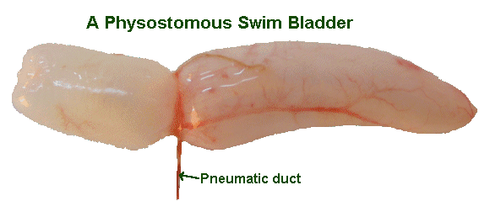
Blood supply in physostomus swim bladder
Air bladder is supplied with blood from dorsal aorta or from the branch of coeliaco-mesenteric artery. The deoxygenated blood is drained into the hepatic portal system or into posterior cardinal vein.
In species belonging to Cluppeidae or Salmonidae, there is uniform distribution of blood capillaries over the bladder wall and red bodies or red glands are not formed.
In cyprinidae blood capillaries are concentrated at one or more points on inner surface of bladder and formed red bodies of various shape
In physostomous fishes, the capillaries are covered by simple epithilium and the structure called red body

Slide 14
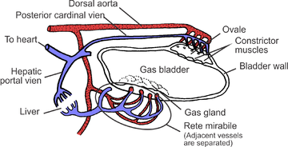
Blood supply in physoclists swim bladder
Inner epithelium of the swim bladder is mostly composed of metabolically active cuboidal cells, but the areas involved in reabsorbing gas from the swim bladder have squamous epithelium. The specialized secretory epithelium of the swim bladder is often called the “gas gland”
Capillaries transporting blood to and from the bladder forms dense bundle of capillary network where arterioles and veinuoles are in close diffusion contact is called rete mirabile
Distance between arterial and venous blood streams is about the same as the distance between air and blood in the human lung
In simplified terms, the rete mirabile is responsible for gas secretion into the swim bladder and the resorbent capillary network is responsible for removing gas from the swim bladder posterior chamber-oval.

Slide 15
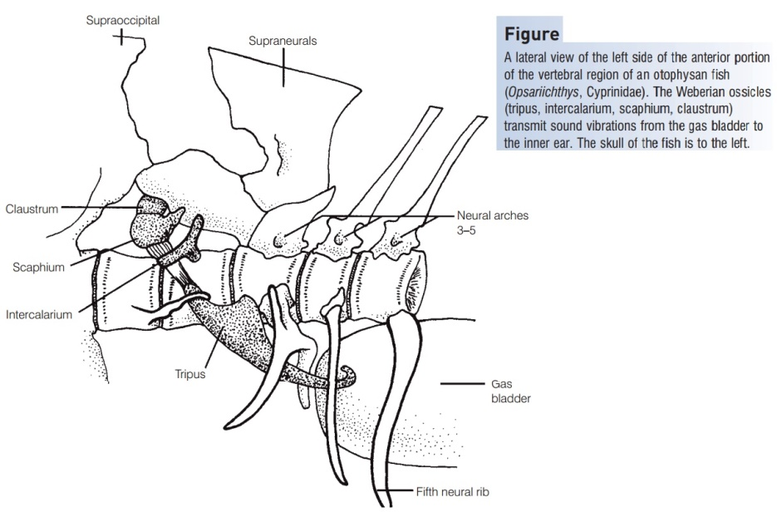
Function of Swim Bladder
Respiratory: In primitive bony fishes and Dipnoi, its act as main respiratory organ
Sound production: Act as a resonator for the sound produced by other organ as in Ballistidae and Triglidae
Auditory: In several fishes air bladder is connected with membranous labyrinth to the bony ossicles –Weberian ossicles that serves to transmit sound waves to the inner ear.
Sensory:Works as a pressure receptor like a barometer
Hydrostatic organ: Volume of gas in bladder increase or decrease to adjust the density of fish when it swim from one depth to another.

Slide 16
Gas secretion mechanism in Physoclist contd.
Blood entering the rete has the same pH and partial pressure of oxygen (P02) as arterial blood elsewhere in the fish’s body.
Venous blood in the rete is acidic and has high PO2. As the arterial blood encounters the venous blood in the rete, oxygen diffuses across its pressure gradient into the arterial blood causing the PO2 in the arterial blood to increase.
As blood circulates through the swim bladder, the PO2 is further increased by lactic acid secretion from swim bladder epithelium (“gas gland”) into the blood which acidifies the blood and causes gas to be less soluble. As PO2 increases in the blood circulating through the swim bladder, oxygen is secreted into the swim bladder lumen
This is a counter-current exchange system, in which acid and free oxygen in the blood leaving the bladder diffuses back into the less acidic blood entering the bladder.
Gas can be removed from the swim bladder by reabsorption into the blood. In reabosrptive areas, the swim bladder epithelium becomes squamous and gas can diffuse according to partial pressure differences

Slide 17
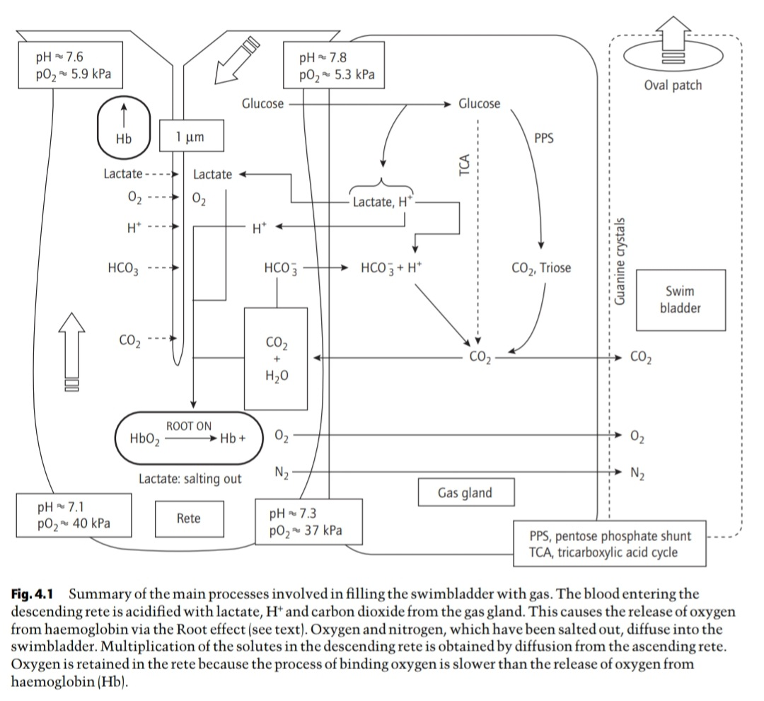

Slide 18
Water as a perfect medium for Sound Production and perception of sound in fishes
Water represents a good environment for distribution of sound due to its high density and low acoustoelasticity.
In water sound is characterised by slow attenuation and rapid distribution leading to appearance of acoustic field that are more extensive than in air.
Production of acoustic oscillations in water is less energy expensive than in air.

Slide 19
Sound production
Sonic pulses evolved due to sonic muscle contractions or dragging of bony structures against surfaces with complex microrelief.
Pulses differ in amplitude, acousti frequency and pulse duration.
Contraction of striated muscles attached to the swim bladder produces thumping sound.
Forcing air back and forth by pressure change between the air chambers of the bladder causes croaking or grunting sounds for communication.
Superficial adductor muscles present in pigmy gourami (T.pumilla) is located in pectoral girdle produces sound.
Grinding of teeth as stridulatory organ produce sound.

Slide 20
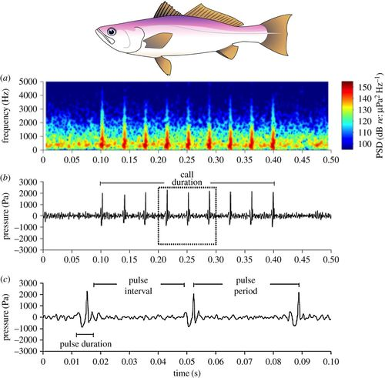
Fig: A single Gulf Covina calls comprising of nine pulses in the in the spectrogram.

Slide 21
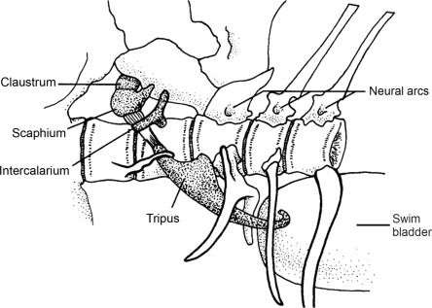
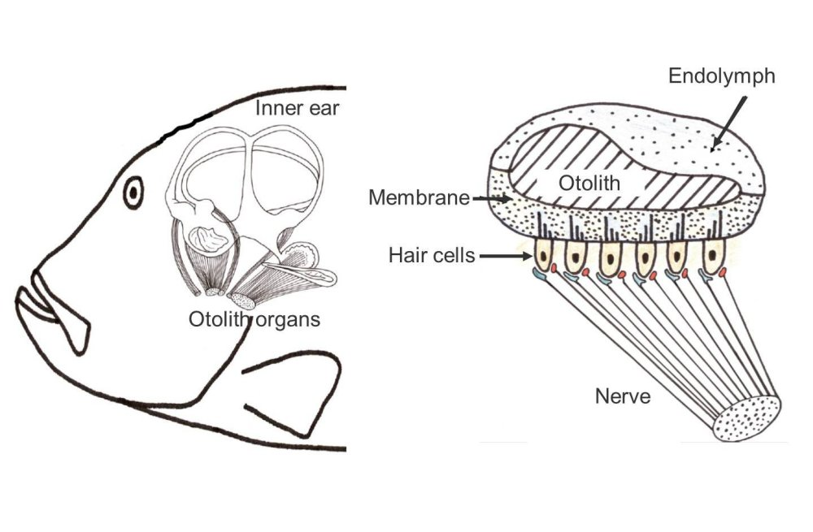
Sound perception in fishes
Swim bladder anterior chamber connected with the broad end of tripus which in turn is associated with a chain of ear ossicles in fishes leads to connect the inner ear sinus impar ( an extension of the perilymphatic space) with claustrum.
The chain of ear ossicles comprising of claustrum, scaphium, intercalarium and tripus for Weberian Ossicles in fishes especially in Cypriniformes.
Changes in the vibration pressure detected by the swim bladder or by sonorific muscles of the body which is conveyed through ossicles into inner ear for perception by otolith organ and endolymph of the inner ear.

