Slide 1
Trophic dynamics of the ecosystem
Who controls whom?

Slide 2
Components of the Ecosystem

Slide 3
Food chain
A linear network of interlinking of the feeding relationship between biotic components within an ecological community of an ecosystem.
It starts from producers and ends at an apex consumer species, detrivores or decomposers.
Each level of the food chain represents a different trophic level.

Slide 4
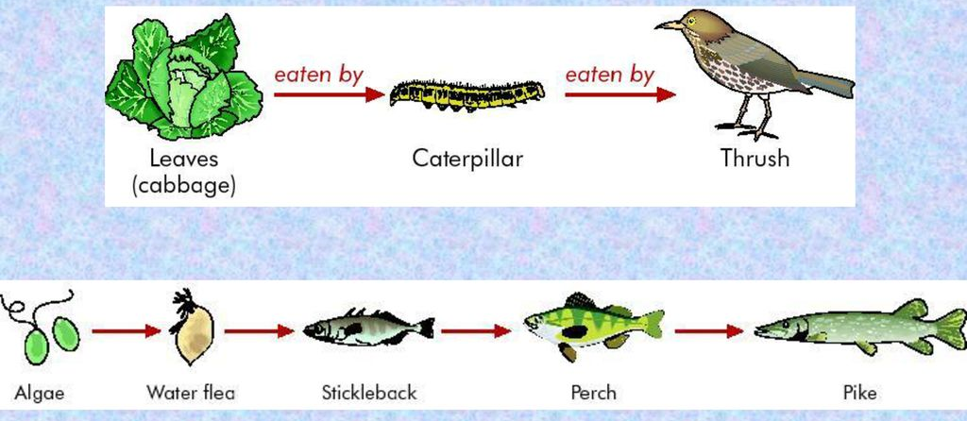
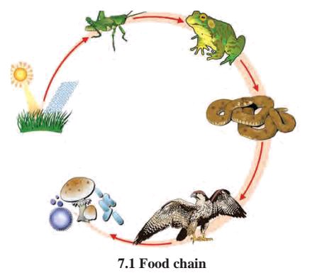
Length of food chain and its types
The length of the food chain are mostly limited to 4 to 5 links and food chains are not isolated but hooked together into food webs (food cycles).
Types:
Grazing food chain
Detritus food chain
Subtypes
Granivore food chain
Nectar food chain

Slide 5
Analysis on food chain
Idea of applying the food chains to ecology and to analyze its consequences was proposed by Charles Elton (Krebs, 2009).
At each transfer, a proportion (often as high as 80 to 90 percent) of the potential energy is lost as heat.
Shorter the food chain– or nearer the organisms to the producer trophic level– more energy available to the next consumers.
The quantity of energy transferred declines from one trophic level to another whereas the quality or concentration of energy transferred increases in each trophic level (Quantity goes down but quality goes up).

Slide 6
Ecological efficiencies
The ratios between energy flows at different points along the food chain when expressed as percentage gives ecological efficiencies.
The ecological efficiencies are important to determine and calculate the production efficiencies and growth efficiencies (assimilatory efficiencies) in any trophic level.
Net production efficiency= NPP/GPP x 100
Production efficiency= Production / assimilation x100
Ecological efficiencies vary depending on the species involved in the food chain of the ecosystem and ranges between 5-20%( 80-95% of the energy is used up in metabolism).
Hence pyramid of energy always show a diminishing size as trophic level increases.

Slide 7
Numbers overemphasize the importance of smaller organisms, and biomass overemphasizes the importance of larger organisms.
Energy flow provides a suitable index for comparing any and all components of an ecosystem.

Slide 8
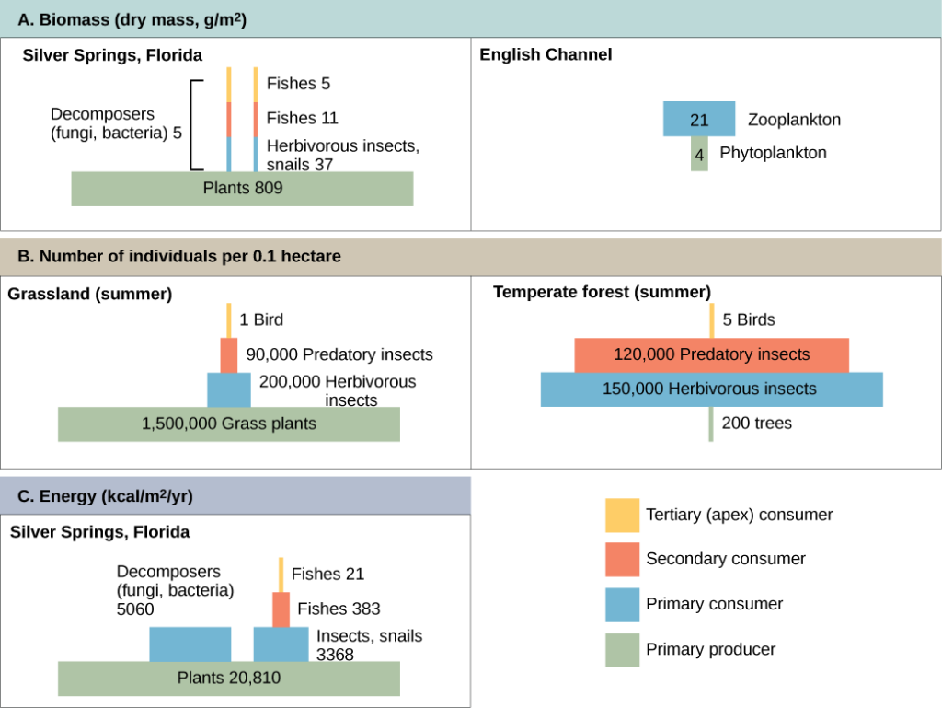
Experimental analysis by ecologists

Slide 9
Food web
Model of the interconnected foodchains or feeding relationships where the nexus is much complex within the ecological communities of an ecosystem.
It offers an important tool for investigating the ecological interactions that defines the energy flow and predator-prey relationship (Cain et al. 2008).
Food web comprises of both weak and strong interacting species (Pimm etal. 1991). For eg. The predator of a desert scorpion may be an owl, golden eagle or a kit fox.
Feeding interactions within a food web may have profound effects on species richness of community, ecosystem productivity and ecosystem stability( Ricklefs, 2008).
Food webs vary in different ecosystems and with changing resource utilizations.

Slide 11
Pelagic food web

Slide 12
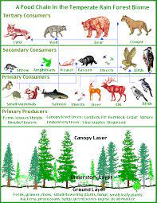
Food web varies according to realm or biome

Slide 14
Community composition regulates ecosystem stability and dynamics

Slide 15
Applications of food webs
Food webs describes the species interactions (direct relationships)
Food webs can be used to illustrate indirect interactions among species. Eg: Keystone predation demonstrated by Robert Paine in the rocky intertidal zone (Cain et al. 2008, Molles 2010). Case study 1.

Slide 16
Case study 1

Slide 19
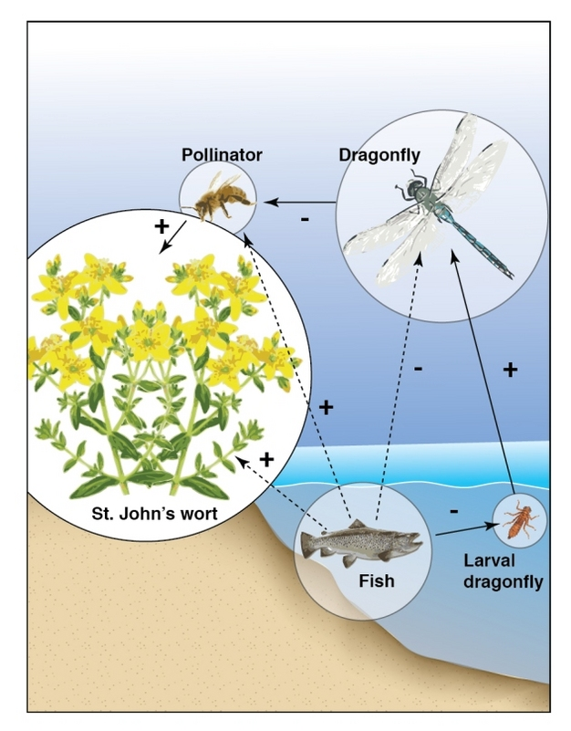
Case Study 2: Effect of fish in ponds on plant seed production (Knight et al. 2009)

Slide 20
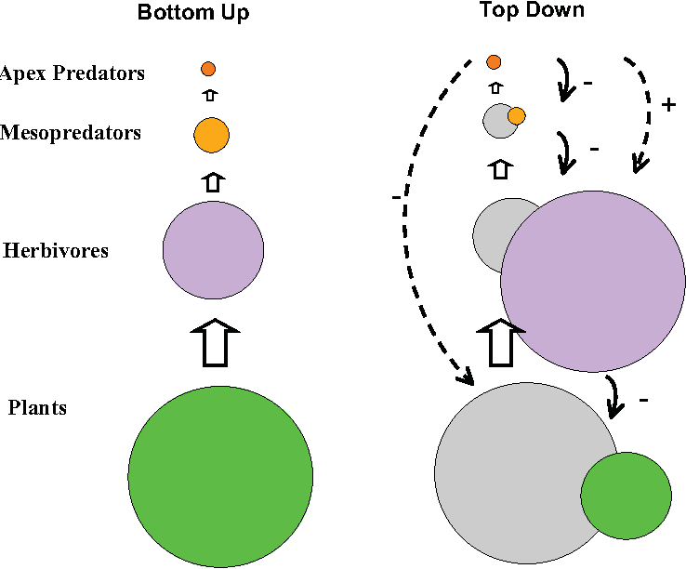
Food web used to study bottom-up and top-down control of community structure
The bottom-up model of community organization proposes a unidirectional influence from lower to higher trophic level.
In this case, presence or absence of mineral nutrients determines community structure, including abundance of primary producers.
The top-down model (trophic cascade model) proposes that top predators or consumers control energy flow or productivity from above.
In this case, the predators control herbivores which in turn control primary producers.

Slide 22
Overexploitation may cause top-down control of mangrove vegetation

Slide 23
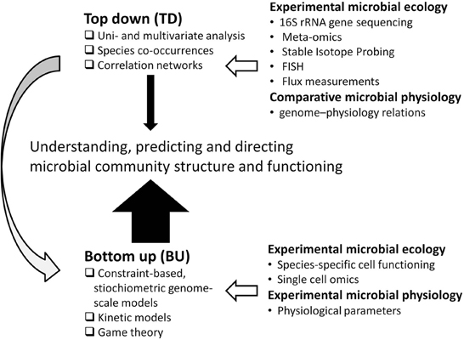
Experiments and analysis on trophic cascades

Slide 24
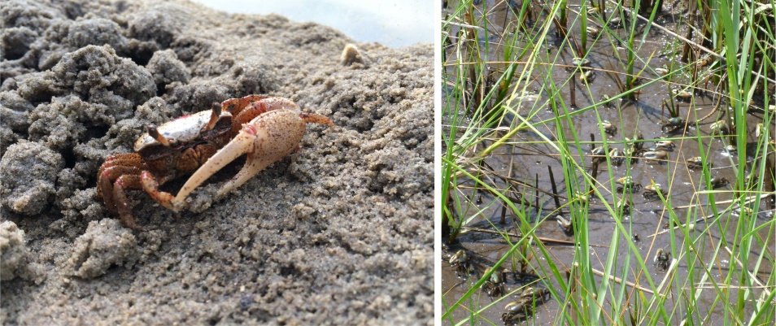
Role of heterotrophs in food web (Case study)
Food web involving prey-predator relationship may have positive or negative as well as mutualistic feedbacks.
Reward feedback- downstream organism(Consumers- herbivore or parasite) has a positive effect on the upstream organism(plant or host) of a food chain.
Eg: Bison and other herbivores grazing on N.American grasslands influences grass growths (Dyer et al, 1993,1995)
Fiddler crab (Uca sp) cultivate their food plant (algae and marsh grasses) by soil turbating or digging holes---increasing aeration and mineral cycling –better for plants root development and food pellets provide N2 fixing bacteria for nutrient recycling for plants availability.

