Slide 1
CRUSTACEAN LARVA

Slide 2
Characteristics
Crustacean taxon within the arthropods exhibit enormous animal diversity.
Varieties of animal larval forms are found which have chitinous exoskeleton that moults and transforms into other type to form adult.
Possess biramous appendages and mostly are free- living aquatic forms.
Shows both direct and indirect development through metamorphosis.

Slide 3
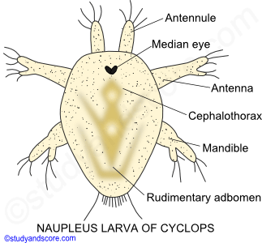
Nauplius larva
Simplest and commonest type of larva of marine crustaceans and melanocrustaceans.
Free swimming, oval body divisible into- head, trunk and anal regions.
Median front eye in the head (nauplian eye) present with three pairs of appendages
First pair of appendage unjointed, remaining two are biramous with antennules in the adults.
Locomotory organ- 1st pair of trunk appendages
2nd pair becomes mandibles which alongwith antenna becomes mouth parts.

Slide 4
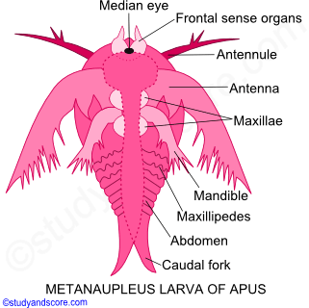
Metanauplius larva
Nauplius transforms into metanauplius by moulting and growth
Oval body transforms into cephalothorax and rudimentary abdomen and terminates into caudal fork.
Three pairs of appendages are associated with two pairs of maxilla and two pairs of maxilliped in adults
Some decapods, stomotopods begins life history with free swimming metanauplius larva
Seen in triops (Branchiopoda) and penaeus (malacostraca).

Slide 5
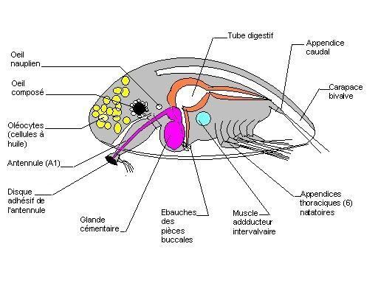
Cypris larva
Cirripedia (Lepas sp., Sacculina sp.) transforms into cypris stage.
Body enclosed into bivalve shell with a median and two compound eyes present.
Anterior antennae four jointed with characteristic disc present and posterior antennae absent.
Six pairs of biramous thoracic antennae present.
Short abdomen ends in a caudal fork.

Slide 6
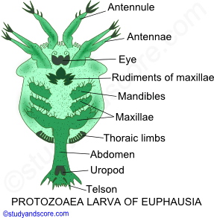
Protozoea larva
Marine prawns (Penaeus sp.) and sergestid decapods by nauplian growth and moulting, develops into protozoea larva.
Body divisible into broad segmented cephalothporax covered with carapace and unsegmented, slender abdomen with no appendages.
Body ends with a forked telson.
Single median eye present with appendages comprising antenna, antennules, mouthparts and 1st and 2nd maxillipeds.
Later moults into zoea larva.

Slide 7
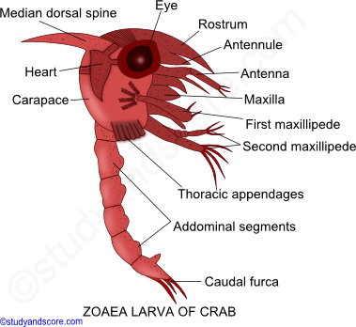
Zoea larva
All marine decapods except sergestids and peneids, hatching of larva takes place at zoea stage (as true crabs).
Broad cephalothorax with curved abdomen (helps in swimming) and ends into forked telson.
Head bears a dorsal, frontal and two lateral spines and one stalked compound eyes.
Rudiments of thoracic appendages present.
Biramous maxillipeds used for swimming.

Slide 8
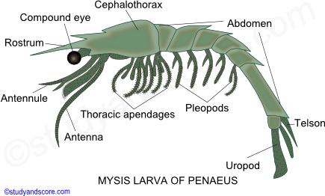
Mysis larva
Peneid decapods and lobsters, zoea metamorphosed into mysis or shizopod larva.
Body divisible into cephalothorax and six segmented abdomen ends into telson.
Five pairs of thoracic, biramous jointed appendages. Abdomen ends into biramous pleopods and a pair uropods and telson.

Slide 9
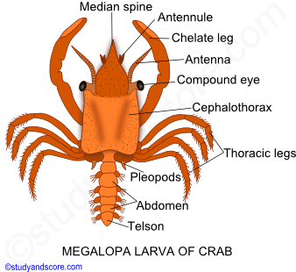
Megalopa larva
Brachyuran decapods metamorphose from zoea to megalopa larva.
Cephalothorax well developed and jointed thorax with five pairs of jointed appendages, helps in walking.
Large stalked eyes present and abdomen has functional swimmerets.
Abdomen with six pairs of pleopods and place straight in line with cephalothorax.

Slide 10
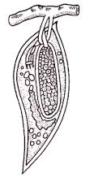
Kentrogen larva
Body sac like and elongated.
Undifferentiated mass of cells present inside the body.
Seen in parasitic form of arthropods like Sacculina sp. (cirripedia).

Slide 11
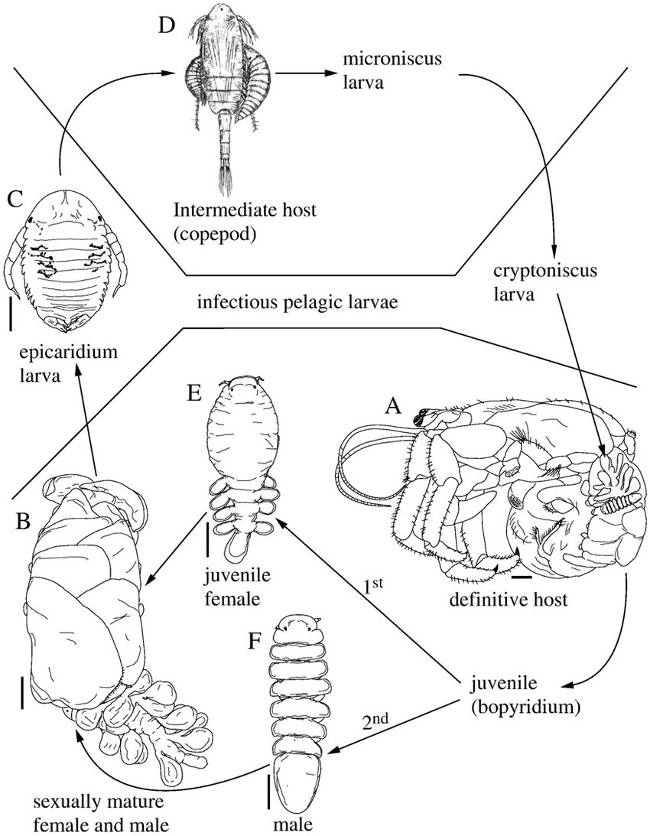
Epicardean larva
Two pairs of antenna prominent with one pair frontal processes and one pair mandibles present.
Six pairs of thoracic limbs.
Abdomen bears six pairs of biramous pleopods.
Epicardian larva transforms into cryptonisean larva, found in parasitic isopods.

Slide 12
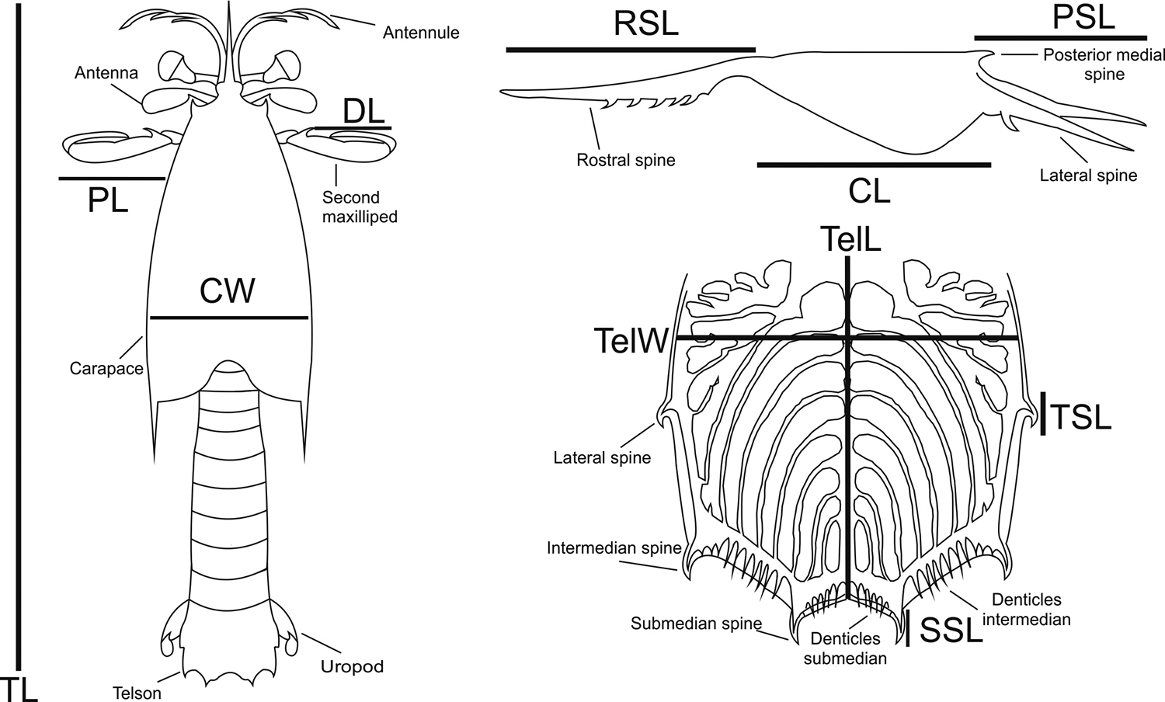
Erichthus larva
Body divisible into cephalothorax and abdomen
Anterior thoracic limbs three pairs are reduced.
Found in stomatopods (meta crustacea).
Develops from erithodina larva.

Slide 13
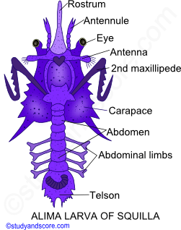
Alima larva
Modified form of zoea, found in melano-crustacea (Squilla sp.) after hatching from eggs.
Bears short, broad carapace.
It has all cephalic appendages but has first two thoracic legs.
Six segmented abdomen with 4 to 5 paired pleopods.
Differs from zoea in having 2nd maxilliped and armature of telson.

Slide 14
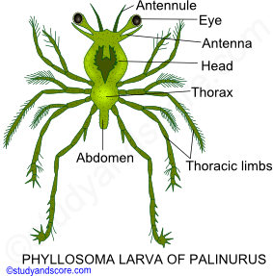
Phyllosoma larva
Larva of palinurus, spiny crab or rock lobster
It is a modified mysis stage marked with large, leaf-like, flattened, delicate and glossy body.
Body distinguished into head, transparent thorax and abdomen.
Compound stalked eyes and six paired thoracic appendages present.
1st maxilliped rudimentary, 2nd uniramous, 3rd well formed biramous and successive 4th, 5th and 6th paired long biramous legs present.
Abdomen limbless.

Slide 15
Sequence of larval appearance
Nauplius larva appears in branchiopoda, cladocera, ostracoda and in copepoda.
In cirripedia nauplius is followed by cypris stage that transformed into adult.
In Sacculina after cypris, kentrogen develops.
In Euphausia nauplius metamorphose into protozoea and calyptopis before passing to adult.
In Penaeus larva pass through nauplius, protozoea, zoea and mysis stages before becoming adult.
In crabs larva transform from zoea to megalopa and then adult.
In Palinurus , larva hatches out to modified mysis stage which then transform into phyllosoma larva.

Slide 16
Significance
According to the biogenic law of Haeckel, every organism during its embryonic development (ontogeny) repeats some evolutionary history (phylogeny).
Due to the occurrence in development, nauplius is regarded as the ancestor of crustacea.
Other forms of crustacean larva (zoea, megalopa etc.) shows stages of development of higher crustaceans from nauplian -like ancestors.
Larval stages are important to find homologies and affinities among various groups.
Animals passing through similar stages are closely related.
Larva are helpful in wide distribution of species and in keeping the food reserves of eggs to minimum.

