Slide 1
Heterochromatin, Polytene and lamp-brush chromosomes
Dr. Ajoy Mallik
Assistant Professor
Department of Zoology
Ramakrishna Mission Vivekananda Centenary College

Slide 2
Heterochromatin: Types, organization, formation and significance
It is the structural form of DNA which is found in the periphery of the nucleus as opposed to euchromatin which is found in the inner body of the nucleus.
It is a part of chromatin which is densely packed – as opposed to euchromatin, which is lightly packed.
The term heterochromatin and euchromatin was coined by Emil Heitz in 1928 who found heterochromatin as densely stained part of the chromosomes.
The heterochromatin has variable forms, such as constitutive heterochromatin and facultative heterochromatin.
Only 10% of the genome though to be present as heterochromatin; rest is euchromtin.
It is epigenetically marked by specific histone modifications.
Compact nature of heterochromatin makes it inaccessible to the proteins which are involved in the gene expression.
It is transcriptionally silent part of the chromosomes mostly located at the centromeric and telomeric regions.
Compact nature of heterochromatin makes it protected from crossing over during cell division.

Slide 3
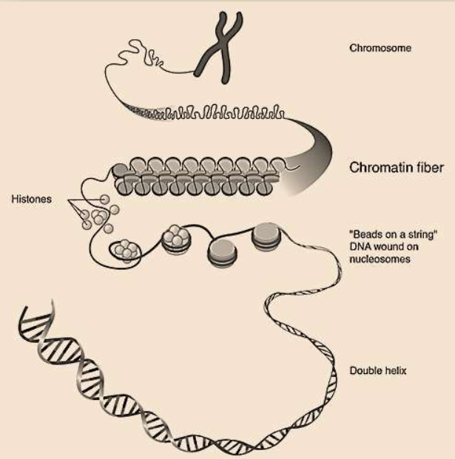
What is chromatin?
As the term suggests, it is complex of DNA and protein (nucleoprotein) within the nucleus of eukaryotic cells (Greek – Chromos meaning ‘coloured’, tene meaning ‘ribbon’).
It looks like threaded structure or beads on a string (string of nucleosome and linker DNA fragments).
It makes the entire chromosome.
It is categorized into base on the compactness in the chromosome, i.e., euchromatin and heterochromatin.
Greek, ‘eu-’ means good, well or true; ‘hetero-’ (English) means different.

Slide 4
What is euchromatin?
❑ Euchromatin is the tightly (lighter than heterochromatin) packed chromatin fiber that is rich in gene concentration.
❑ Euchromatin represents transcriptionally active part of the chromosomes.
❑ Being transcriptionally active is due to the loose wrapping or light condensation of nucleoprotein so that the DNA is easily accessed by the proteins involved in the transcription.
❑ It is simple chromatin fiber of nucleoprotein complex which appears as an elongated open 10mm microfibril as noted from electron micrograph.

Slide 5
Packaging of DNA molecules into chromatin
Double-stranded helical DNA (first illustration) is coiled around histones, forming nucleosomes (second illustration)
Nucleosome constitute the euchromatin or beads-on-a-string structure (third illustration).
Euchromatin is further condensed into heterochromatin or 30-nm fibers (fourth and fifth illustrations).
The last four illustrations depict more tightly condensed DNA in the form of active and metaphase chromosomes.

Slide 6
Structure of heterochromatin
Heterochromatin mainly consists of genetically inactive satellite sequence where many genes are repressed, while many can’t be expressed.
Both centromere and telomere are heterochromatic, as is the Barr body of the second, inactivated X-chromosome in a female.

Slide 7
Types of heterochromatin
Heterochromatins are mainly of two types; constitutive heterochromatin and facultative heterochromatin.
Constitutive heterochromatin
❑ Constitutive heterochromatin is the stable form of heterochromatin, i.e. it does not loosen up to form euchromatin
❑ It contains repeated sequences of DNA called satellite DNA.
❑ It can be found in centromeres and telomeres and throughout the chromosomes in meager amount as well.
❑ It is made of satellite DNA and is usually involved in structural functions.
Facultative heterochromatin
❑ Facultative heterochromatin is reversible, i.e. its structure can change depending on the cell cycle. It may convert to euchromatin..
❑ It is characterized by the presence of another kind of repeated DNA sequences known as LINE (long interspersed nuclear element) sequences.
❑ Example is the inactivated X-chromosome (Barr body) of females.

Slide 8
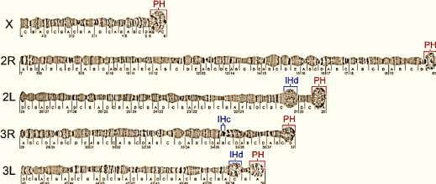
Intercalary heterochromatin
Intercalary heterochromatin consists of extended chromosomal domains which are interspersed throughout the euchromatin.
It is basically a constitutive heterochromatin that contain silent and or permanently repressed genetic material.
It is comparable to that of classic pericentric heterochromatin which are represented by high compaction, late replication and underreplication of genomic material.
It also comprises either clusters of functionally unrelated genes or tandem gene duplications.
It can be easily visualized in the polytene chromosome.
The pericentric and intercalary heterochromatin of polytene chromosomes . PH – pericentric heterochromatin, IHc – compact intercalary heterochromatin, IHd – diffuse intercalary heterochromatin.
Sharakhova et al. 2010, 11:459

Slide 9
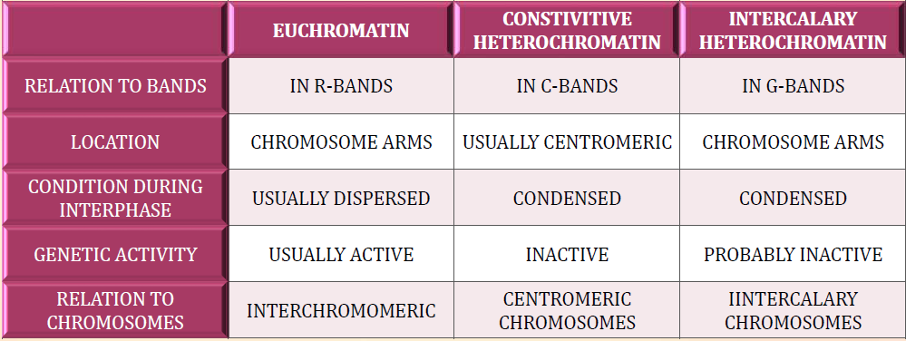
Difference between euchromatin and heterochromatin

Slide 10
Functions of heterochromatin
It plays an indispensable role in organization of nuclear domains.
HC is usually localized in the periphery of the nucleus and is attached to the nuclear membrane. In contrast, the active chromatin occupies a more central position.
It plays an important role in centromere.
HC is necessary for the cohesion of sister chromatids and that it allows the normal disjunction of mitotic chromosomes.
It has profound role in gene repression or epigenetic regulation.
Heterochromatin appears to be involved in controlling the transcriptability of the genome. Genes that are usually located in the euchromatin can, therefore, be silenced when they are placed close to a heterochromatic domain.

Slide 11
Polytene chromosome-Introduction
Polytene chromosomes are giant interphase chromosomes with several DNA strands placed side by side.
They are first observed by E. G. Balbiani in 1881 in squash of salivary gland cells of Chironomous larvae, hence also known as salivary gland chromosome or giant chromosome.
They are strongly amplified form of interphase chromosomes that are commonly seen in salivary glands of dipteran species, e.g. Chironomus larva, Drosophila melanogaster larvae, Sciara, Rhyncosciara, etc.
They are also found in various other tissue in the larvae of dipteran, such as midgut, rectal and Malpighian tubules as well as in several species of protozoans and plants.
They are many times larger than the normal chromosomes reaching a length of 200μm and are visible even under a compound microscope.
The enormous size is due to the duplication of chromonema which do not separate.
Non-separtion of chromonema results in presence of many strands and therefore, it is known as polytene chromosome.
Sutton worked on polytene chromosomes of Anopheles mosquitoes.
Riandian worked on polytene chromosomes of Tse-tse fly.

Slide 12
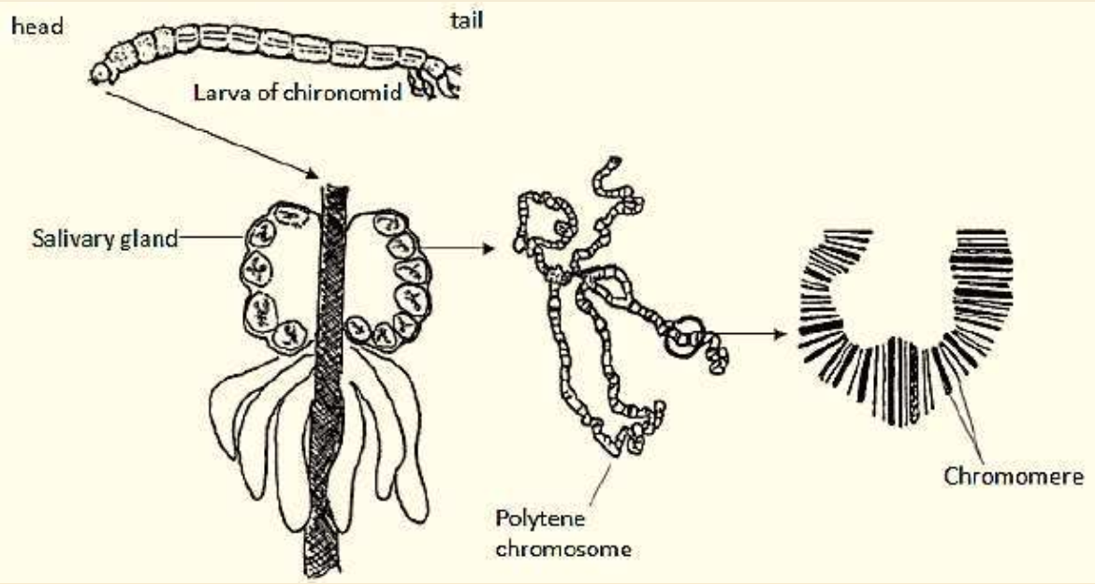
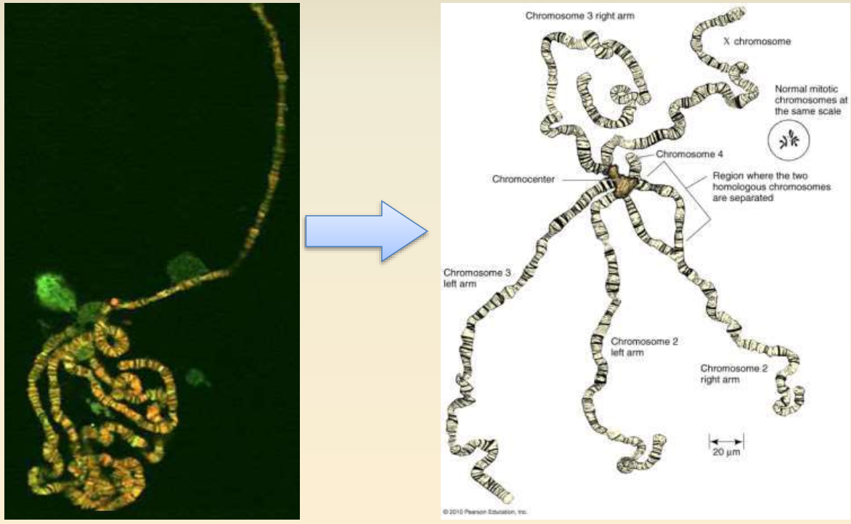
Morphology of polytene chromsome
It is seen in the nucleus during interphase.
It is a giant chromosome with 5 long and 2 short arm radiating from a central point called chromocentre. It is 2000 μm in length (7.5 μm in somatic cells).
Chromocentre is formed by the fusion of centromeres of all the chromosome (2n = 8 in Chironomus & 2n = 4 in Drosophila) found in the cell.
Out of 6 arms, the short arm represents the fused IV chromosome.
The II chromosome is the longest and is metacentric, with seven weak spots.
The longest represent the fused sex chromosome.
It shows linear series of alternating bands and integrands which are species specific.

Slide 13
Morphology of polytene chromsome
It has 6 radiating arms from chromocentre (5 long and 1 short arm) as described below:
I. X-chromosome (longest arm) (Y chromsome is fused with chromocentre in male and usually not seen as separate strand)
II. 2R (II-chromsome Right arm)
III. 2L (II-chromsome Left arm)
IV. 3R (III-chromsome Right arm)
V. 3L (III-chromsome Left arm)
VI. IV-chromosome (Shortest arm)
Chromatin of polytene chromsomes are stained in banded pattern. The chromatin in darkly stained band is more condensed than lightly stained interbands.
The dark bands represents heterochromatin region which have no gene or permanently repressed genes, while lightly stained regions contain genes(euchromtin)
About 80% of the DNA is located in bands & about 15% in interbands, that means only 15% of DNA is genetically active.
It was Painter (1933) & Bridges (1936), who showed that in Drosophila the bands are associated with genes.
In Drosophila, 5000 bands have been found in the 4 chromosomes of salivary gland cells. It was established by Bridges in ~1936 by constructing salivary gland chromosome map of D. melanogaster.
Dark bands have a high DNA content & absorb U.V light.

Slide 14
Why it is so giant?
It is 1000 times larger than other somatic chromosomes and as long as 0.5mm, and up to 20mm in diameter looking giant.
The larger size of the chromosomes is due to the presence of many longitudinal strands called chromonemata.
Hence they are also called Polytene chromosomes (many threaded).
The many strands of the giant chromosomes are due to repeated division of the chromosome without the cytoplasmic division/mitosis. This type division is called endoreduplication or endoreplication.
Drosophila chromosomes has been replicated through 10 cycles without separation of the daughter chromosomes, so that 1024 (= 210) identical strands of chromatin are lined up side by side.
Polytene homologues are held together by somatic pairing.
The centromeres of all four chromosomes aggregate to form a chromocentre that is seen amorphous and consists largely of heterochromatin.

Slide 15
Polytenization
It is the process of making multiple copies of chromosomes without the segregation and cell division.
It occurs when the DNA repeatedly replicates, but the daughter chromosomes do not separate – no karyokinesis.
The result is an enlarged chromosome composed of many parallel copies of itself .
The amplification of chromosomal DNA greatly increases gene copy number, presumably to supply sufficient mRNA for protein synthesis in the massive salivary gland cells.

Slide 16
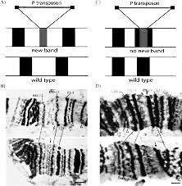
Banding pattern of polytene chromosomes
The Polytene chromosome contains two types of transverse bands, namely dark bands and inter bands.
The dark bands are darkly stained and the inter bands are lightly stained with nuclear stains.
The dark bands contain more DNA and less RNA.
The inter bands contain more RNA and less DNA.
Since the bands can be recognized by their different thicknesses and spacings, each one has been given a number to generate a polytene chromosome "map."
The bands in Drosophila polytene chromosomes represent 50,000–100,000 base pairs.
There are approximately 5000 bands in the total Drosophila genome.

Slide 17
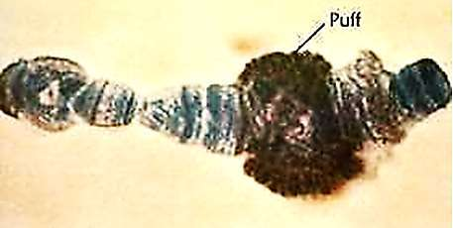
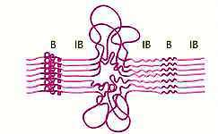
Chromosomal puffs or Balbiani Rings
The bands of Polytene chromosomes become enlarged at certain times to form swellings called puffs or Balbiani rings. The formation of puffs is called puffing.
In the regions of puffs, the chromonemata uncoil and open out from many loops. Thus puffing is caused by the uncoiling of individual chromomeres in a band.
The puffs indicate the site of active genes when mRNA synthesis takes place.
Several factors hold sister chromatids together, including topological entanglement caused by DNA coiling, under-replication in some species and cell types, somatic pairing in Diptera and possibly in some ciliates, and cohesin complexes.
In order to separate polytene chromosomes into individual strands, condensins are required.

Slide 18
Functional stages in polytene chromosome
Polytene chromosomes form structures that correlate with the functional state.
During the larval development of drosophila, a series of expansions (puffs) appear in temporal stages in the polytene chromosomes.
Chromosome puffs are decondensed, expanded segments that represent active chromosomal regions, i.e., regions that are being transcribed.
The location and duration of the puffs reflect different stages of larval development.
The incorporation of radioactively labeled RNA has been used to demonstrate that RNA synthesis, a sign of gene activity (transcription),occurs in these regions

Slide 19
Function of polytene chromosomes
Increasing the volume of the cells' nuclei and causing cell expansion.
Metabolic advantage as multiple copies of genes permits a high level of gene expression.
In Drosophila melanogaster, the chromosomes undergo many rounds of endoreduplication to produce large amounts of glue before pupation.
There is tandem duplication of various polytene bands located near the centromere of the X chromosome which results in the Bar phenotype of kidney-shaped eyes.
Because polytene chromosomes are interphase chromosomes, and are therefore transcribed.
Thus it provides opportunity to study transcription by direct observation, and transcriptional responses to specific stimuli can be observed.

Slide 20
Lampbrush Chromosome Introduction
Lamprush chromosome is a greatly enlarged chromosome that has apparently filamentous granular loops extending from the chromomeres.
It is a largest chromosome found ever and is a characteristic of vertebrate oocytes.
It was first reported by Flemming in 1882 in Salamander (Amblystoma maxicanum, an amphibian) eggs. However, the name lampbrush was given by Ruckert in 1982.
The lampbrush name is given because of its similarities in appearance to the brushes used to clean lamp chimneys at that time.
It is found in oocytes of birds, lower vertebrata and invertebrates during the prolonged prophase of the first meiotic division. It is also found in plants.
It is found in diplotene stage of prophase I and is meiotic bivalents, each consisting of two pairs of sister chromatids.

Slide 21
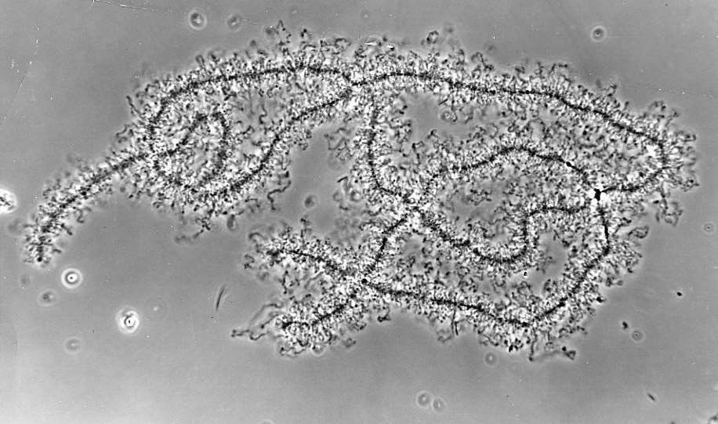
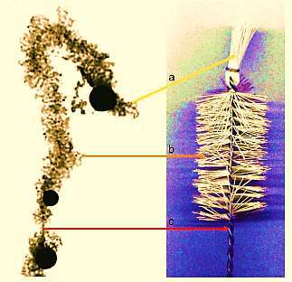
Morphology of Lampbrush chromosome
In the early prophase, lampbrush chromosome (LBC) is a bivalent that consists of two pairs of conjugating homologues, forming a tetrad.
Each chromatid is composed of alternatively positioned regions of condensed inactive chromatin (visible as dark irregular structures) and side loops of decondensed chromatin.
In the homologous sections of the bivalent, chromatin is condensed (spirally twisted) or decondensed in the form of side loops – two per each chromosome and four at the level of the bivalent.
The loops of a paired chromosome form mirror-image structure.
The loop constitutes a part of the chromosome axis. It is extensible as well as contractible.
This stage can last several months to several years.
It is 400 ± 800μm long as opposed to as the most 15 ± 20 μm during later stages of meiosis.
Thus the lampbrush chromosomes (LBCs) are ~30 times less tightly packed.
The total length of the entire chromosome is 5 to 6mm and is organized into ~5000 chromomeres (thickenening on the chromosome axis).

Slide 22
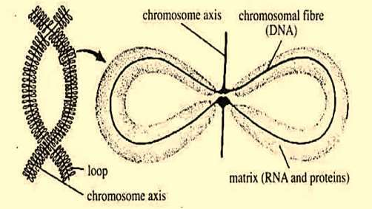
Morphology of Lampbrush chromosome
They are composed of a main axis having two chromatids. Main axis has a row of granules known as chromomeres, which are held together by the axial fibres.
The lateral loops in pairs project from the chromomeres and are transcriptionally active.
The contractibility of the loop results in the contraction and dilation of the chromomere.
Each chromosome of a pair has several chromomeres distributed over its length; from each of a majority of the chromomeres generally a pair of lateral loops extends in the opposite directions perpendicular to the main axis of the chromosome.
In some cases, more than one pair, even up to 9 pairs of loops may emerge from a single chromomere. About 1 to 9 loops of variable size may arise from a single chromomere.

Slide 23
Loops of Lampbrush chromosome
The pairs of loops are produced due to uncoiling of the two chromatin fibers present in a highly coiled state. The loops are always asymmetrical.
The centromere of the chromosomes have no loops.
About 10,000 loops per chromsome set or haploid set are found.
The size of loops varies with an average of 4 -5μm in interchromomeric fibres.
About 5 -10% of DNA exists in the lateral loops, the rest being tightly condensate in the chromomeres which are transcriptionally inactive.
The loop’s size increases with the size of genome.
Each loops has an axis made out of single DNA molecule that is unfolded from the chromosome during RNA synthesis.
Uncoiling or formation of loops makes the DNA exposed and available for transcription of gene.
The number of pairs of loops gradually increases in meiosis till it reaches maximum in diplotene.
As meiosis proceeds further, number of loops gradually decreases and the loops ultimately disappear.
Disappearance of loops is due to reabsorption back into the chromomere.
Actin filaments are seen involved in extending the loop away from the chromomeric axis.

Slide 24
Genesis of Lampbrush chromosome (LBC)
It is formed during the diplotene stage of meiosis in yolk rich oocytes nuclei during the active synthesis of mRNA molecules for the future use by the egg.
It is considered as an primitive and adaptive feature that has evolved to preprogramme the egg for rapid early development (not in mammal).
It is formed to meet the demand during cleavage when no synthesis of mRNA molecule is possible due to active involvement of chromosomes in the mitotic cell division.
It is 400 ± 800μm long as opposed to as the most 15 ± 20 μm during later stages of meiosis.
Thus the lampbrush chromosomes (LBCs) are ~30 times less tightly packed.

Slide 25
Transcription in loops
❑ The loop is seen as differentiated into thin end from where transcription starts and a thick end from where transcribed RNA is collected.
❑ There is no RNA synthesis at the thick end of the loop.
❑ Chromatin fibers are seen progressively uncoiling towards the thin end of the loop which later associated with RNA and protein to become thicker.
❑ The DNA at the thick end of a loop is progressively withdrawn and reassembled into the
chromomere.
❑ The loops can be categorized by size, thickness and other morphological characteristics.
❑ Polymerase II transcribes largest loops , while the smallest loops are transcribed by polymerase III.
❑ They contain 5S RNA coding units, tRNA or short replication sequences.
❑ Since, 5S RNA sequences are short and divided by noncoding elements, transcription being basically limited to coding sequences,
❑ The transcripts of these sequences are also short and, consequently, do not have the distinctive matrix made up of RNP filaments.
❑ That is why they are so well visible in the microscopic phase contrast.
❑ LBCs can be divided into those with one transcriptional unit and those with two or more.
❑ Over the length of 1μm, one transcriptional unit is transcribed by a densely compacted package of around 13-20 polymerase molecules.
❑ Changes in transcriptional activity greatly affects the morphology of chromosome.

Slide 26
Function of Lampbrush chromsomes
It is involved in the synthesis of mRNA and therefore proteins that are needed for heavy demand of embryonic development.
It is also involved in the production of “masked” mRNA for early development.
Each loop is believed to represent one long Operon consisting of repetitive citrons to meet high rate of synthesis.
Each locus codes for RNA.
It also helps in the formation of yolk material in the egg.
Much about function of lampbrush chromosome is not known since most of the studies has been focused on its structural detail.
It has been shown that disintegrating loop ceases the formation of lampbrush chromosome (LBC).
Loops are used in chromosome mapping, especially each loop appears at a constant point in the chromosome.
It is extremely useful to visualize gene expression in its natural state and enables to observe changes that are associated with transcription.
It provides evidence for eukaryotic gene amplification which is required during the growth phase of oocytes.
It is fit model for experiments related to hybridization analysis.

Slide 27
The Structure of Chromatin
Chromatin is the stainable material in a cell nucleus: DNA and proteins. The term is commonly used in descriptions of chromosome structure and function.
The fundamental structure of chromatin is essentially identical in all eukaryotes.
Histones and non-histones are two major types of proteins associated with DNA in chromatin.
Both types of proteins play an important role in determining the physical structure of the chromosome.
The histones are the most abundant proteins in chromatin. They are small basic proteins with a net positive charge that facilitates their binding to the negatively charged DNA.
Five main types of histones are associated with eukaryotic nuclear DNA: H1, H2A, H2B, H3, and H4. Weight for weight, there is an equal amount of histone and DNA in chromatin.
The amino acid sequences of histones H2A, H2B, H3, and H4 are highly conserved, evolutionarily speaking, even between distantly related species.
Evolutionary conservation of these sequences is a strong indicator that histones perform the same basic role in organizing the DNA in the chromosomes of all eukaryotes.

Slide 28
The Structure of Chromatin
Histones play a crucial role in chromatin packing. A diploid human cell, for example, has more than 1,400 times as much DNA as does E. coli. Without the compacting of the bp of DNA in the diploid cell (two genome copies), the DNA of the chromosomes of a single human cell would be more than 2 meters long (about 6.5 feet) if the molecules were placed end to end.
Several levels of packing enable chromosomes that would be several millimeters or even centimeters long to fit into a nucleus that is a few micrometers in diameter.
Nonhistones are all the proteins associated with DNA, apart from the histones. Nonhistones are far less abundant than histones. Many nonhistones are acidic proteins—proteins with a net negative charge.
Nonhistones include proteins that play a role in the processes of DNA replication, DNA repair, transcription (including gene regulation), and recombination.
Each eukaryotic cell has many different nonhistones in the nucleus.
In contrast to the histones, the nonhistone proteins differ markedly in number and type from cell type to cell type within an organism, at different times in the same cell type, and from organism to organism.

Slide 29
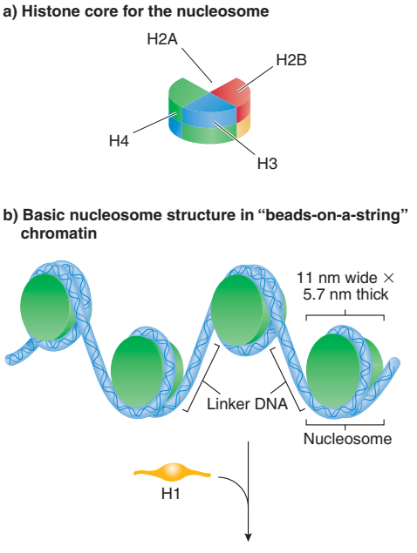
The Structure of Chromatin
With the electron microscope, different chromatin structures are seen.
The lowest-level structures are seen while reconstituting purified DNA and histones in vitro, and the higher-level structures reflect the extra degrees of packaging necessary to compact the DNA in vivo.
The least compact form seen is the 10-nm chromatin fiber, which has a characteristic “beads-on-a-string” morphology; the beads have a diameter of about 10 nm (Figure 2.19).
The beads are nucleosomes, the basic structural units of eukaryotic chromatin.
A nucleosome is about 11 nm in diameter and consists of a core of eight histone proteins— two each of H2A, H2B, H3, and H4 (Figure 2.20a)— around which a 147-bp segment of DNA is wound about 1.65 times (Figure 2.20b).
This configuration serves to compact the DNA by a factor of about six.

Slide 30
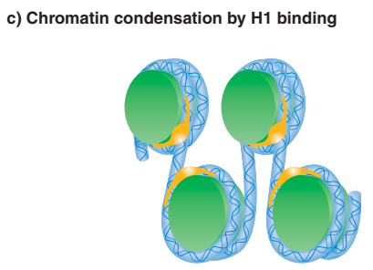
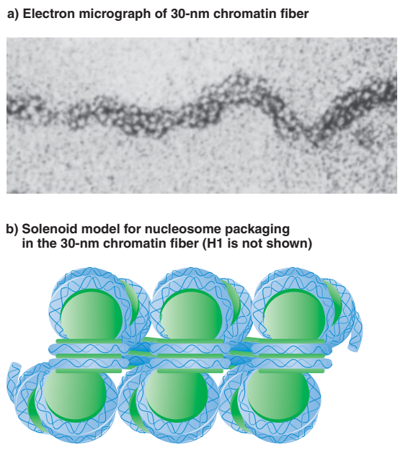
The Structure of Chromatin
Individual nucleosomes are connected by strands of linker DNA (see Figures 2.19 and 2.20b).
The length of linker DNA varies within and among organisms.
Human linker DNA, for example, is 38–53 bp long.
The next level of chromatin condensation is brought about by histone H1.
A single molecule of H1 binds both to the linker DNA at one end of the nucleosome and to the middle of the DNA segment wrapped around core histones.
The binding of H1 causes the nucleosomal DNA to assume a more regular appearance with a zigzag arrangement (Figure 2.20c).
The nucleosomes themselves then compact into a structure about 30 nm in diameter

Slide 31
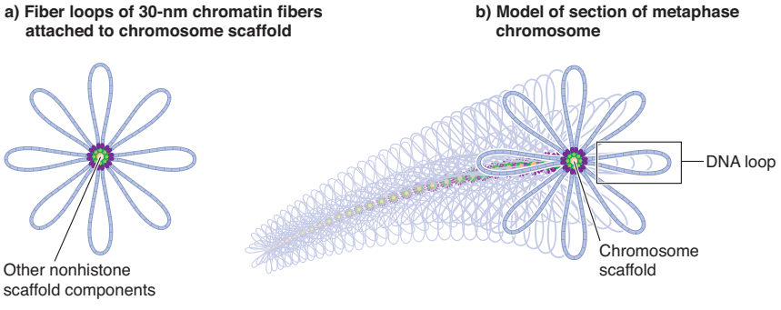
The Structure of Chromatin
Chromatin packing beyond the 30-nm chromatin filaments is less well understood.
Current models derive from 1970s-vintage electron micrographs of metaphase chromosomes depleted of histones.
The photos show 30–90-kb loops of DNA attached to a protein “scaffold” with the characteristic X shape of the paired sister chromatids.
If the histones are not removed, looped domains of 30-nm fibers are seen.
An average human chromosome has approximately 2,000 looped domains.
Each looped domain is held together at its base by nonhistone proteins that are part of the chromosome scaffold (Figure 2.23a). Stretches of DNA called scaffold associated regions, or SARs, bind to the nonhistone proteins to determine the loops.
It is simplest to think of these loops as being arranged in a spiral fashion around the central chromosome scaffold (Figure 2.23b).
In cross section, the loops would be seen to radiate out from the center like the petals of a flower. Overall, this packing produces a chromosome that is about 10,000 times shorter, and about 400 times thicker, than naked DNA.
The chromosomes are not organized into rigid structures. Rather, many regions of the chromosomes have dynamic structures that unpack when genes become active and pack when genes cease their activity.

Slide 32
Centromeric and Telomeric DNA
.The centromere and the telomere are two areas of special function in eukaryotic chromosomes.
The behavior of chromosomes in mitosis and meiosis depends on the kinetochores that form on the centromeres.
A telomere, a specific set of sequences at the end of a linear chromosome, stabilizes the chromosome and is required for replication.
Each chromosome has two ends and, therefore, two telomeres.
A centromere is the region of a chromosome containing DNA sequences to which mitotic and meiotic spindle fibers attach.
Under the microscope a centromere is seen as a constriction in the chromosome.
The centromere region of each chromosome is responsible for the accurate segregation of replicated chromosomes to the daughter cells during mitosis and meiosis.
The centromere of a mitotic metaphase chromosome—a duplicated chromosome that is partway through the division of the cell and concomitant segregation of the chromosomes to the progeny cells.

Slide 33
Centromeric and Telomeric DNA
The DNA sequences of centromeres have been analyzed extensively in a few organisms, and notably in the yeast Saccharomyces cerevisiae. These sequences in yeast are called CEN sequences, after the centromere.
Although each yeast centromere has the same function, the CEN regions are highly similar—but not identical to one another—in nucleotide sequence and organization.
The common core centromere region in each yeast chromosome consists of 112–120 base pairs that can be grouped into three sequence domains (centromere DNA elements,
or CDEs; Figure 2.24).
CDEII, a 78–86-bp region, more than 90% of which is composed of A–T base pairs, is the largest domain. To one side is CDEI, which has an 8-bp sequence (RTCACRTG, where R is a purine—i.e., either A or G), and to the other side is CDEIII, a 26-bp sequence domain that is also AT rich.
Centromere sequences have been determined for a number of other organisms and are different both from those of yeast and from each other.
The centromeres of the fission yeast Schizosaccharomyces pombe, for example, are 40–80 kb long, with complex arrangements of several repeated sequences.
Human centromeres are even longer, ranging from 240 kb to several million base pairs; the longer ones are larger than some bacterial genomes! Thus, although centromeres carry out the same function in all eukaryotes, there is no common sequence that is responsible for that function.

Slide 34
Centromeric and Telomeric DNA
The DNA sequences of centromeres have been analyzed extensively in a few organisms, and notably in the yeast Saccharomyces cerevisiae. These sequences in yeast are called CEN sequences, after the centromere.
Although each yeast centromere has the same function, the CEN regions are highly similar—but not identical to one another—in nucleotide sequence and organization.
The common core centromere region in each yeast chromosome consists of 112–120 base pairs that can be grouped into three sequence domains (centromere DNA elements,
or CDEs; Figure 2.24).
CDEII, a 78–86-bp region, more than 90% of which is composed of A–T base pairs, is the largest domain. To one side is CDEI, which has an 8-bp sequence (RTCACRTG, where R is a purine—i.e., either A or G), and to the other side is CDEIII, a 26-bp sequence domain that is also AT rich.
Centromere sequences have been determined for a number of other organisms and are different both from those of yeast and from each other.
The centromeres of the fission yeast Schizosaccharomyces pombe, for example, are 40–80 kb long, with complex arrangements of several repeated sequences.
Human centromeres are even longer, ranging from 240 kb to several million base pairs; the longer ones are larger than some bacterial genomes! Thus, although centromeres carry out the same function in all eukaryotes, there is no common sequence that is responsible for that function.

Slide 35
Centromeric and Telomeric DNA
A telomere is required for replication and stability of a linear chromosome.
In most organisms that have been examined, the telomeres are positioned just inside the nuclear envelope and often are found associated with each other as well as with the nuclear envelope.
All telomeres in a given species share a common sequence, but telomere sequences differ among species.
Most telomeric sequences may be divided into two types:
1. Simple telomeric sequences are at the extreme ends of the chromosomal DNA molecules.
Depending on the organism and its stage of life, there are on the order of 100–1,000 copies of the repeats.
Simple telomeric sequences are the essential functional components of telomeric regions, in that they are sufficient to supply a chromosomal end with stability.
These sequences consist of a series of simple DNA sequences repeated one after the other (called tandemly repeated DNA sequences).
In the ciliate Tetrahymena, for example, reading the sequence toward the end of one DNA strand, the repeated sequence is 5-TTGGGG-3 (Figure 2.25a). In humans
and all other vertebrates, the repeated sequence is 5-TTAGGG-3.
Different researchers may describe the telomere repeat with other starting points, such as 5-GGTTAG-3 or 5-GGGTTA-3 for humans and other vertebrates.
The telomeric DNA is not doublestranded all the way out to the end of the chromosome.
In one model, the telomere DNA loops back on itself, forming a t-loop (Figure 2.25b). The singlestranded end invades the double-stranded telomeric sequences, causing a displacement loop, or D-loop, to form.

Slide 36
Centromeric and Telomeric DNA
2. Telomere-associated sequences are regions internal to the simple telomeric sequences.
These sequences often contain repeated, but still complex, DNA sequences extending many thousands of base pairs in from the chromosome end.
The significance of such sequences is not known. Whereas the telomeres of most eukaryotes contain short, simple, repeated sequences, the telomeres of Drosophila are quite different structurally.
Drosophila telomeres consist of transposable elements—DNA sequences that can move to other locations in the genome.
Unique-Sequence and Repetitive-Sequence DNA
Now that you know about the basic structure of DNA and its organization in chromosomes, we can discuss the distribution of certain sequences in the genomes of prokaryotes and eukaryotes.
From molecular analyses, geneticists have found that some sequences are present only once in the genome, whereas other sequences are repeated.
For convenience, these sequences are grouped into three categories: unique-sequence DNA (present in one to a few copies in the genome), moderately repetitive
DNA (present in a few to about copies in the genome), and highly repetitive DNA (present in about to copies in the genome). In prokaryotes, with
the exception of the ribosomal RNA genes, transfer RNA genes, and a few other sequences, all of the genome is present as unique-sequence DNA.
Eukaryotic genomes, by contrast, consist of both unique-sequence and repetitivesequence DNA, with the latter typically being quite complex in number of types, number of copies, and distribution.
To date, we have sketchy information about the distribution of the various classes of sequences in the genome.
However, as the complete DNA sequences of more and more eukaryotic genomes are determined, we will develop a precise understanding of the molecular organization patterns of unique-sequence and repetitive sequence DNA.
Unique-Sequence DNA.
Unique sequences, sometimes called single-copy sequences, are sequences that are present as single copies in the genome. (Thus, there are two copies per diploid cell.) In current usage, the term usually applies to sequences that have one to just a few copies per genome.
Most of the genes we know about—the proteincoding genes—are in the unique-sequence class of DNA. In humans, unique sequences are estimated to make up approximately 55–60% of the genome.

Slide 37
Centromeric and Telomeric DNA
Repetitive-Sequence DNA. Both moderately repetitive and highly repetitive DNA sequences are sequences that appear many times within a genome.
These sequences can be arranged within the genome in one of two ways: distributed at irregular intervals—known as dispersed repeated DNA or interspersed repeated DNA—or clustered together so that the sequence repeats many times in a row—known as tandemly repeated DNA.
Dispersed repeated sequences consist of families of repeated sequences interspersed through the genome with unique-sequence DNA.
Each family consists of a set of related sequences characteristic of the family.
Often, small numbers of families have very high copy numbers and make up most of the dispersed repeated sequences in the genome.
Two types of dispersed repeated sequences are known: (1) long interspersed elements (LINEs), in which the sequences in the families are about 1,000–7,000 bp long; and (2) short interspersed elements (SINEs), in which the sequences in the families are 100–400 bp long.
All eukaryotic organisms have LINEs and SINEs, with a wide variation in their relative proportions. Humans and frogs, for example, have mostly SINEs, whereas Drosophila and birds have mostly LINEs.
LINEs and SINEs represent a significant proportion of all the moderately repetitive DNA in the genome.

Slide 38
Centromeric and Telomeric DNA
Mammalian diploid genomes have about 500,000 copies of the LINE-1 (L1) family, representing about 15% of the genome.
Other LINE families may be present also, but they are much less abundant than LINE-1. Fulllength LINE-1 family members are 6–7 kb long, although most are truncated elements of about 1–2 kb.
The fulllength LINE-1 elements are transposons, meaning that they are DNA elements that can move from location to location in the genome.
Genes they contain encode the enzymes necessary for that movement. SINEs are found in a diverse array of eukaryotic species, including mammals, amphibians, and sea urchins.
Each species with SINEs has its own characteristic array of SINE families. A well-studied SINE family is the Alu family of certain primates.
This family is named for the cleavage site for the restriction enzyme AluI (“Al-you-one”), typically found in the repeated sequence.
In humans, the Alu family is the most abundant SINE family in the genome, consisting of 200–300-bp sequences repeated as many as a million times and making up about 9% of the total haploid DNA.
One Alu repeat is located every 5,000 bp in the genome, on average. The SINEs are also transposons, but they do not encode the enzymes they need for movement.
They can move, however, if those enzymes are supplied by an active LINE transposon.
Tandemly repeated DNA sequences are arranged one after the other in the genome in a head-to-tail organization.
Tandemly repeated DNA is common in eukaryotic genomes, in some cases in short sequences 1–10 bp long and in other cases associated with genes and in much longer sequences.

