Slide 1
Molecular and recent approaches to
Polyphasic Bacterial Taxonomy

Slide 2
Ribotyping
Ribotyping is a technique which measures the unique pattern that is generated when DNA from a bacterium (all other organisms also) is digested by a restriction enzyme and the fragments are separated and probed with a rRNA probe.
The technique does not involve nucleic acid sequencing. Ribotyping has proven useful for bacterial identification and has found many applications in clinical diagnostics and for the microbial analyses of food, water, and beverages.
Ribotyping is a rapid and specific method for bacterial identification; it is so specific that it has been given the nickname ‘molecular fingerprinting’ because a unique series of bands appears for virtually any bacterium (any organism).
In ribotyping, first the DNA is isolated from a colony or liquid culture of the bacterium to be identified. Using polymerase chain reaction (PCR), genes of DNA for rRNA (preferably 16S rRNA) and related molecules are amplified, treated with one or more restriction enzymes, separated by electrophoresis, and then probed with rRNA genes.
The pattern generated from the fragments of DNA on the gel is then digitized and a computer used to make comparison of this pattern with patterns from other bacteria available from a database.

Slide 3
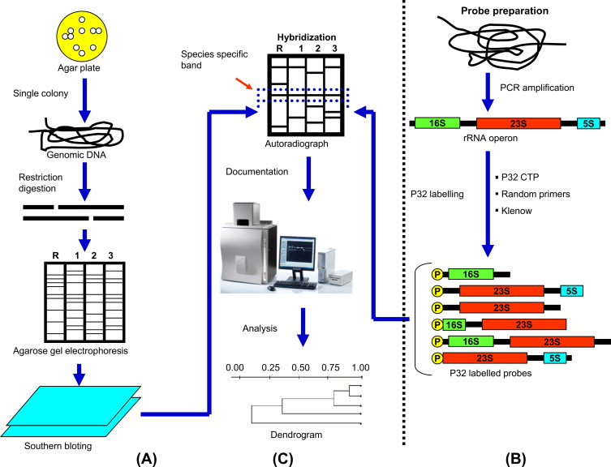

Slide 4
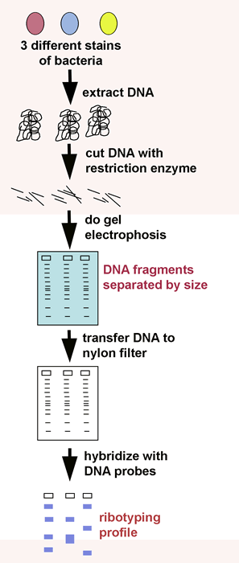
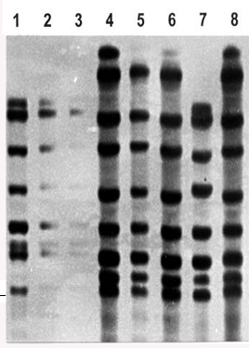
PROFILE

Slide 5
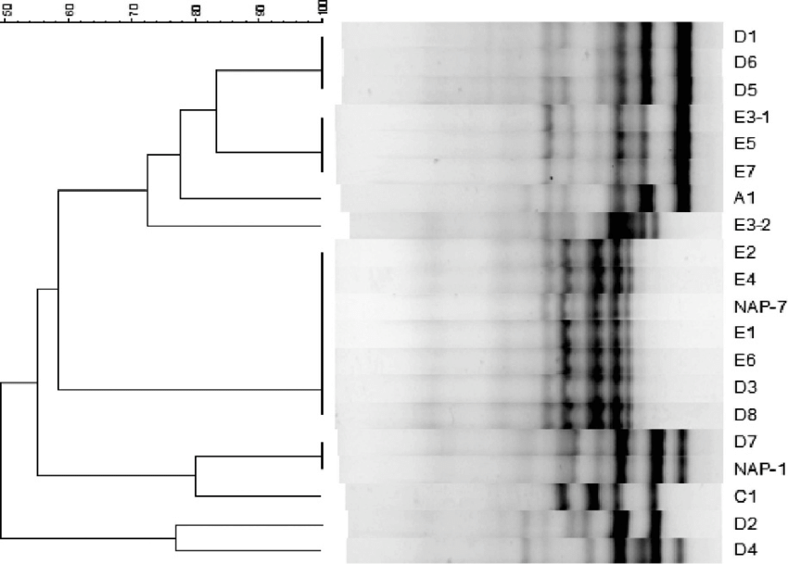

Slide 6
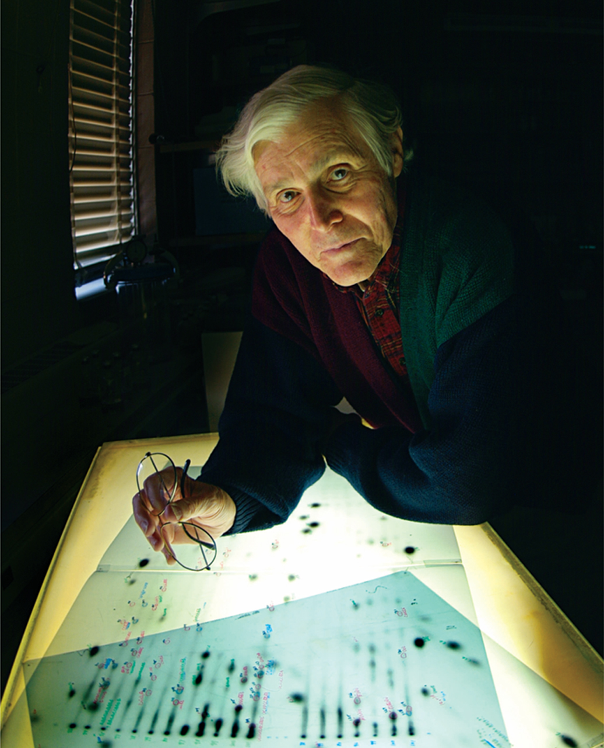
Archaea and The Discovery of the Third Domain of Life
In 1977, Carl Woese overturned one of the major dogmas of biology. Until that time, biologists had taken for granted that all life on Earth belonged to one of two primary lineages, the eukaryotes and the prokaryotes .
Woese discovered that there were actually three primary lineages. Within what had previously been called prokaryotes, there exist two distinct groups of organisms no more related to one another than they were to eukaryotes. Because of Woese’s work, it is now widely agreed that there are three primary divisions of living systems – the Eukarya, Bacteria, and Archaea, a classification scheme that Woese proposed in 1990.

Slide 7
Bergey’s Manual of Systematic Bacteriology (Second Edition)
Phylogenetic Classification:
Prokaryotic taxonomy enjoyed enormous progress after the publication of the first edition of Bergey’s Manual of Systematic Bacteriology. It became possible with the aid of newer molecular techniques such as the sequencing of ribosomal RNA (rRNA), DNA, and proteins. These techniques has made phylogenetic analysis of prokaryotes practicable.
As a result, the second edition is quite different from the first edition in the characteristics chosen as basis for classification. However, the second edition consists of five volumes. Its first volume was published in 2001, second in 2005, and three additional volumes expected shortly.
The details of the five volumes are the following:
Vol. I: The Archaea, and the Deeply Branching and Phototropic Bacteria
Vol. II: The Proteobacteria
Vol. III: The Low G + C Gram-positive Bacteria
Vol. IV: The High G + C Gram-positive Bacteria
Vol.V: The Planctomycetes, Spirochaetes, Fibrobacteres, Bacteriodetes, and Fusobacteria (Vol. V also contains a section accommodating the update descriptions and phylogenetic arrangements that have been revised since publication of volume I)

Slide 9
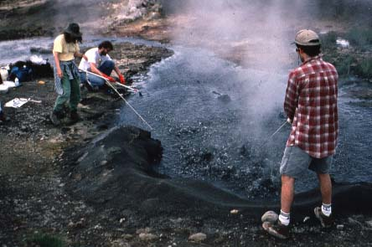

Slide 10
NANOARCHAEOTA
Nanoarchaeota is a phylum of very small parasitic Archaea that branches closest to the root of the archaeal phylogentic tree. Cells of Nanoarchaeum, the only genus in this phylum, are small coccoids that live as parasites, or possibly as symbionts, of the crenarchaeota Ignicoccus. Cells of Nanoarchaeum are about 0.4 μm in diameter and replicate only when attached to the surface of Ignicoccus. Nanoarchaeum is hyperthermophilic, with an optimal growth of about 90°C. The metabolism of Nanoarchaeum is unknown, but its host is an autotroph, growing with H₂ as electron donor and elemental sulfur as electron acceptor. Isolates from Nanoarchaeum have been obtained from submarine hydrothermal vents as well as terrestrial hot springs. The genome of Nanoarchaeumis only 0.49 Mbp, the smallest genome known. It lacks identifiable genes for most known metabolic functions, including the synthesis of monomers, such as aminoacids, nucleotides, and coenzymes.

Slide 11
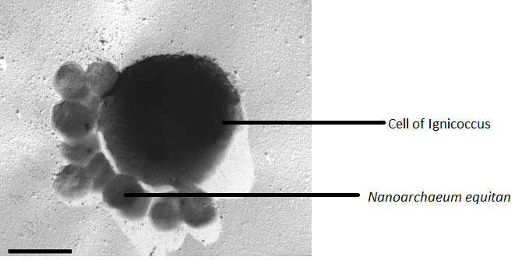
Nanoarchaeum equitans is a species of marine Archaea that was discovered in 2002 in a hydrothermal vent off the coast of Iceland on the Kolbeinsey Ridge by Karl Stetter. Strains of this microbe were also found on the Sub-polar Mid Oceanic Ridge, and in the Obsidian Pool in Yellowstone National Park. Since it grows in temperatures approaching boiling, at about 80 degrees Celsius, it is considered to be a thermophile. It grows best in environments with a pH of 6, and a salinity concentration of 2%.
https://alchetron.com/Nanoarchaeum-equitans

Slide 12
Archaebacteria, diverse group of bacteria (prokaryotes), sometimes called the archaea and considered a major group unto themselves. Archaebacteria are contrasted with the Eubacteria, from which they differ biochemically in the arrangement of the bases in their ribosomal RNA and in the composition of their plasma membranes and cell walls. There are three major known groups of Archaebacteria: methanogens, halophiles, and thermophiles. The methanogens are anaerobic bacteria that produce methane. They are found in sewage treatment plants, bogs, and the intestinal tracts of ruminants. Ancient methanogens are the source of natural gas. Halophiles are bacteria that thrive in high salt concentrations such as those found in salt lakes or pools of sea water. Thermophiles are the heat-loving bacteria found near hydrothermal vents and hot springs. Many thermophiles are chemosynthetic using dissolved sulfur or other elements as their energy source and iron as a means of respiration. Archaebacteria emerged at least 3.5 billion years ago and live in environments that resemble conditions existing when the earth was young.

Slide 13
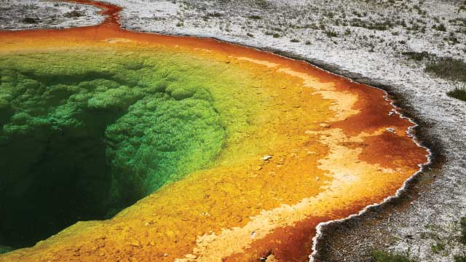
Morning Glory Pool is a hot spring in the Yellowstone Upper Geyser Basin of the United States.

Slide 14
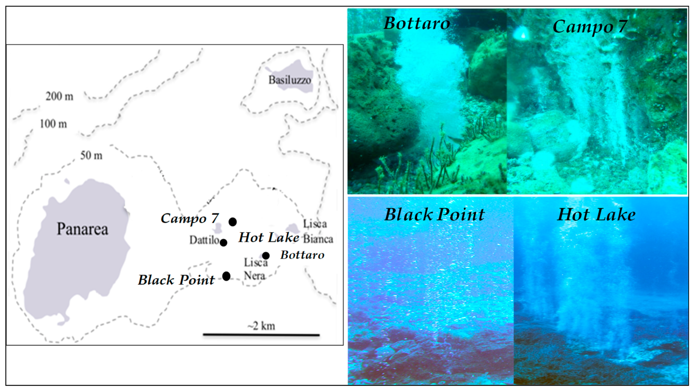
Domain Archaea:
Phylum AI:
Crenarchaeota:
The phylum Crenarchaeota contains thermophilic and hyperthcrmophilic sulfur-metabolizing prokaryotes; arranged in single class Thermoprotei divided into three orders and five families. The important genera are Thermoproteus, Desulgurococcus, Pyrodictium, and Sulfolobus.

Slide 15
The Crenarchaeota are Archaea that have been classified as either a phylum of the Archaea kingdom or a kingdom of its own. Initially, the Crenarchaeota were thought to be sulfur-dependent extremophiles but recent studies have identified characteristic Crenarchaeota environmental rRNA indicating the organism may be the most abundant archaea in the marine environment. Originally, they were separated from the other archaea based on rRNA sequences. However, other physiological features, such as lack of histones have supported this division, although some crenarchaea were found to have histones. Until recently all cultured Crenarchaea had been thermophilic or hyperthermophilic organisms, some of which have the ability to grow at up to 113 °C.
These organisms stain Gram negative and are morphologically diverse having rod, cocci, filamentous and oddly shaped cells. Beginning in 1992, data were published that reported sequences of genes belonging to the Crenarchaea in marine environments making these bacteria psychrophiles or cryophiles. Since then, analysis of the abundant lipids from the membranes of Crenarchaea taken from the open ocean have been used to determine the concentration of these “low temperature Crenarchaea.” Based on these measurements of their signature lipids, Crenarchaea are thought to be very abundant and one of the main contributors to the fixation of carbon. DNA sequences from Crenarchaea have also been found in soil and freshwater environments, suggesting that this phylum is ubiquitous to most environments.

Slide 16
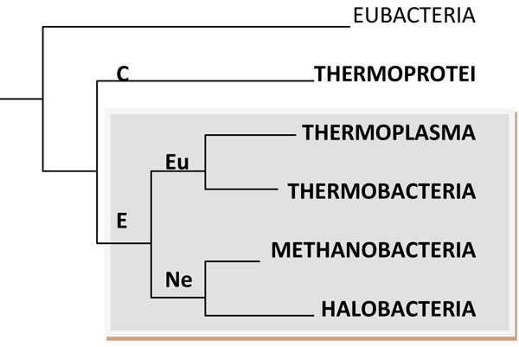
Phylum A II:
Euryarchaeota:
The phylum Euryarchaeota comprises an extreme physiologically diverse group of microorganisms, adapted to the most extreme environments known. Euryarchaeota contains primarily methanogens and halophiles; thermophilic, sulfur-reducers also are included in this phylum. This phylum is divided into seven classes (Methanobacteria, Methanococci. Halobacteria, Thermoplasmata, Thermococci, Archeoglobi, and Methanopyri), nine orders, and sixteen families.
The representative genera of each class are Methanobacterium, Methanococcus, Halobacterium, Thermophasma, Thermococcus, Archaeoglobus, and Methanopyrus, respectively.

Slide 17
Euryarchaeota organisms show very diverse metabolism. For example, phylogenetically close orders can exhibit very different kinds of metabolism, while important similarities can be observed in distantly related orders. Most of the Euryarchaeota are strictly anaerobic, although some of them can grow at low oxygen concentrations. Euryarchaeota, like most of the anaerobic organisms studied, lacks the defense mechanisms against oxidative stress (ROS). However, recently, the ability of P. furiosus to grow even in the presence of 8% oxygen has been described, which led to postulate the existence of a mechanism through which a part of the electrons destined to H₂ production are diverted to the O₂ reduction. Further, this phylum comprises mainly autotrophic organisms, and some heterotrophs can be found. This trait has been suggested to be an evolutive novelty acquired later The systematic studies of archaeal metabolism were undertaken soon after the first genome sequence from archaea was obtained. The initial studies contemplated metabolic reconstructions based on the presence of homologous sequences with known activities

Slide 18
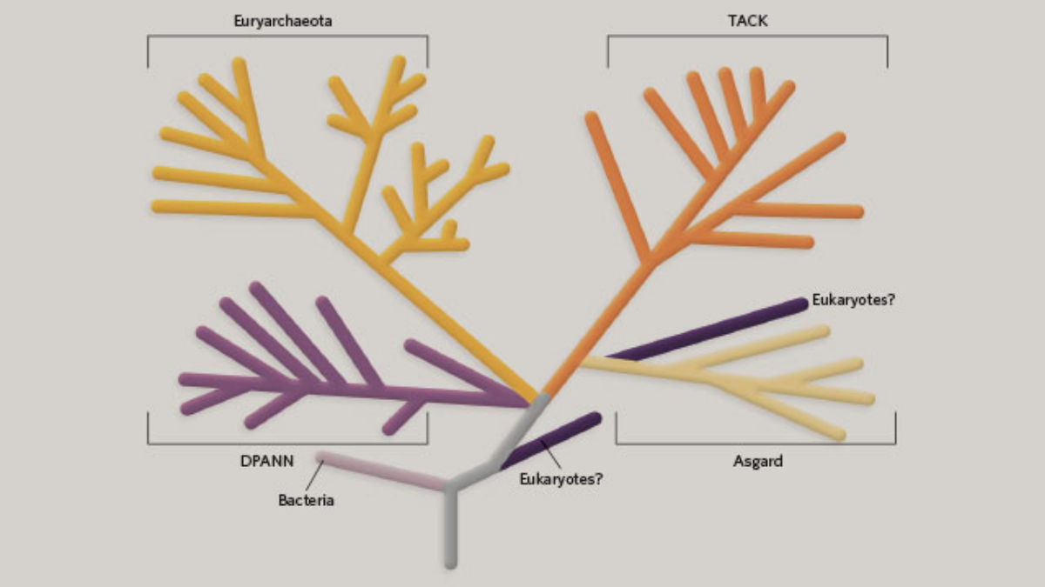
AN EVOLVING FAMILY TREE
The family tree of Archaea, which encompassed just two phyla 16 years ago, has exploded in recent years. It now includes more than a dozen phyla, organized into four informal “supergroups,” based mostly on sequence similarities. Scientists have yet to determine precisely how novel archaea should be classified. Also in dispute is how Eukarya fit into the picture—some scientists suggest they’re an offshoot of a branch known as Asgard archaea, while others suspect they diverged from Archaea earlier on. Researchers predict the tree will sprout many more branches in the years to come.

Slide 19
RECENT RESEARCH
Supergroup | History | Characteristics
Euryarchaeota | Carl Woese and colleagues divided the Archaea into two “kingdoms,” Euryarchaeota and Crenarchaeota, in 1990.¹ | Includes halophiles and methanogens. Members of the order Thermoplasmateles are acidophiles and thermophiles.
TACK | Scientists proposed the TACK name in 2011 to encompass the phyla Thaumarchaeota, Aigarchaeota, Crenarchaeota, and Korarchaeota;2 more phyla have been added since. | Includes thermophiles. Thaumarchaeota participate in nitrogen cycling. Some are also methanogens.
DPANN | The first phylum named was Nanoarchaeota, in 2002, for a tiny deep-sea vent organism that didn’t fit into Euryarchaeota or Crenarchaeota.³ In 2013, researchers proposed linking it with the taxa Diapherotrites, Parvarchaeota, Aenigmarchaeota, and Nanohaloarchaeota.⁴ New phyla have been added since. | At least some are small in size, with small genomes lacking genes for key proteins in metabolism and other processes. Some may rely on a symbiont or host organism to survive.
Asgard | The first discovered were Lokiarchaeota, which were initially thought to be members of the TACK superphylum.⁵ The group now contains a handful of phyla, all named for Norse deities.⁶ | Genomes encode several proteins similar to those found in eukaryotes.

Slide 20
Non-proteobacteria
The majority of the gram-negative bacteria belong to the phylum Proteobacteria, those that do not are called the non-proteobacteria.

Slide 21
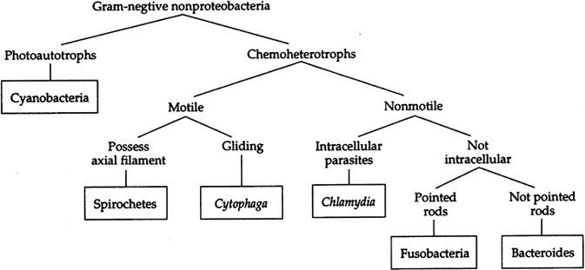

Slide 22
Domain: Bacteria:
Phylum BIV:
Dienococcus-Thermus:
The phylum contains one class (Dienococci). The representative genera are Dienococcus, Thermus, Marinithermus, etc. The bacteria are gram-positive and extraordinarily radiation resistant.
Deinococcus is a gram-positive bacteria found to form pink or reddish colored colonies. Deinococcus is known for being the most radiation-resistant vegetative cell (R. Murray). In fact, Deinococcus radiodurans can live through blasts of radiation thousands of times greater than the level that would kill a human being, and its Latin name means "strange berry that withstands radiation." To learn how D. radiodurans manage to live through such intense blasts of radiation

Slide 23
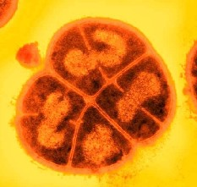
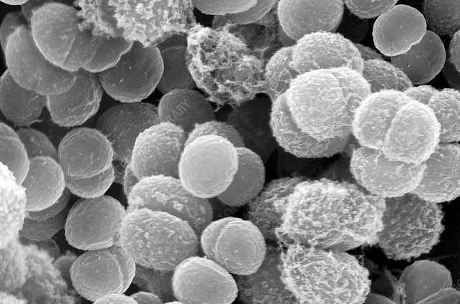
Cell Structure and Metabolism
When observed by an electron microscope, the cell wall was discovered to have an unusual thickness of about 50-60 nm, with a dense inner layer of about 14-20 nm. This inner wall creates the septa and sometimes the fenestrated layer. The septum forms an unusual shape, described as a pair of curtains rather than the typical "iris-diaphram". Deinococcus typically forms a tetrad shape, allowing a second division to begin before the first is complete during cell division.

Slide 24
Ecology
The natural habitat of Deinococcus is not yet known because Deinococcus is chemoorganotrophic. A chemoorganoheterotrophic organism is one that requires organic substrates to get its carbon for growth and development, and that obtains its energy from the decomposition, often an oxidation of an organic compound.
It has been isolated from a variety of sites, and needs a complex growth media. It seems that the proteases of Deinococcus may be used for the generation of several useful amino acids and possibly a few sugars as well. Deinococcus strains have been grown from a variety of materials including soil, animal feces, and meat. It is speculated that these aerobic bacteria are likely to live in rich organic habitats, such as feces or intestinal contents

Slide 25
Phylum B XVI:
Chlamydias:
Phylum Chlamydiae contains a single class (Chlamydiae) and seven genera. The genus Chlamydia is by far the most important genus; its species cause many human diseases. They have an extremely ancient origin within the eubacterial kingdom, perhaps as ancient as the origin of the early eukaryote. No free-living species are known, and all chlamydiae are entirely dependent on a eukaryotic host.
Chlamydia is another taxon of the Alphaproteobacteria. Members of this genus are gram-negative, obligate intracellular pathogens that are extremely resistant to the cellular defenses, giving them the ability to spread from host to host rapidly via elementary bodies. The metabolically and reproductively inactive elementary bodies are the endospore-like form of intracellular bacteria that enter an epithelial cell, where they become active.

Slide 26
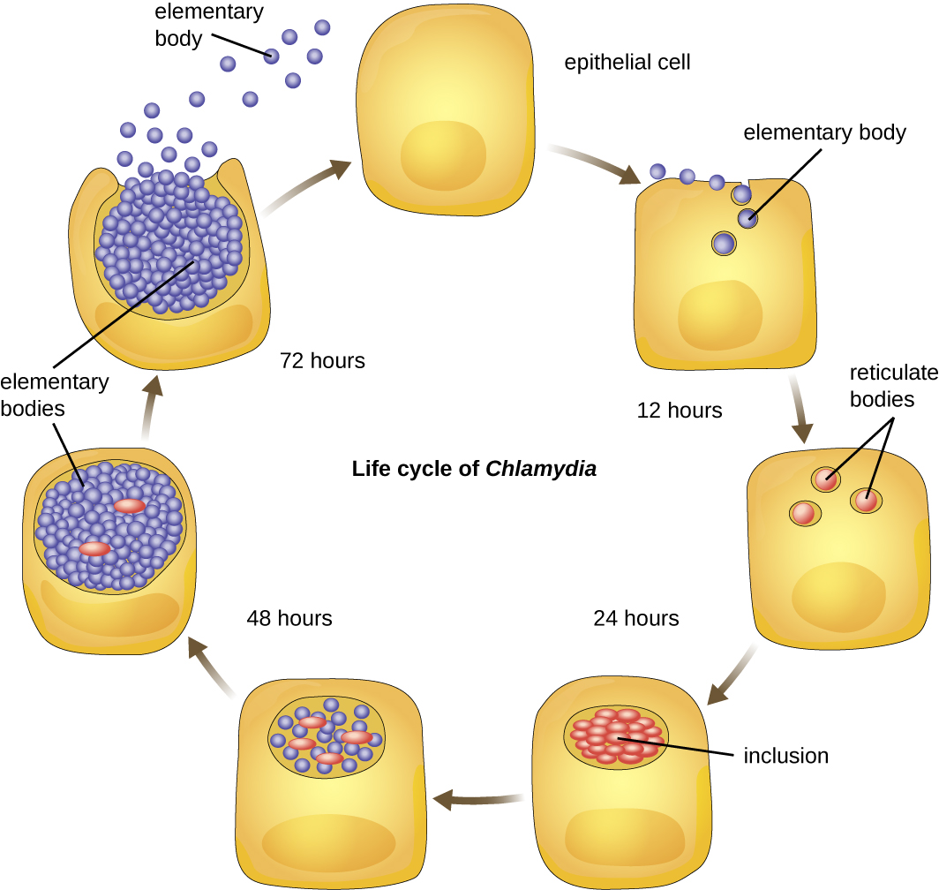

Slide 27
Phylum B XVII:
Spirochaetes:
Phylum Spirochaetes is classified into one class (Spirochaetes) containing thirteen genera, the important ones are Spirochaeta, Borellia, Treponema, Cristispira, Leptospira, etc. They are gram-negative, motile, helically-shaped bacteria characterized by a unique motility behaviour.
Spirochetes are characterized by their long (up to 250 μm), spiral-shaped bodies. Most spirochetes are also very thin, which makes it difficult to examine gram-stained preparations under a conventional brightfield microscope. Darkfield fluorescent microscopy is typically used instead. Spirochetes are also difficult or even impossible to culture. They are highly motile, using their axial filament to propel themselves. The axial filament is similar to a flagellum, but it wraps around the cell and runs inside the cell body of a spirochete in the periplasmic space between the outer membrane and the plasma membrane .

Slide 28
Several genera of spirochetes include human pathogens. For example, the genus Treponema includes a species T. pallidum, which is further classified into four subspecies: T. pallidum pallidum, T. pallidum pertenue, T. pallidum carateum, and T. pallidum endemicum. The subspecies T. pallidum pallidum causes the sexually transmitted infection known as syphilis, the third most prevalent sexually transmitted bacterial infection in the United States, after chlamydia and gonorrhea. The other subspecies of T. pallidum cause tropical infectious diseases of the skin, bones, and joints.

Slide 29
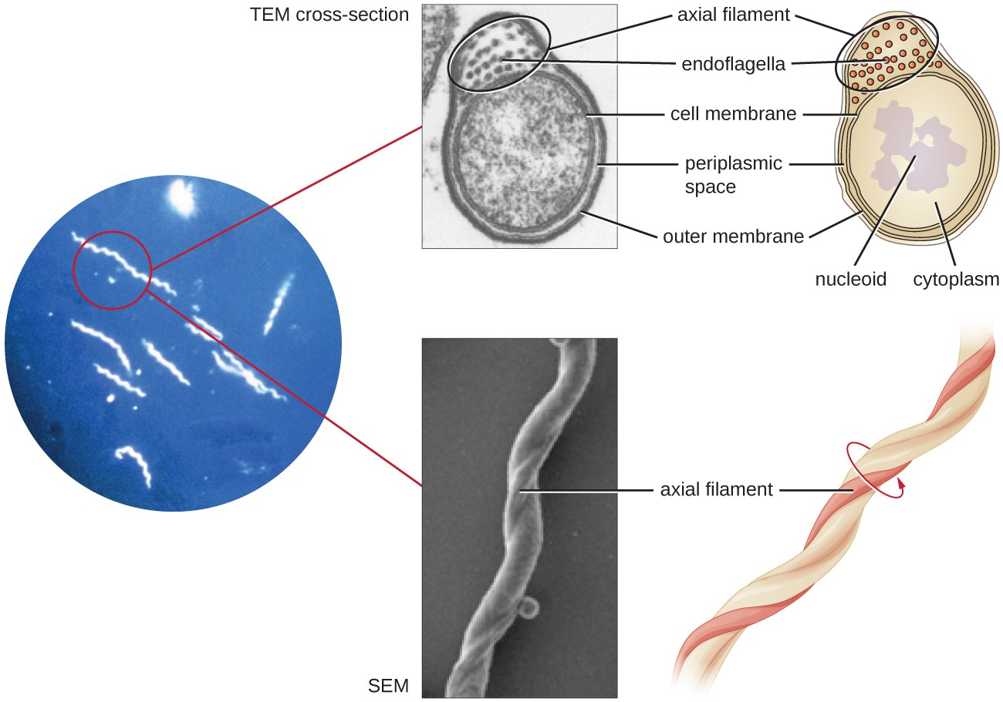
Spirochetes are typically observed using darkfield microscopy (left). However, electron microscopy (top center, bottom center) provides a more detailed view of their cellular morphology. The flagella found between the inner and outer membranes of spirochetes wrap around the bacterium, causing a twisting motion used for locomotion

Slide 30
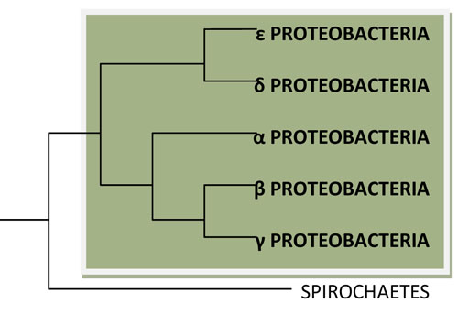
Volume II:
The Proteobacteria:
Phylum B XII: Proteobacteria

Slide 31
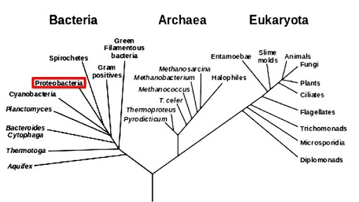
The phylum Proteobacteria consists of five classes (Alfaproteobacteria, Betaproteobacteria, Gammaproteobacteria, Deltaproteobacteria, and Epsilonproteobacteria).
Proteobacteria contains over 400 genera which are all gram-negative, show extreme metabolic diversity, and represent the majority of bacteria of pharmaceutical, industrial, agricultural, and biological research significance. It is believed by many that the proteobacteria evolved from a photosynthetic ancestor and, presumably, many strains lost photosynthetic activity during adaptation to new ecological niches.

Slide 32
Alphaproteobacteria (∝-proteobacteria) consist of the most bacteria that are capable of growing at low nutrient levels (i.e., oligotrophic forms); the representative genera of this class are Rhodospirillum, Azospirillum, Rickettsia, Rhizobium, Agrobacterium, Nitrobacter, Hyphomicrobium, Methylobacterium, etc.
Betaproteobacteria (β-proteobacteria) utilize the substances that diffuse from organic decomposition in the anaerobic zone of their habitats. Some of its genera are pathogenic. The important genera included in betaprotobacteria are Thermothrix, Bordetella, Leptothrix, Neissaria, Aquaspirillum, Nitrosomonas, Gallionella, Spirillum, etc.
Gammaproteobacteria (γ-proteobacteria) are chemoorganotrophic, facultative anaerobic, and the representative genera are Chromatium, Xanthomonas, Beggiatoa, Pseudomonas, Vibrio, Photobacterium, Escherichia, Klebsiella, Erwinia, etc. Deltaproteobacteria (δ-proteobacteria) can mainly be categorized as of three groups.

Slide 33
Many of the Deltaproteobacteia are anaerobic and cause desulfurication (generate sulfide from sulfate and sulfur); representative genera of such bacteria are Desulfovibrio, Deslfuromonas, Desulfobaca, etc. Some deltaproteobacteria (e.g., Bdellovibrio, Bacteriovorax) are predators on other bacteria. Representatives such as Myxococcus, Polyangium and Chondromyces are the deltaproteobacteria that form fruiting bodies and also prey on other bacteria.
Epsilonproteobacteria (Ɛ- proteobacteria) is a small class and its members like Helicobacter and Campylobacter are important human pathogens causing intestinal infections.

Slide 34
The class Zetaproteobacteria is the sixth and most recently described class of the Proteobacteria. Zetaproteobacteria can also refer to the group of organisms assigned to this class. The Zetaproteobacteria were originally represented by a single described species, Mariprofundus ferrooxydans, which is an ironoxidizing neutrophilic chemolithoautotroph originally isolated from Loihi Seamount in 1996 (post-eruption). Molecular cloning techniques focusing on the small subunit ribosomal RNA gene have also been used to identify a more diverse majority of the Zetaproteobacteria that have as yet been unculturable.

Slide 35
GRAM POSSITIVE BACTERIA

Slide 36
Volume III: The Low G + C Gram-Positive Bacteria:
Phylum B XIII: Firmicutes: Phylum Firmicutes consists of the gram-positive bacteria with low G + C content (mol% value below 50%) in their DNA. Most of the bacteria of this phylum are heterotroptic. Though mycoplasmas lack cell wall and stain gram-negative, they are classified under this phylum because of their close relationship to low G + C gram-positive bacteria. While many Firmicutes stain Gram-positive, some do not. In fact, some Firmicutes have no cell wall at all! They are called "low G+C" because their DNA typically has fewer G and C DNA bases than A and T bases as compared to other bacteria. Exceptions have been identified and some Firmicutes have G+C content as high as 55% (e.g. Geobacillus thermocatenulatus).

Slide 37
The phylum is classified into three classes, Clostridia, Mollicutes, and Bacilli.
Class Clostridia contains a very wide variety of gram-positive bacteria that vary in morphology and size but tend to be anaerobic. Some produce endospores but others do not. Important genera are Clostridium, Acetobacterium, Desulfotomaculum, Eubacterium, Heliobacterium, Syntrophomonas, etc.
Class Mollicutes consists of the members that are wall-less and are generally called mycoplasmas. These bacteria are pleomorphic in shape, normally non-motile, stain gramnegative due to absence of cell wall, and require sterols for growth. The important genera include Mycoplasma, Phytoplasma, Spiroplasma. that contain several important animal and plant pathogens.
Class Bacilli comprises a variety of bacteria which are aerobic or facultatively anaerobic cocci and rods, and many of them are endospore-forming (e.g., Bacillus, Sporosarcina, Paenibacillus). Many genera of this phylum are pharmaceutical and industrially significant (e.g., Bacillus, Lactobacillus, Enterococcus, Leuconostoc, Streptococus, Lactococcus).

Slide 38
Volume IV: The High G + C Gram-Positive Bacteria:
Phylum B XIV: Actinobacteria: The phylum Actinobacteria is classified into a single class Actinobacteria which contains high G + C gram-positive bacteria with mole% value above 50 to 55%. These bacteria show enormous morphological variations ranging from cocci to regular or irregular rods to extensively branching hyphae. Endospore formation lacks but many genera do form a variety of asexual spores. The phylum consists of five subclasses, six orders, forteen suborders, forty four families, and many a number of genera. The important genera of actinobacteria are Actinomyces, Arthrobacter, Brevibacterium, Cellulomonas, Clavibacter, Corynebacterium, Mycobacterium, Nocardia, Actinoplanes, Propionibacterium, Streptomyces, Frankia, etc. The largest and the most complex genes is Streptomyces containing over 500 species.

Slide 39
CYANO BACTERIA

Slide 40
Cyanophyceae (blue green algae)
a. They are mostly fresh water.
b. Plant body may be- unicellular or multi cellular and the cells are prokaryotic in nature.
c. The cell wall is composed of mucopeptide, together with amino acids, fatty acids andcarbohydrate.
d. The dominant pigment is c-phycocyanin which gives blue green coloura tion to the cells. In addition, other pig ments like chlorophyll a, β- carotene and c- phycoerythrin are also present.
e. The reserve food is cyanophycean starch and cyanophycean granule (protein).
f. There is no motile stage in the members of this class.
g. Carboxisome found for carbon-concentrating mechanism.
h. Reproduction takes place by both vege tative (cell division, fragmentation etc.) and asexual means (exospore, endospore, heterocysts etc.). Sexual
repro duction is absent (genetic recombination is reported in a few members).
i. Having capacity of Nitrogen Fixation.

Slide 41
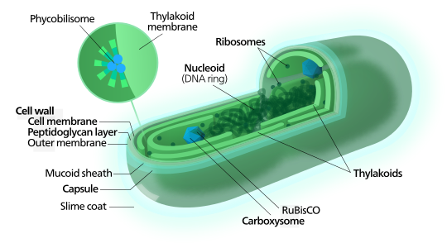

Slide 42
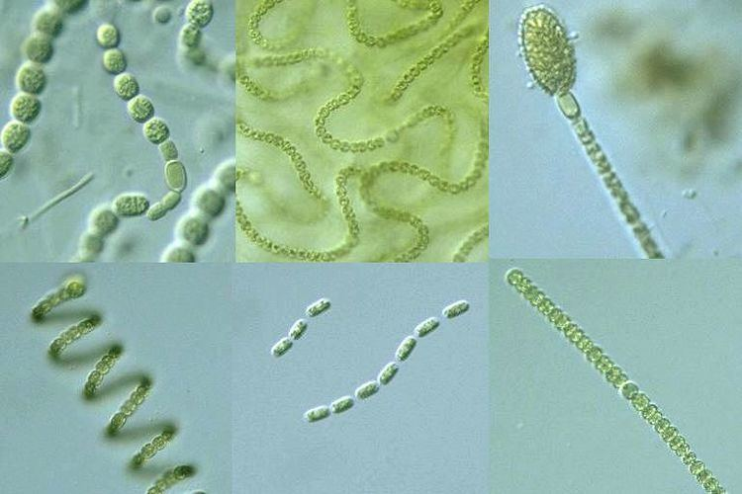

Slide 44
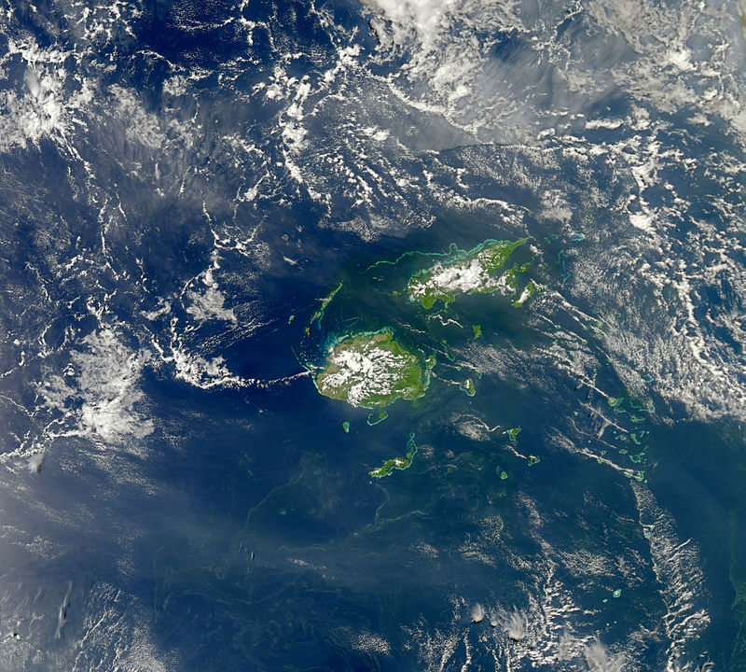
Cyanobacterial bloon- Fiji island

Slide 45
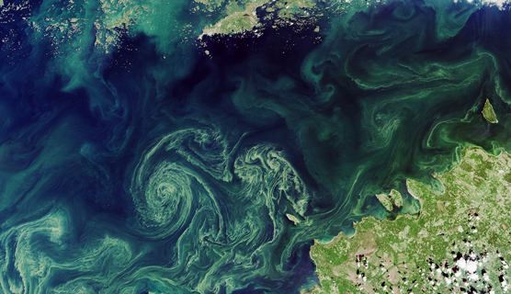

Slide 46
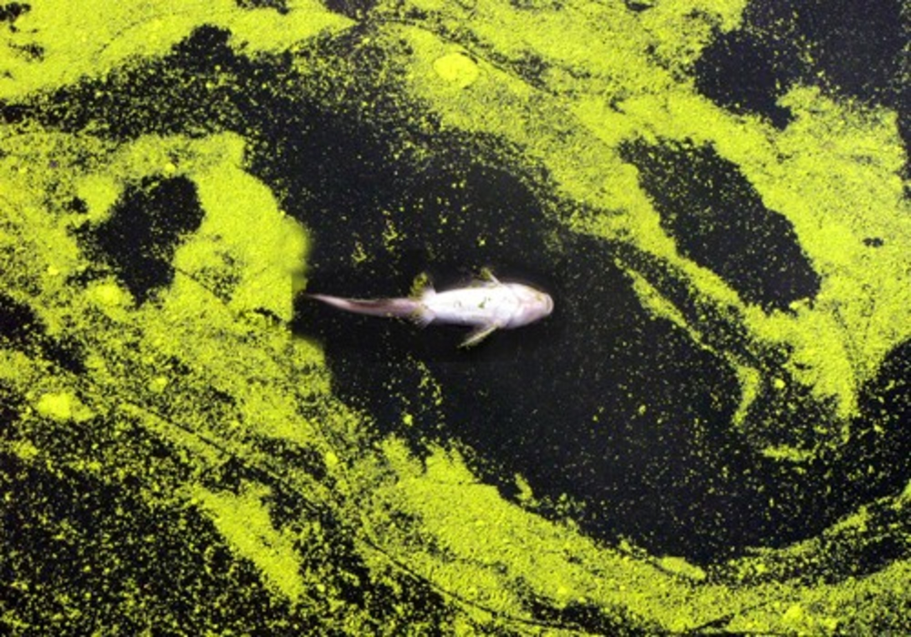

Slide 47
THANK YOU

