Slide 1
Fungus Sexual Cycle
Plasmogamy is a stage in the sexual reproduction of fungi, in which the cytoplasm of two parent cells (usually from the mycelia) fuses together without the fusion of nuclei, effectively bringing two haploid nuclei close together in the same cell.
Karyogamy is the final step in the process of fusing together two haploid eukaryotic cells, and refers specifically to the fusion of the two nuclei. Before karyogamy, each haploid cell has one complete copy of the organism's genome.
Somatogamy : The fusion of two cells (but not their nuclei), especially as the first stage of syngamy.
In mycology, the terms teleomorph, anamorph, and holomorph apply to portions of the life cycles of fungi in the phyla Ascomycota and Basidiomycota: Anamorph: an asexual reproductive stage (morph), often mold-like; When a single fungus produces multiple morphologically distinct anamorphs, these are called synanamorphs. Teleomorph: the sexual reproductive stage (morph), typically a fruiting body. Holomorph: the whole fungus, including anamorphs and teleomorph.

Slide 2
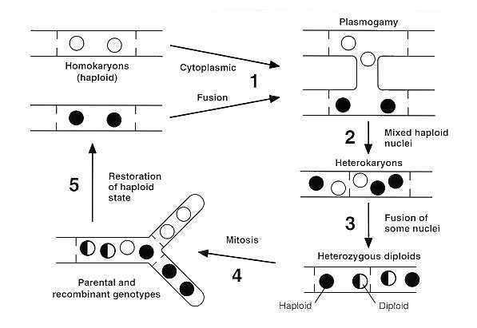

Slide 3
Parasexuality
Parasexual cycle, a process peculiar to fungi and single-celled organisms, is a nonsexual mechanism of parasexuality for transferring genetic material without meiosis or the development of sexual structures.
Homothallic refers to the possession, within a single organism, of the resources to reproduce sexually; i.e., having male and female reproductive structures on the same thallus. The opposite sexual functions are performed by different cells of a single mycelium.
Heterothallic species have sexes that reside in different individuals. The term is applied particularly to distinguish heterothallic fungi, which require two compatible partners to produce sexual spores, from homothallic ones, which are capable of sexual reproduction from a single organism.
Pseudohomothallism: Pseudohomothallism adheres to the physiological definition of homothallism and, as such, single spores of species exhibiting this type of self-fertility are fully able to undergo independent sexual reproduction (Whitehouse 1949). However, from a cellular and molecular standpoint, the underlying mechanism is more complex than that of primary homothallism and has consequently been referred to as an example of secondary homothallism or functional heterothallism.

Slide 4
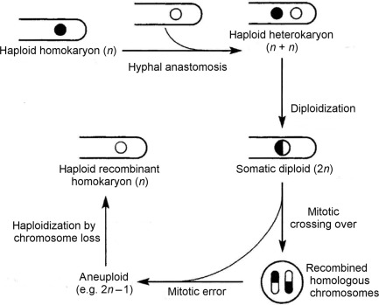

Slide 5
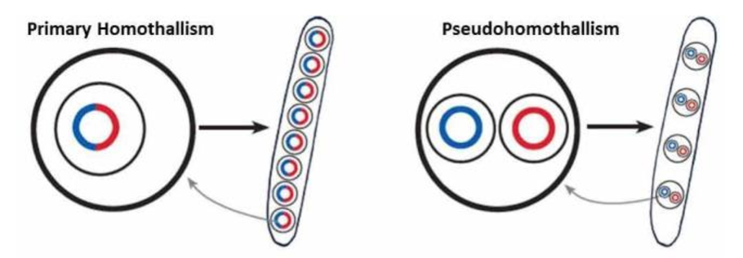
Homothallism: an umbrella term for describing diverse
sexual behaviours
Primary homothallism: The presence of both MAT idiomorphs within a single genome allows the independent production of eight uninucleate ascospores identical to the parental cell as seen in Aspergillus nidulans.
Pseudohomothallism: Self-fertility is the result of the packaging of two, opposite mating type nuclei within a single cell. Independent sexual reproduction results in the production of four binucleate ascospores as seen in Neurospora tetrasperma.

Slide 6
Bidirectional mating type switching: Cells of either mating type undergo mitosis to form two identical cells, one of which is then able to switch to the opposite mating type. This leads to a mixed colony capable of sexual reproduction via functional heterothallism as seen in Saccharomyces cerevisiae

Slide 7
Unidirectional mating type switching: Cells of the hyphae of one mating type are able to switch mating type, producing a mixed mating type culture capable of sexual reproduction. The other mating type is unable to switch and thus requires the presence of a second individual to undergo sexual reproduction. This mating system is seen in Chromocrea spinulosa.

Slide 8
Unisexual reproduction: Cells of the same mating type are able to interact and produce sexual spores regardless of the absence of an opposite mating type partner as in Cryptococcus neoformans.
Homothallism: an umbrella term for describing diverse sexual behaviours ,
Andrea M. Wilson1 , P. Markus Wilken1 , Magriet A. van der Nest1 , Emma T. Steenkamp2 , Michael J. Wingfield1 , and Brenda D. Wingfield1; IMA Fungus · 6(1): 207–214 (2015), doi:10.5598/imafungus.2015.06.01.13

Slide 9
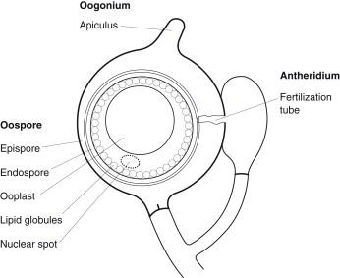

Slide 10
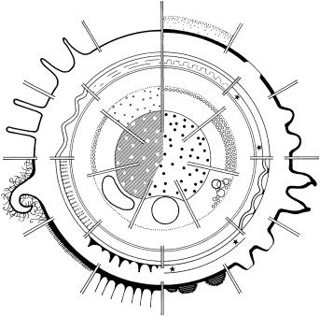
The biodiversity of oogonial and oosporic wall structure and oosporic cytoplasmic organization. The diagram is arranged as three partially exploded wheels of sectors: The outermost sector provides examples of oogonial wall structure; the middle sector displays the complex layers of the oospore wall (the usually thick endospore wall is resorbed on germination; the epispore wall usually is thin, but it may become convoluted; the exospore wall (of periplasmic derivation) is blocked in); and the innermost sector with the dotted line, indicating the plasma membrane, indicates the cytoplasmic reorganization in the oospore (zygote). The central ooplast is diagrammed to indicate the phase reversal between a solid ooplast (hatched) with translucent zones and a fluid ooplast with granules in Brownian motion; the outer zone displays the differential coalescence of lipids. ∗Indicates a fluid layer.
https://www.sciencedirect.com/topics/agricultural-and-biological-sciences/heterothallism

Slide 11
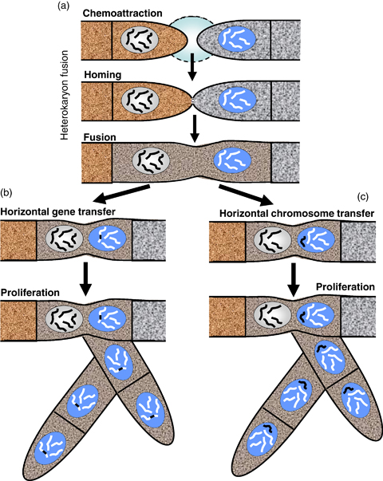

Slide 12
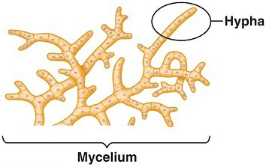
Morphological heterothallism:
Morphological heterothallism may be defined as the condition when morphologically different male and female sex organs are produced in two closely associated mycelia.
The two sex organs or gametes are so morphologically different that it is easier to term one of them as male and the other as female-examples of such type of morphological heterothallic fungi are: Achlya ambisexualis, A. bisexualis, Blastocladiella variabilis, Dictyuchus monosporus, Phytophthora palmivora and Peronospora parasitica
However, in Blastocladiella variabilis the male and female gametangia are morphologically distinct, the male being smaller than the female.
Whitehouse (1949) also used the term haplodioecious for morphologically heterothallic species of fungi.

Slide 13
Physiological heterothallism
(i) Two Allelomorphs or Two-Allele Heterothallism:
When nuclei of both the mating types are different in genetic characters, this type of Heterothallism is known as Two-Allele heterothallism. In these types compatibility is governed by a pair of Alleles represented by A and a located at single same locus of the chromosome.
Due to the dominance of A over a, A is represented by (+) and a by (-). At the time of meiosis, separation of the chromatids take place. Half of the haploid spores thus have (+) and the other half (-) allele.
The spores bearing (+) allele will produce (+) mycelia and the spores with (-) allele will give rise to (-) mycelia. The mycelia of (+) and (+) and (-) and (-) are self-sterile or self-incompatible. Thus, two complimentary mating types (+) and (-) are essential for sexual reproduction.
Two-Allele heterothallism has been reported in several fungi of like Ascobolus magnificus, Puccinia graminis

Slide 14
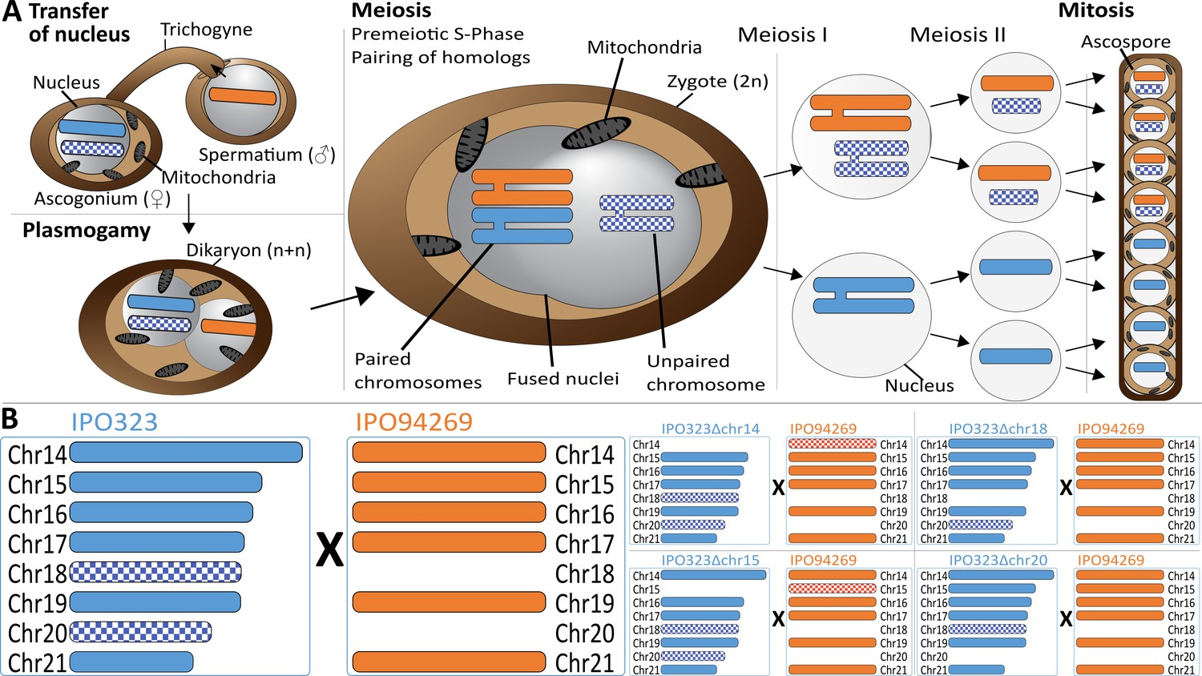
(ii) Multiple Allelomorph or Multiple Allele Heterothallism:
In this type of heterothallism, more than two (multiple) alleles determine the sexual compatibility. These may be located at one (bipolar) or two (tetrapolar) loci.
Because of the larger number of alleles involved in this type of heterothallism, chances of mating of compatible strains increase.
As stated above, the multiple allele heterothallism may be of two types:
(a) Bipolar Multiple-allele heterothallism
(b) Tetrapolar multiple-allele heterothallism.

Slide 15
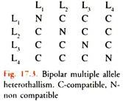
(a) Bipolar Multiple-Allele Heterothallism:
This type of heterothallism is controlled by multiple alleles at a single locus, instead of a pair of Alleles. For example, if the locus is named as L, the multiples alleles will be designated as L₁, L₂, L₃, L₄—Ln and these are present on the single locus L.
The meiotic division will give rise to thalli which may be of several mating types, generally equal to the number of alleles. The thallus containing the allele L₁ can mate with a thallus of any mating type except L₁.
Similarly L₂ can mate with any thallus except that containing L₂ allele and so on. In this type of heterothallism, incompatibility factors are more commonly involved. Bipolar multiple allele heterothallism is characteristic of Basidiomycetes except rusts and smuts

Slide 16
(b) Tetrapolar Multiple Allele heterothallism:
This type of heterothallism is characteristic of Basidiomycetes except rusts. In this type of heterothallism, which is very similar to bipolar multiple allele heterothallism, compatibility is determined by two loci.
Multiple allele—the compatible factor is present on two loci L₁ and L₂ of two Chromatids of a chromosome. At the time of meiotic division, both the loci are separated with chromatids.
If the allele composition of mating type is A₁ B₁, it would be compatible with any other type of allele composition except A₁ B₁. But the mating type with allele composition is not fully compatible with allele composition A₂ B₂ or A₂ B₂.
Figure 17.4 fully explains type of heterothallism which has been reported in Ustilago maydis and Comprinus firmaterius.
This type of heterothallism encourages out-breeding. Whereas in bipolar multiple Allele heterothallism, the out-breeding is 25%, in tetrapolar, it is 100%. This may be due to enormous increase in the number of possible mating types of thalli.

