Slide 1
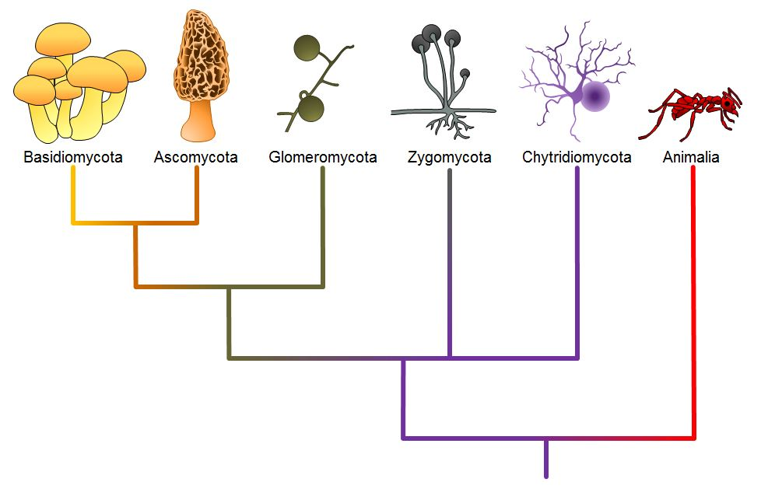
Classification of Fungi

Slide 2
Classification of Fungi by C. J. Alexopoulos (1962)
C. J. Alexopoulos (1962) also included slime molds under fungi and placed them as Division Mycota and it was divided into two subdivisions: Myxomycotina (wall-less form) and Eumycotina(true, walled fungi).The outline of his classification is:
Division: Mycota
Microscopic, unicellular or filamentous thallus with chitinous or cellulosic cell wall containing typical eukaryotic nucleus. Reproduction takes place both asexually and sexually.
A. Subdivision. Myxomycotina:Plant body is Plasmodium.
1. Class. Myxo-mycetes:
Vegetative phase is plasmodium. Reproductiontakes place by very small multinucleate spore

Slide 3
Myxomycota
Division: Myxomycota
Members of this division are commonly referred to as slime molds. Although presently classified as Protozoans, in the Kingdom Protista, slime molds were once thought to be fungi (=kingdom Mycetae) because they produce spores that are borne in sporangia, a characteristic common to some taxa of fungi. However, the assimilative stage in slime molds is morphologically similar to that of an amoeba. This assimilative stage has been designated a myxamoeba. The myxamoeba, as is the case of the amoeba, is a uninucleate, haploid cell which is not enclosed in a rigid cell wall, and ingests its food by means of phagocytosis. During this mode of ingestion, the food particles, usually bacteria, beceome surrounded by the pseudopodia of the myxamoeba. Once the food has been engulfed in this matter, it is surrounded by a membrane or food vacuole where hydrolytic enzymes are secreted that will digest the food. In fungi, the assimilative stages are mycelium and yeast, both of which are surrounded by a rigid cell wall and obtain their food by means of absorption. These are some of the reasons why mycologists no longer recognize slime molds as being fungi. However, organisms in this group continue to be studied in mycology as a matter of tradition and not because they are thought to be related to fungi. Within the Myxomycota, the class Myxomycetes, often referred to as the acellular slime molds, will be the only class that we will consider.

Slide 4
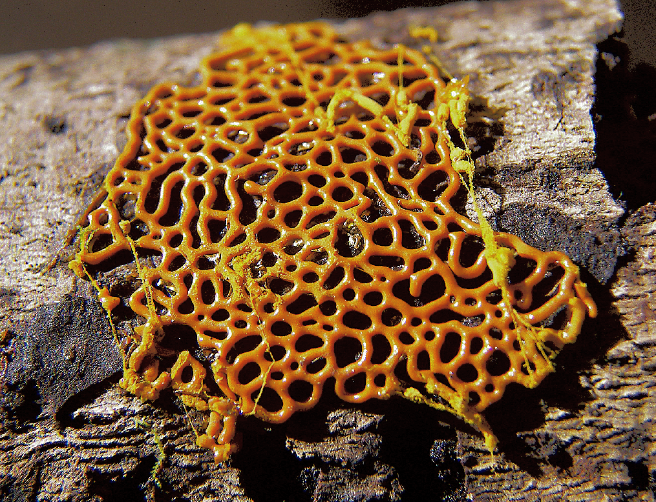
Myxomycotina: Slime mould
Hemitrichia serpula

Slide 5
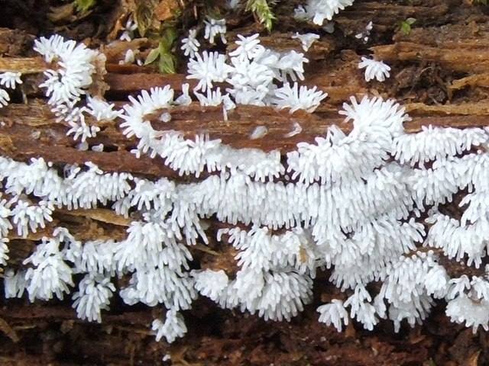
Ceratiomyxa fruticulosa

Slide 6
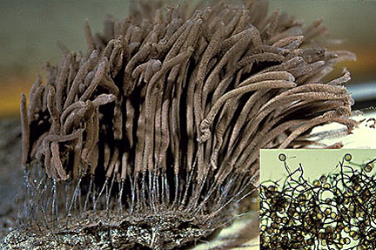
Stemonitis spp.

Slide 7
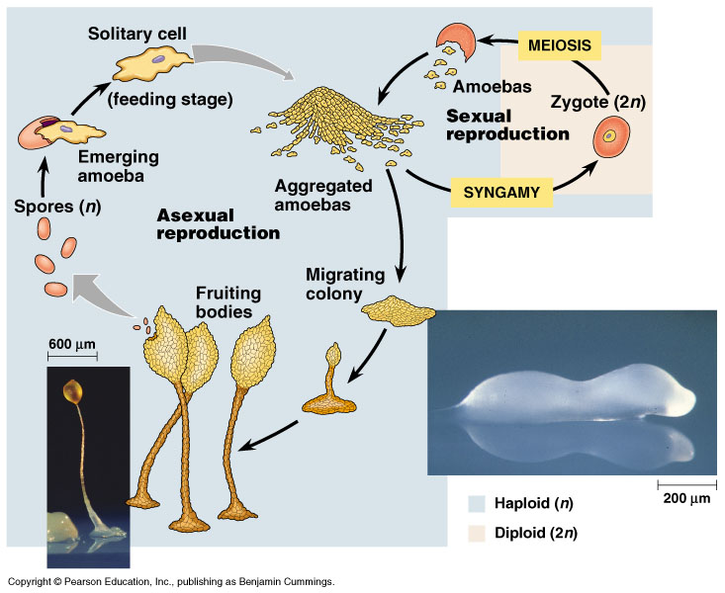
Slime mold: a simple organism (Protista) that consists of an acellular mass of creeping jelly-like protoplasm containing nuclei, or a mass of amoeboid cells. When it reaches a certain size it forms a large number of spore cases.

Slide 9
B. Subdivision. Eumycotina:Vegetative phase is either unicellular or branchedmycelium with distinct cell wall. Hyphae are coenocytic (aseptate and multinucleate) or septate. Eachcell may be uni-, bi- or multinucleate. Reproductionby asexual (spore) or sexual (gamete) means.The sub-divisions has been .divided into eightnatural classes and one form-class.
These are:
1.Class. Chytridiomycetes: Motile cells with single whiplash flagellum placed posteriorly.
2.Class. Hypochytridiomycetes: Motile cells with single tinsel flagellum placed anteriorly.
3. Class. Oomycetes: Vegetative phase con sists of multinucleate and well developed mycelium. Motile cells have two flagellai.e., biflagellate consists of one whiplash and the other tinsel type.
4. Class. Plasmodiophoromycetes: Multi nucleate thallus without cell wall, remain sparasitically inside the host cells. Motile cells are with two whiplash flagella of unequal inlength.
5. Class. Zygomycetes: Well-developed coenocytic (multinucleate andaseptate) mycelium grows either parasitically or saprophytically. Motile cells are absent.
6. Class. Trichomycetes: Multinucleate simple or branched thallus; mostly parasite on arthopods.
7. Class. Ascomycetes: Well-developed mycelium with septate hyphae.Ascospores are produced endogenously insideascus.
8. Class. Basidiomycetes: Well-developed mycelium with septate hyphae.Basidiospores are produced exogenously onbasidium.
Form-class. Deuteromycetes: Well-developed mycelium with septate hyphae.Sexual phase unknown.Reproduces mainly by asexual means.

Slide 10
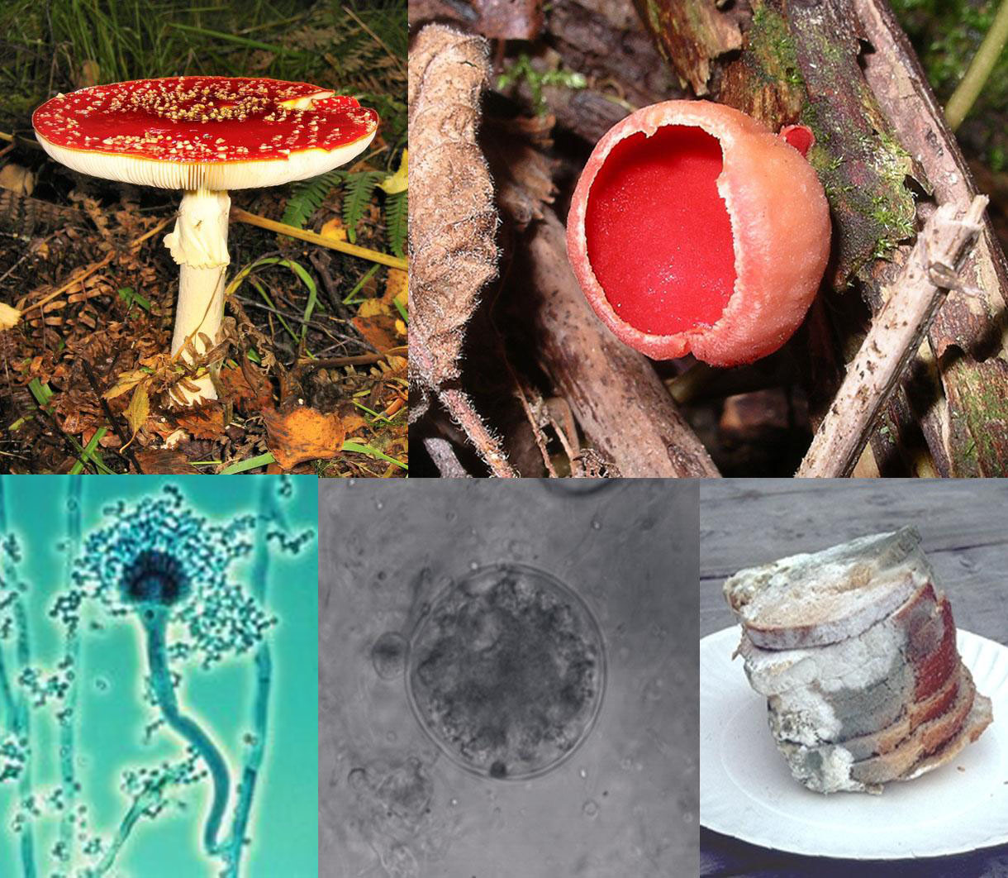

Slide 11
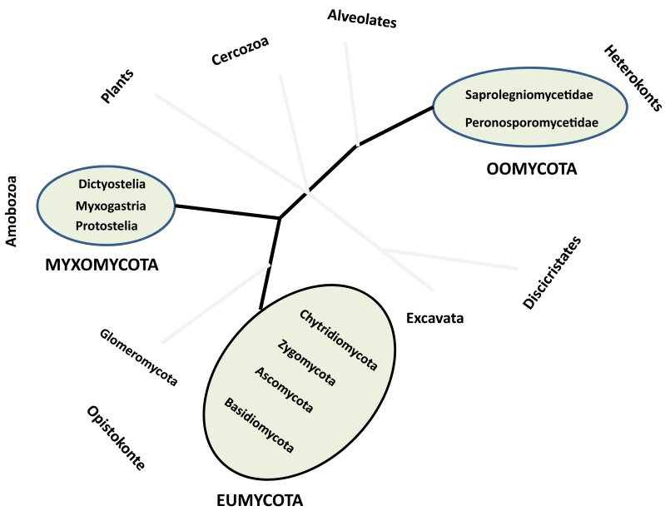
Root less cladogram

Slide 12
Classification of Fungi:A schematic outline of Ainsworth’s (1973)
Kingdom: Mycota
Important features:
i. Free-living, parasitic or mutualistic symbionts,devoid of chlorophyll.
ii. Cell wall composition is very variable, majoritycontain chitin and glucan.
iii. Reserve food materials are oil, mannitol andglycogen.
iv. Except some unicellular members, majority arefilamentous.
A. Division. Myxomycota:
Wall-less organisms possess either a Plasmodium (amass of naked multinucleate protoplasm havingamoeboid movement) or a pseudoplasmodium (anaggregation of separate amoeboid cells). Both are ofslimy consistency, hence slime molds.
1. Class. Acrasiomycetes (cellular slime molds)
2. Class. Hydromyxomycetes (net slime molds)
3. Class. Myxomycetes (true slime molds)
4. Class. Plasmodiophoromycetes (endo- parasitic slime molds).

Slide 13
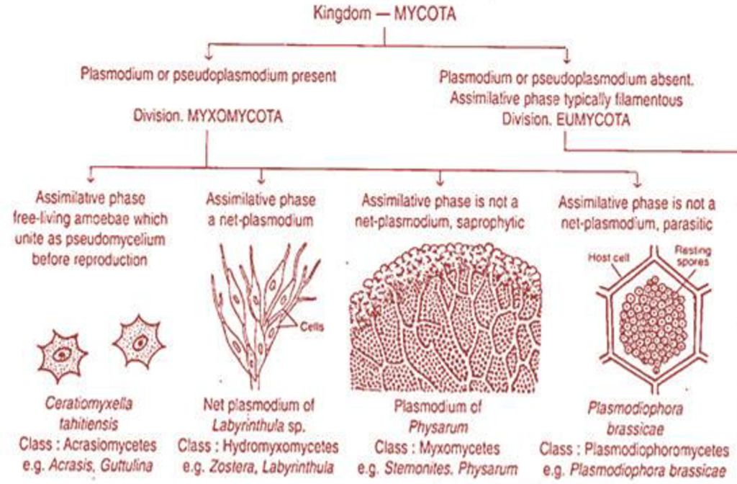

Slide 14
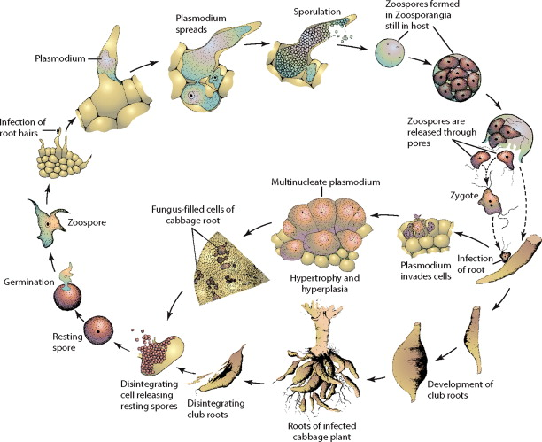
Plasmodiophorida life cycle

Slide 15
B. Division Eumycota (True fungi, all withwalls):
a. Subdivision Mastigomycotina (motile cells –zoospores present, perfect state spore-oospore).
b. Subdivision. Zygomycotina (mycelium aseptate,perfect state spore-zygospore).
c. Subdivision. Ascomycotina (yeasts or septatemycelium, perfect state spore- ascospores formed inascus, usually within ascocarp).
d. Subdivision. Basidiomycotina (yeast or septatemycelium, perfect state spore – basidiospore
formed on a basidium).
(e) Subdivision. Deuteromycotina or Fungiimperfecti.Yeast or septate mycelium. Perfect stateunknown.
1. Class. Blastomycetes. Budding (Yeast or Yeast like) cells with or without pseudomycelium.Truemycelium lacking or not well-developed.
2. Class. Hyphomycetes. Mycelia sterile or bearing asexual spore directly or on conidiophore, in various aggregation.
3. Class. Coelomycetes. Mycelial; asexual spore formed in pycnidium or acervulus.

Slide 16
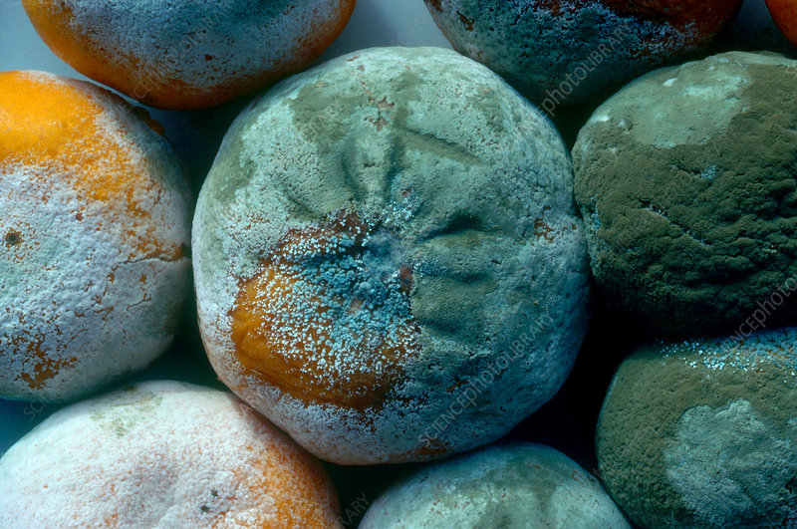

Slide 17
The kingdom Fungi contains five major phyla that were established according to their mode of sexual reproduction or using molecular data. Polyphyletic, unrelated fungi that reproduce without a sexual cycle, were once placed for convenience in a sixth group, the Deuteromycota, called a “form phylum,” because superficially they appeared to be similar. However, most mycologists have discontinued this practice. Rapid advances in molecular biology and the sequencing of 18S rRNA (ribosomal RNA) continue to show new and different relationships among the various categories of fungi.
The five true phyla of fungi are the Chytridiomycota (Chytrids), the Zygomycota (conjugated fungi), the Ascomycota (sac fungi), the Basidiomycota (club fungi)
and the recently (2001) described Phylum Glomeromycota

Slide 18
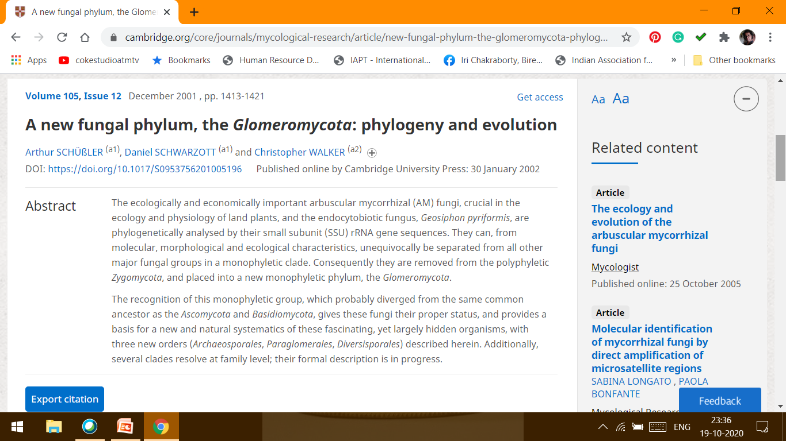

Slide 19
A new fungal phylum, the Glomeromycota: phylogeny and evolution
Arthur SCHÜßLER , Daniel SCHWARZOTT and Christopher WALKER
Mycological Research: Volume 105, Issue 12 ; December 2001 , pp. 1413-1421
The ecologically and economically important arbuscular mycorrhizal (AM) fungi, crucial in the ecology and physiology of land plants, and the endocytobiotic fungus, Geosiphon pyriformis, are phylogenetically analysed by their small subunit (SSU) rRNA gene sequences. They can, from molecular, morphological and ecological characteristics, unequivocally be separated from all other major fungal groups in a monophyletic clade. Consequently they are removed from the polyphyletic Zygomycota, and placed into a new monophyletic phylum, the Glomeromycota.
The recognition of this monophyletic group, which probably diverged from the same common ancestor as the Ascomycota and Basidiomycota, gives these fungi their proper status, and provides a basis for a new and natural systematics of these fascinating, yet largely hidden organisms, with three new orders (Archaeosporales, Paraglomerales, Diversisporales) described herein. Additionally, several clades resolve at family level; their formal description is in progress.

Slide 20
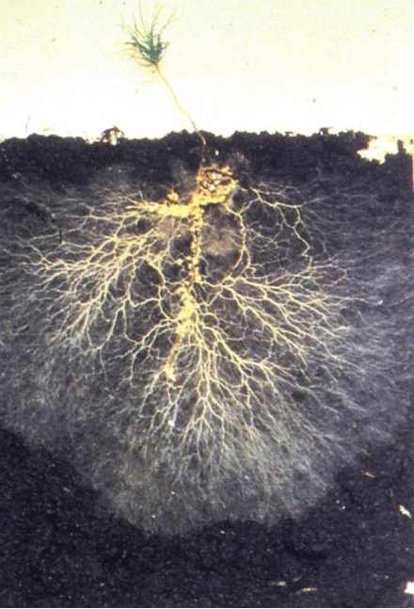
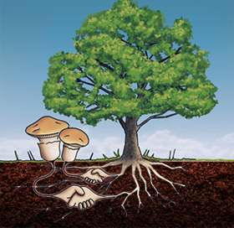
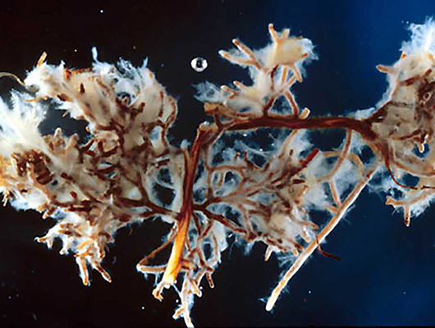

Slide 21
Classification of Fungi by Hawksworth et al. (1983 and 1995)
Ten years after the classification of Ainsworth(1973), Hawksworth et al. (1983) revised Ainsworth’s classification in the 7th edition of the“Dictionary of the Fungi”.
The changes made by them are:
1. The Division Myxomycota divided into eight classes instead of four classes.
2. The Sub-division Ascomycotina is directly divided into thirty seven (37) orders and arranged alphabetically; there are no classes in between.
3. The subdivision Basidiomycotina is divided into four classes instead of three, where class Teliomycetes is replaced by Urediniomycetes and Ustilaginomycetes.
4. In the sub-division Deuteromycotina, the class Blastomycetes was not considered.

Slide 22
Later, Hawksworth et al. (1995) thoroughly revised the classification in the 8th edition of the “Dictionary of the Fungi”. The classification was based on the sequence of 18s rRNA among the different members. Though members of fungi, show similarity in their morphology, mode of nutrition and ecology, but the higher dissimilarity is observed in the base sequences of their 18s rRNA (or more precisely in the DNA coding for it), which is now considered as the most important parameter to determine the genetic relationship. Thus, it shows that the fungi are polyphyletic aggregation of unrelated members. Based on the above fact and Phylogenetic consideration, the entire fungal communities are now segregated out and placed them under three different Kingdoms Fungi (Eumycota), Straminopila(Chromista) and Protozoa. Based on comparison of several factors such as, 18srRNA, cytoskeleton protein, chemical features like chitin, mitochondrial codon UGA coding for tryptophan instead of termination, storage of glycogen, elongation factors and morphological structure of motile cells like male gamete in animal and zoospores in fungi, there is close similarity of fungi with animals than to other two groups like Straminopila and Protozoa.

Slide 23
Further the species are divided into varieties, biological strains, physiological races, etc. The different taxa considered in this system along with their ‘ending’ are:
Phylum — mycota
Sub-phylum — mycotina
Class — mycetes
Sub-class — mycetidae
Order — ales
Family — aceae
The International Code of Botanical Nomenclature (ICBN) is the set of rules and recommendations dealing with the formal botanical names that are given to plants. Its intention is that each taxonomic group ("taxon", plural "taxa") of plants has only one correct name that is accepted worldwide. The name was changed at the International Botanical Congress in Melbourne in July 2012 as part of the Melbourne Code which replaces the Vienna Code of 2006, and now presented as “International Code of Nomenclature for algae, fungi, and plants (ICN)

Slide 24
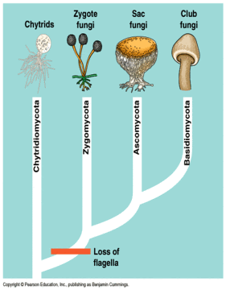
MAJOR FUNGAL GROUPS AND THEIR COMMON CHARACTERS

Slide 25
Phylum. Chytridiomycota
1. Vegetative body is coenocytic and thalloid, eitherglobose or ovoid structure, either an elongated simple hypha, or well, developed mycelium.
2. Cell wall is mainly made up of chitin and glucan.
3. Nuclear division is intra-nuclear and centric type.
4. Members of this group produce motile cells at some stage of their life cycle.
5. Motile cells (zoospores and gametes) possess single posteriorly placed, whiplash type of flagellum except a few poly-flagellate cells.
6. Sexual reproduction takes place by planogametes developed in gametangia. The fused gametes form zygote. Zygote on germination develops either into a resting spore or resting sporangium except’ a few those develop diploid thallus.
Common genera: Synchytrium, Monoble- pharis, Rhizophidium etc.

Slide 26
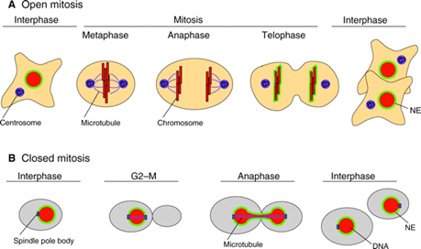
CLOSED MITOSIS
Fungi have nuclear mitosis. Mitosis in fungi is different from that in plants or most other eukaryotes in one key respect: the nuclear envelope does not break down and re-form. Instead, mitosis takes place within the nucleus. A spindle apparatus forms there, dragging chromosomes to opposite poles of the nucleus.

Slide 27
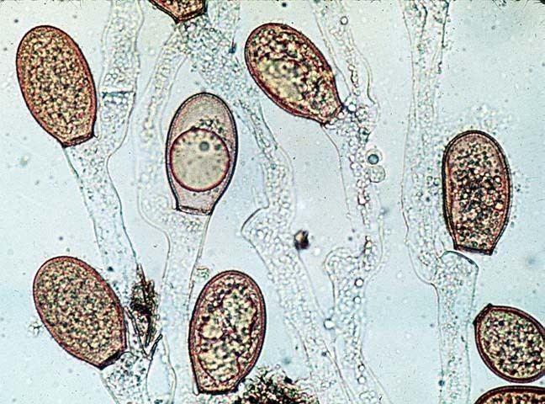

Slide 28
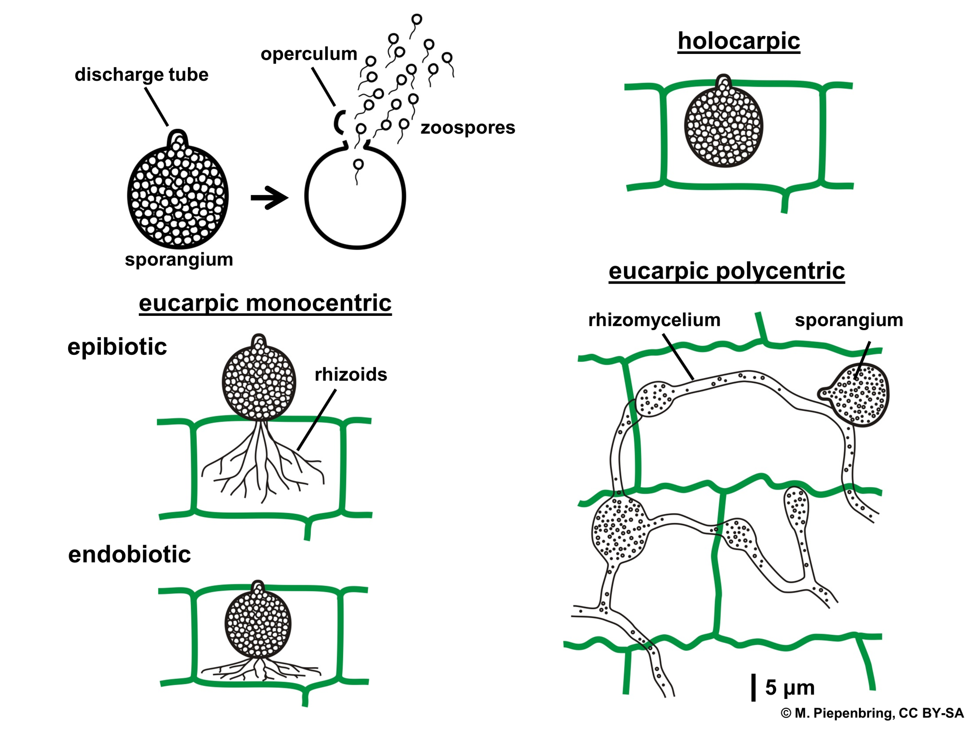

Slide 29
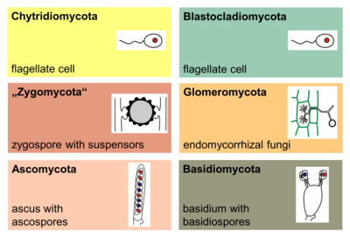

Slide 30
Phylum: Zygomycota
1. The thallus is normally haploid, consisting of coenocytic mycelium and its wall contains chitin and chitosan.
2. The mycelium contains cell organelles like other fungi, except typical Golgi bodies and centriole.
3. Asexual reproduction takes place by aplanospores.
4. Sexual reproduction takes place by gametangial copulation results in the formation of zygospore (2n)[only diploid spore].
Common genera: Mucor, Rhizopus, Phyco- myces, Cunninghamella etc.

Slide 31
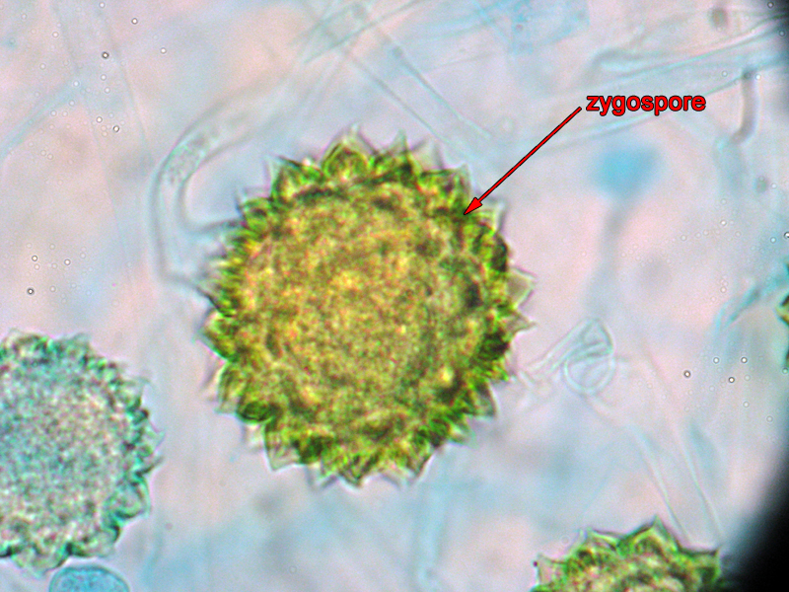

Slide 32
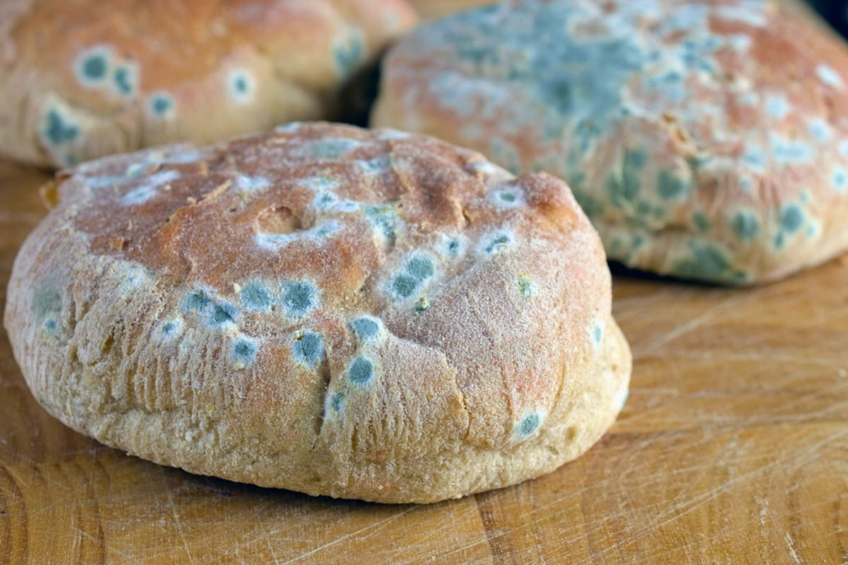

Slide 33
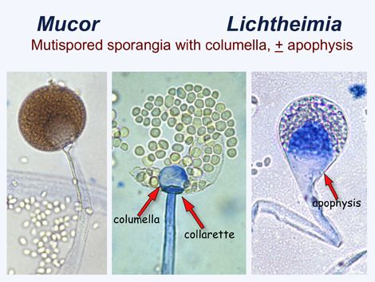

Slide 34
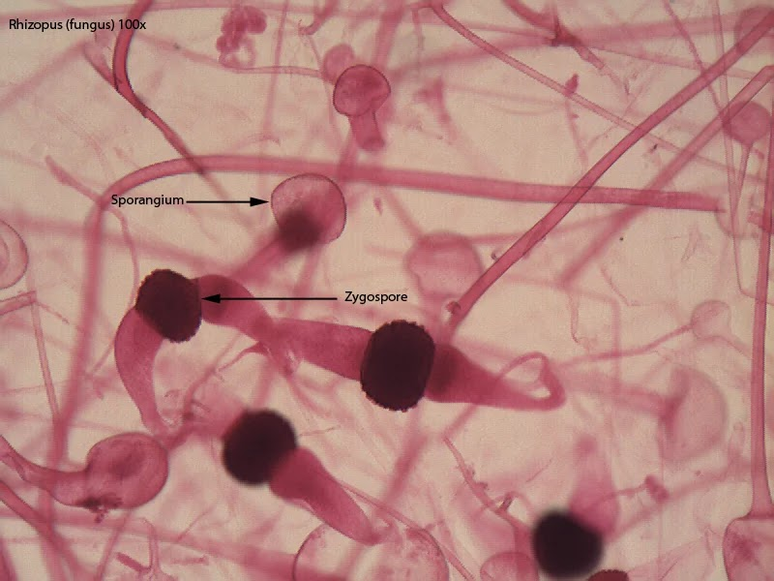

Slide 35
Phylum Ascomycota
1. Vegetative body is unicellular or commonly well developed, branched septate mycelium with uni or multinucleate cells having perforated septa.
2. Mostly, the cell wall is composed of chitin and glucans, but in unicellular form, it is composed of glucans and mannans.
3. Vegetative reproduction takes place by fragmentation (in filamentous form), fission and budding (in unicellular form).
4. Asexual reproduction takes place by non-motile spores, such as conidia, oidia and chlamydospores.
5. Sexual reproduction takes place by gametangial copulation (Saccharomyces), gametangial contact(Penicillium), somatogamy (Morchella) or spermatization (Polystigma).
6. Complete absence of motile structures.
7. The product of sexual reproduction is the ascospores grown inside a small specialised saclike structure, called ascus.

Slide 36
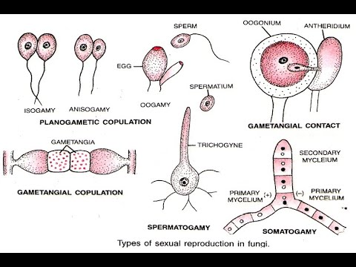

Slide 37
8. The fruit bodies (inside which ascus developed) are the ascocarps. The ascocarps may be cleistothecium (Penicilliumi), apothecium (Ascobolus), perithecium (Daldenia) or ascostroma (Elsinoeveneta).

Slide 38
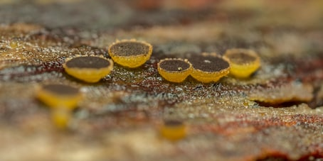

Slide 39
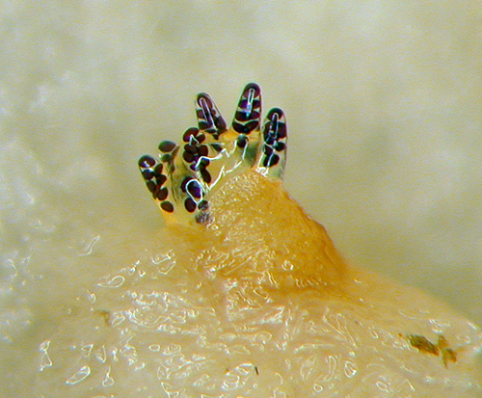

Slide 40
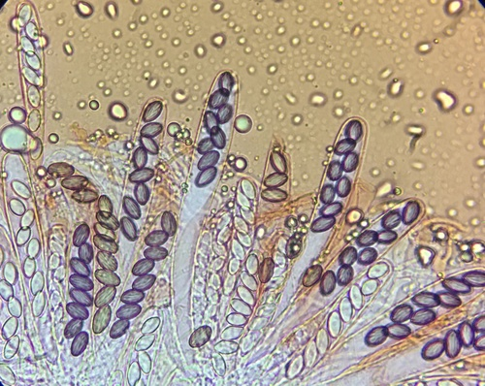

Slide 41
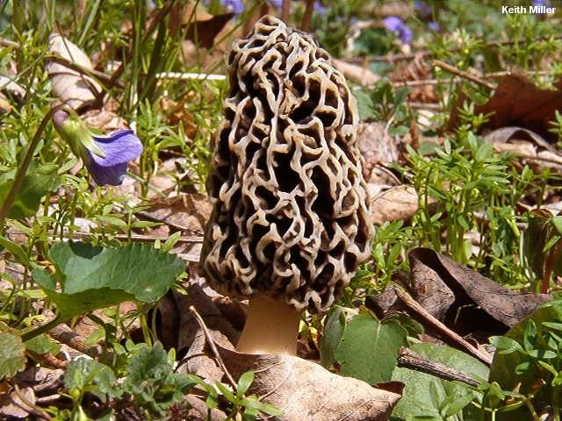
Morchella esculentoides.

Slide 42
Phylum: Basidiomycota
1. Presence of well-developed, branched and septatemycelium having simple (e.g., Ustlaginales and Uredinales) or dolipore (e.g., Auriculariaceae,aphyllo- phorales and Agaricales) septum.
2. The mycelial cells contain one nucleus, called monokaryotic i.e., primary mycelium or two nuclei, called dikaryotic i.e., secondary mycelium. The secondary mycelia may organise and form fruit body, called tertiary mycelium.
3. The cell wall is mainly composed of chitin and glucans.
4. Reproduction
(a) Vegetative reproduction takes place by budding and fragmentation.
(b) Asexual reproduction takes place by conidia, oidia or chlamydo spores. This is lacking in some higher taxa of this subdivision.
(c) Sex organs are absent. During sexual reproduction, the dikaryotic cell is formed by somatogamy, spermatisation or by buller phenomenon.
The dikaryotic phase persists for long period of time. Karyogamy occurs in basidium mother cell and forms diploid nucleus, which is ephemeral (short lived). 4-haploid basidio sporesare formed by meiosis. Basidiospores are developed exogenously on the horn-shaped structure, the sterigmata (generally 4) on the basidium.

Slide 43
The Buller Phenomenon is one example of such autonomous behaviour, in which a nucleus in a dikaryon can migrate and fertilize a mating-type compatible monokaryon, leading to opportunities for choosiness by the monokaryotic “female” mycelium.
Experimental set-up for artificial selection for fast migration of nucleus X. Nucleus X is serially passed through monokaryon Y, which is not coevolving. This experimental set-up uses the ‘Buller phenomenon’, since the newly formed dikaryon XY fertilizes monokaryon Y. At the end of the experiment, the nuclear migration rate of the evolved X can be compared with that of the ancestral X.
http://www.fgsc.net/FGR/FGR55/FGR55aanen.pdf

Slide 44
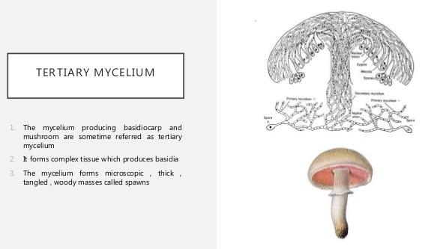
5. Basidia are of two types: Holobasidium (aseptate)e.g., Agaricus, Polyporusetc. And Phragmobasidium (septate) e.g., Puccinia, Ustilago
6. Except in lower forms (Puccinia, Ustilago),secondary mycelia by aggregation form fruit body, the basidiocarp [Agaricus, Polyporus etc.). The number of spores’ on each basidium is commonly 4,but 2 or more than 4 are also pre sent.
Common genera: Agaricus, Polyporus, Puccinia etc.

Slide 45
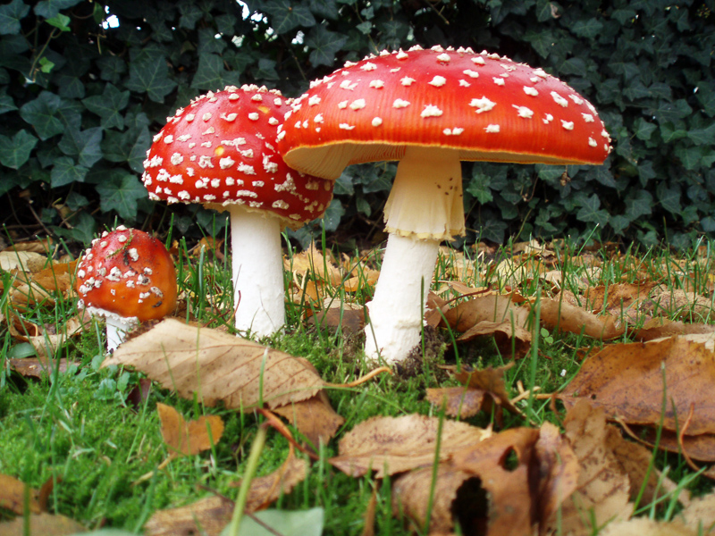
Amanita muscaria

Slide 46
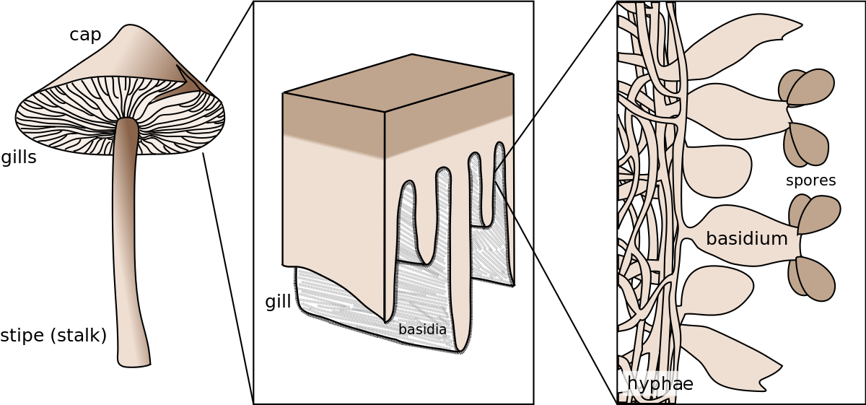

Slide 47
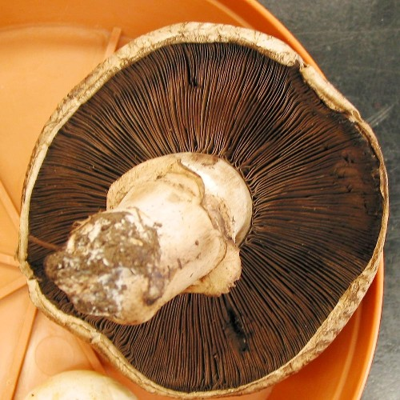

Slide 48
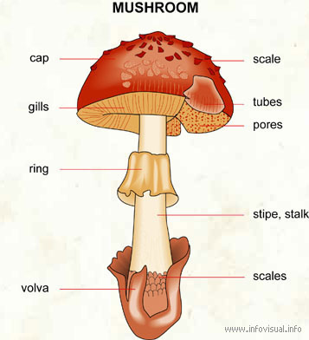

Slide 49
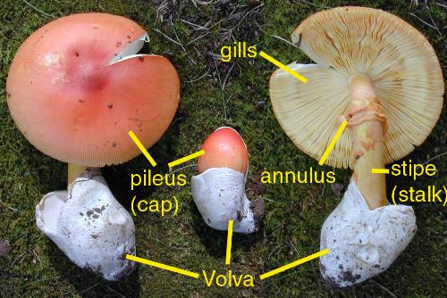

Slide 50
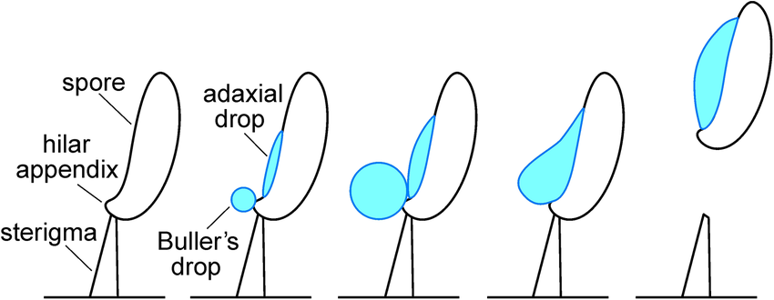
The mechanism of spore release has been the subject of much study. Buller's drop is formed when the spore releases a dense hydrophilic solution of mannitol and hexose sugars. This solution is so strongly hydrophilic that it literally draws water out of the air, causing the Buller's drop to grow.

Slide 51
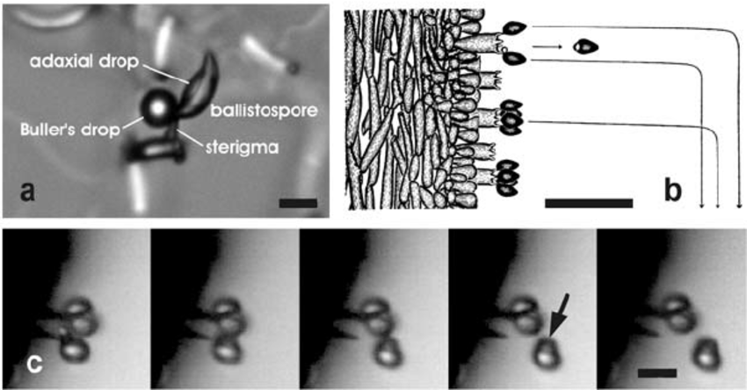
The process of ballistospore discharge. a , Ballistospore of Tilletia caries a few seconds before discharge. b , Predicted trajectories of spores discharged from a mushroom gill illustrated by A. H. R. Buller [1]. c , Successive images of ballistospore discharge in Armillaria tabescens from video recording obtained at 50,000 fps. Buller’s drop (arrowed) carried with discharged spore. Scale bars, a , c , 10 m m b , 50 m m.

Slide 52
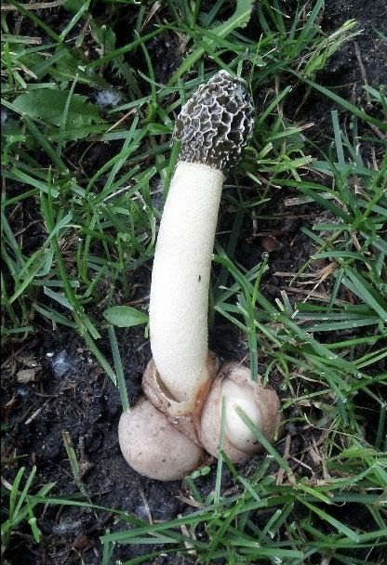
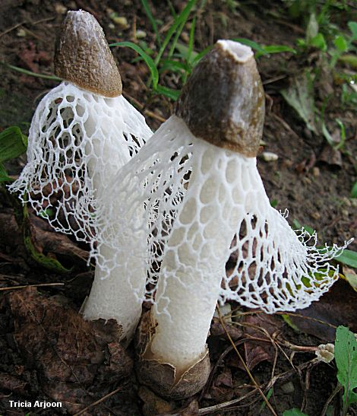
Phallus indusiatus

Slide 53
